Slide 1

Acids and Bases
Dr. Thamina Acter
27th June, 2019

Slide 2
Content
Concept of Acids and Bases
pH of Solutions
Buffer Solutions
Acid-Base Indicators

Slide 3
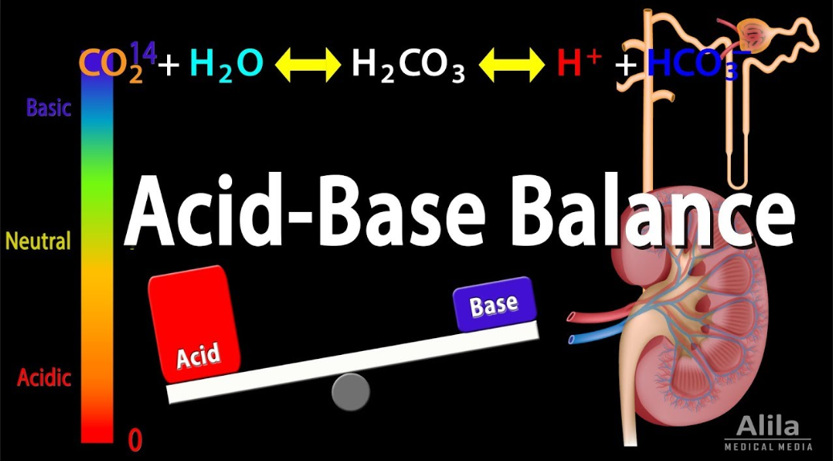
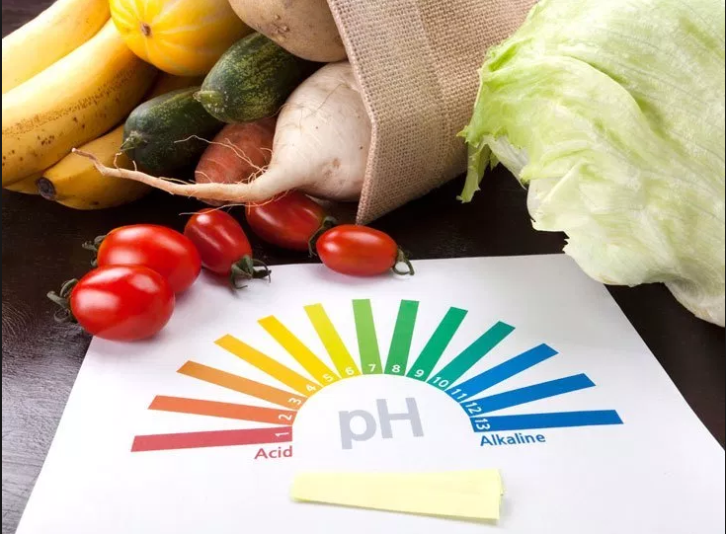
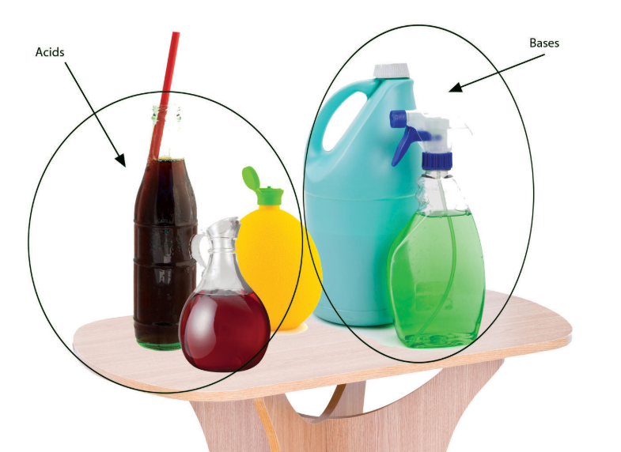
Introduction
What are Acids and Bases?
Source: Google image/Alila Medical Media
1

Slide 4
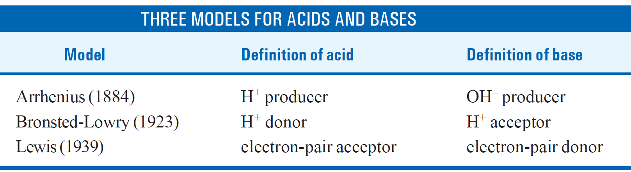
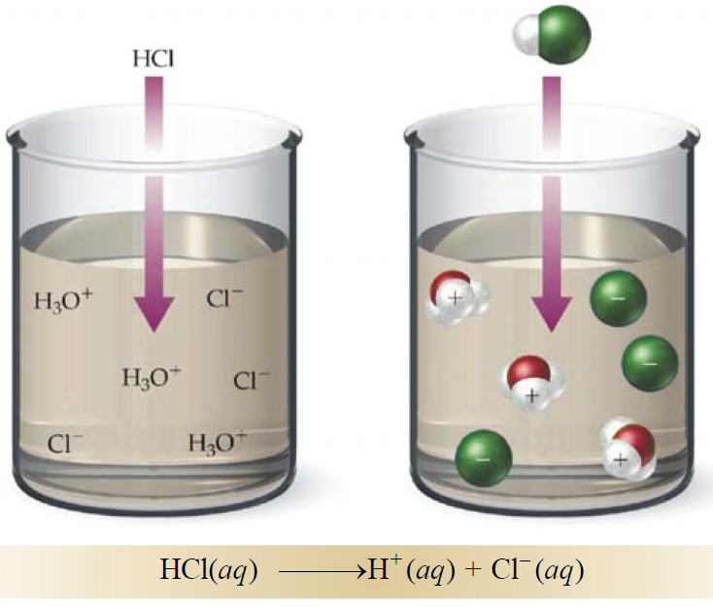
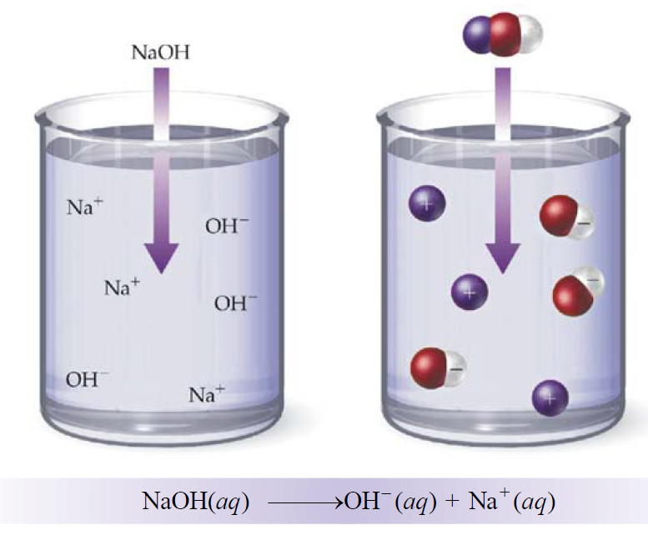
Concept of Acids and Bases
**
1. Arrhenius concept (Traditional)
Limitations:
No Free H⁺ and OH– ions
Limited to water only
All bases do not contain OH–
Arrhenius acid:
Arrhenius base:
Release H⁺
ions in water
Release OH–
ions in water
Reference: Essentials of Physical Chemistry, Bahl. A.; Bahl, B.S; Tuli, G.D.;
2

Slide 5
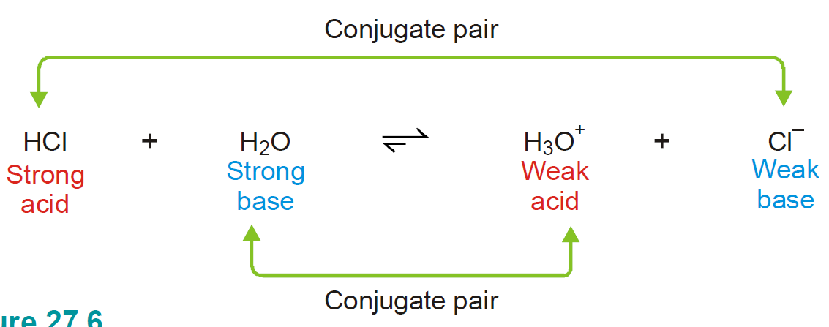
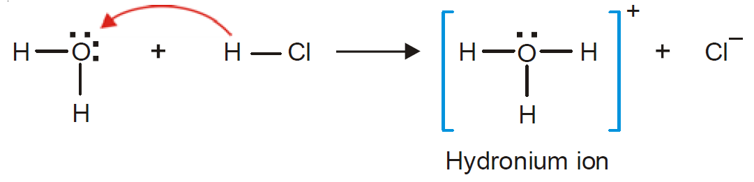
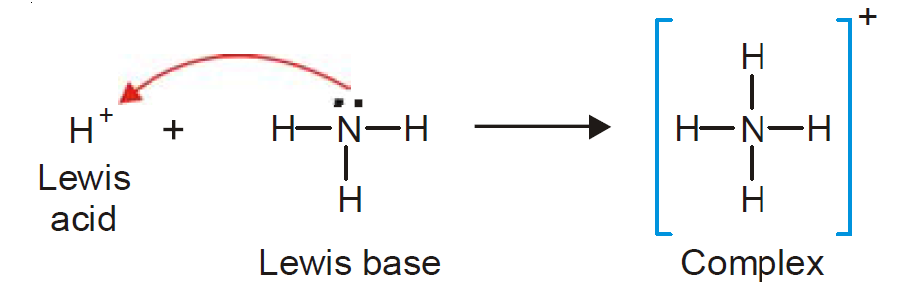
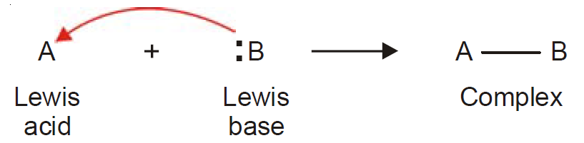
Concept of Acids and Bases
2. Bronsted-Lowry concept:
Conjugate Acid-Base pairs:
Acids → Proton (H+) donor
Bases → Proton (H+) acceptor
Acid
Base
Acid and Conjugate base → Conjugate Acid-Base pair
2. Lewis concept:
Example of Lewis reaction:
Acid → electron-pair acceptor
Base → electron-pair donor
Reference: Essentials of Physical Chemistry, Bahl. A.; Bahl, B.S; Tuli, G.D.;
3

Slide 6
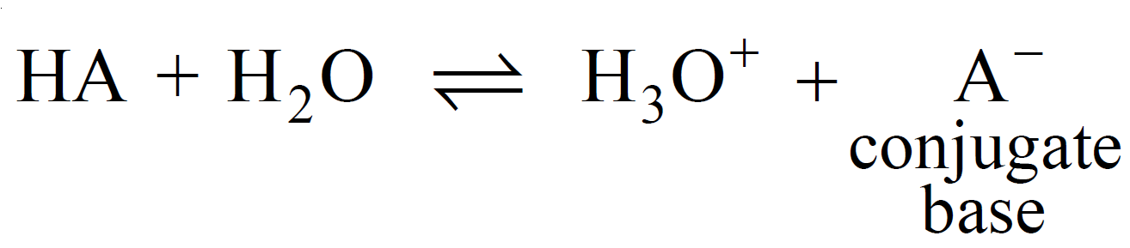
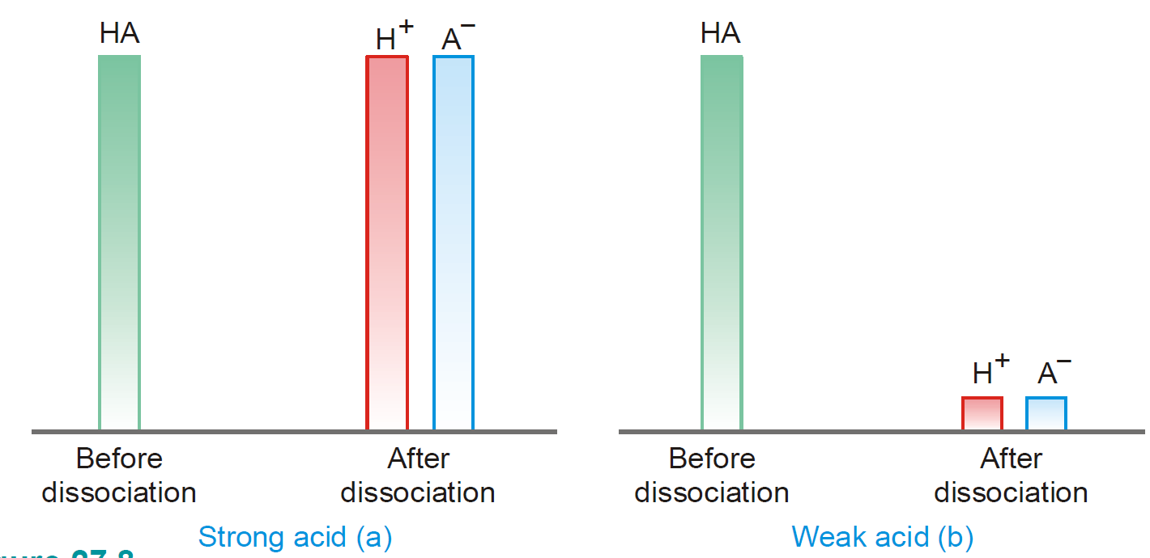
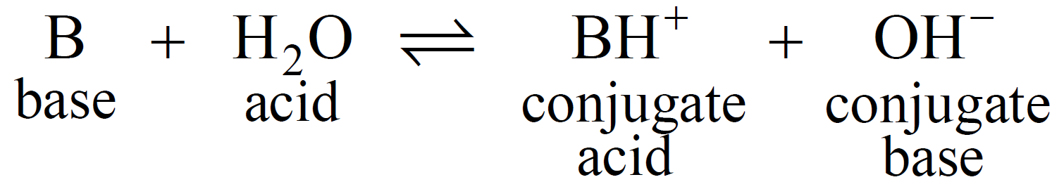
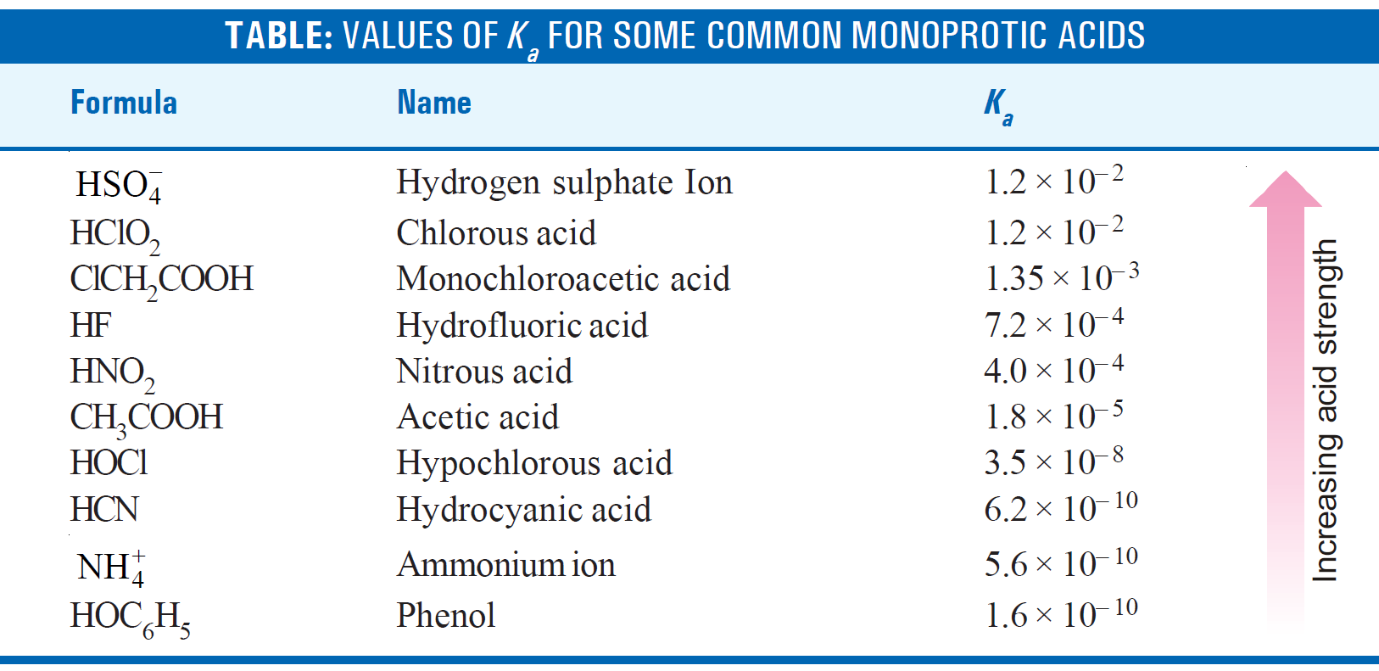
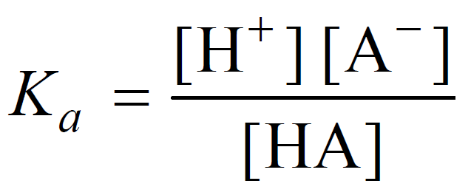
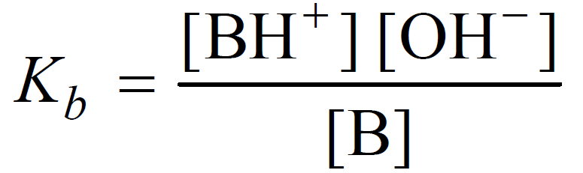
Strong and weak acids/bases
Figure: Graphical extent of concentrations of H⁺ and A⁻ in aqueous solution compared to original concentration of HA
Acid dissociation constant:
Concentration of H⁺ ions in its aqueous solution
Base dissociation constant:
Concentration of OH– ions in its aqueous solution
Reference: Essentials of Physical Chemistry, Bahl. A.; Bahl, B.S; Tuli, G.D.;
4

Slide 7
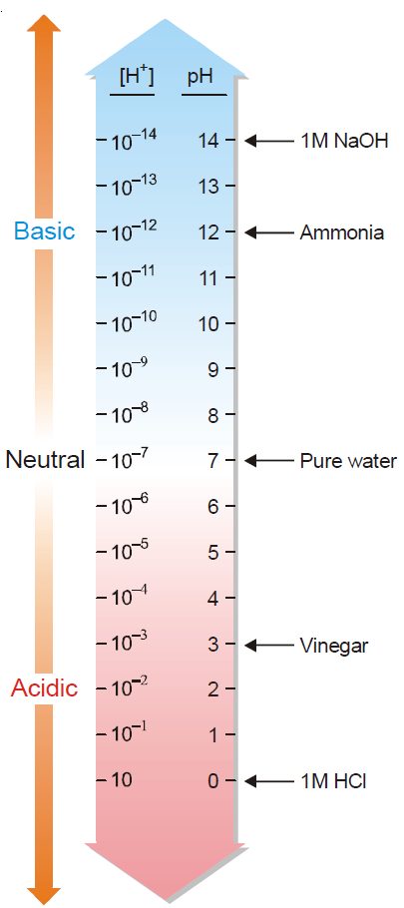
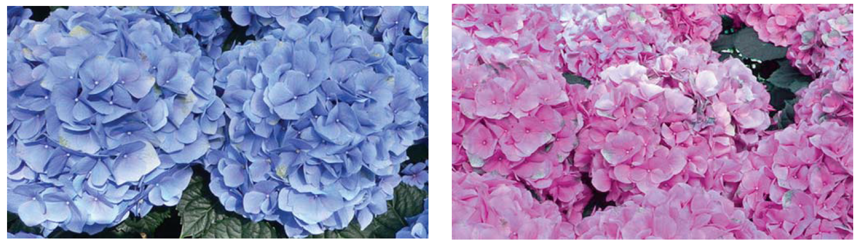
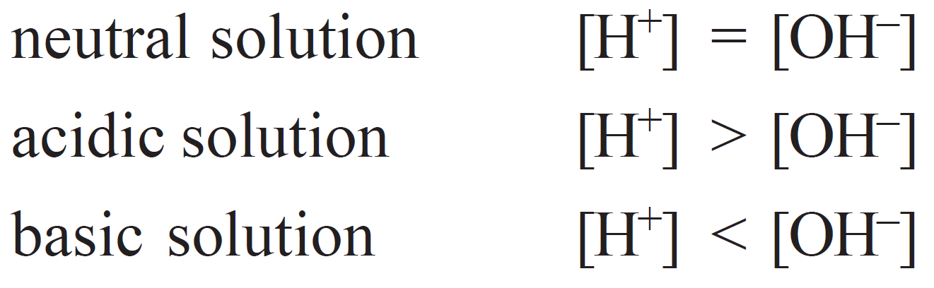
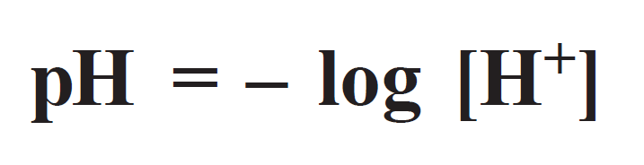
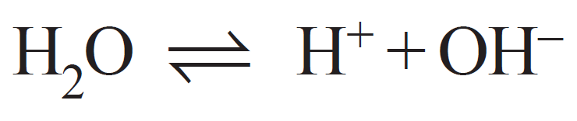
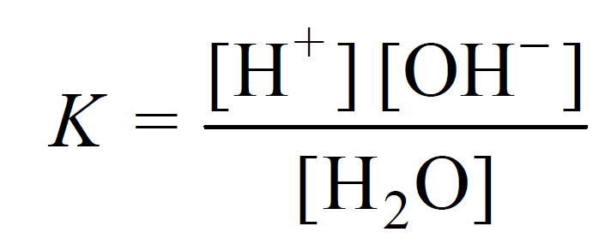
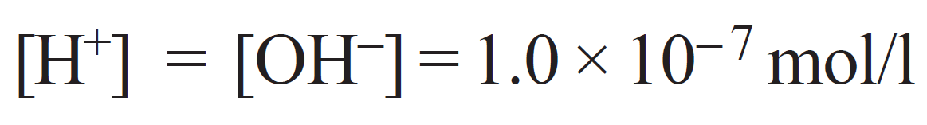
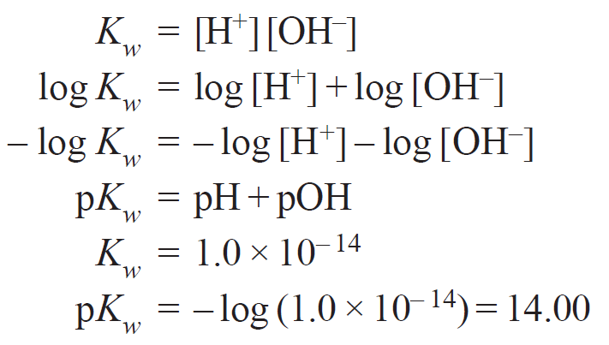
pH of Solutions
Acidic soil
Alkaline soil
Figure: The Hydrangea macrophylla blossoms in pink or blue, depending on soil pH
Hydrogen ion concentration of a solution:
= 1.0 × 10^{– 14}
Relation between pH and pOH:
Figure: pH scale
5

Slide 8
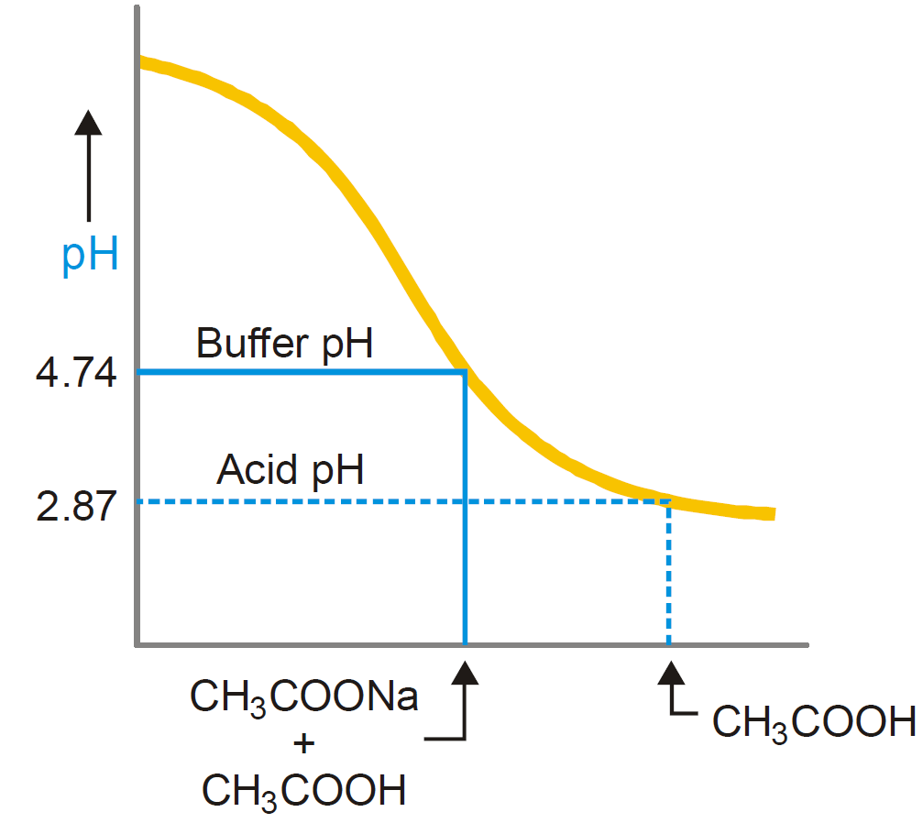
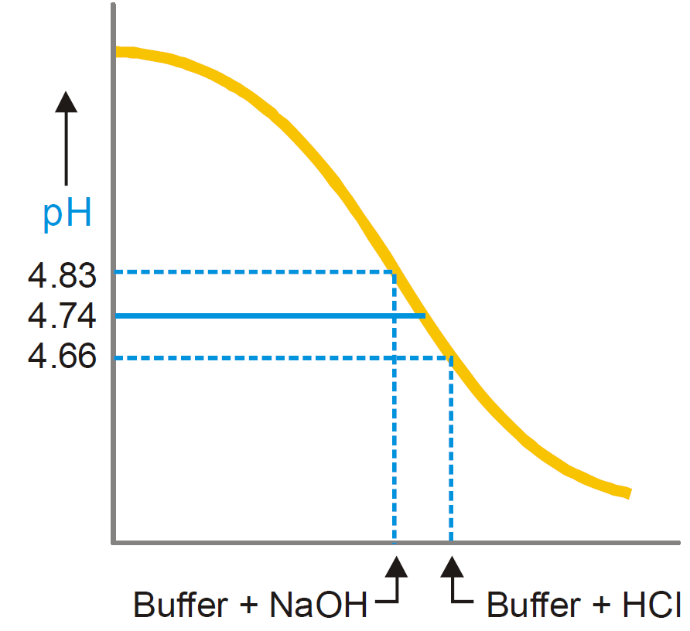
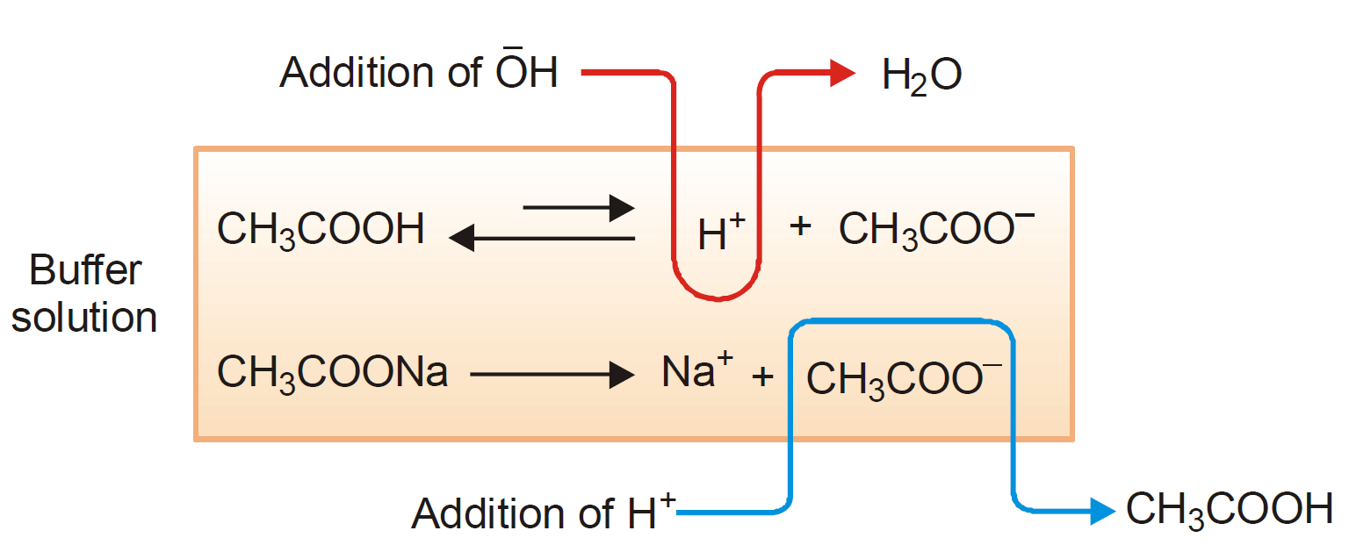
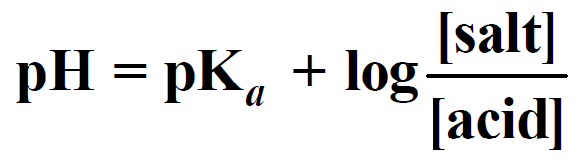
Buffer Solutions
Buffer solution (CH₃COOH/CH₃COONa) has a higher pH than the acid itself
pH of buffer changes only slightly upon addition of an acid (0.01 moles) or base (0.01 mole NaOH)
Acid Buffer:
CH₃COOH + CH₃COONa
Basic Buffer:
NH₄OH + NH₄Cl
0.1 M
0.1 M
0.1 M
Mechanism of Buffer action of an acid buffer
pH of Buffer Solutions
Henderson-Hasselbalch equation
Significance:
Calculation of pH of buffer solution
Determination of dissociation constant of a weak acid (or weak base)
Preparation of buffer solution of desired pH
Addition of HCl:
increased H⁺ ions associate with excess of acetate ions
increased concentration of CH₃COOH
equilibrium shifts slightly to the right to increase H⁺ ions
decrease of pH of the buffer solution
Reference: Essentials of Physical Chemistry, Bahl. A.; Bahl, B.S; Tuli, G.D.;
6

Slide 9
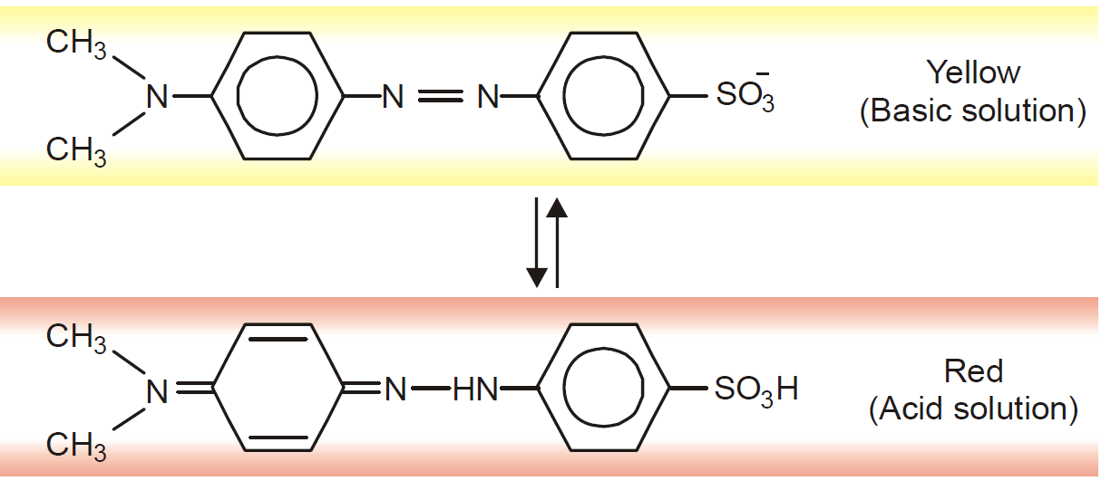
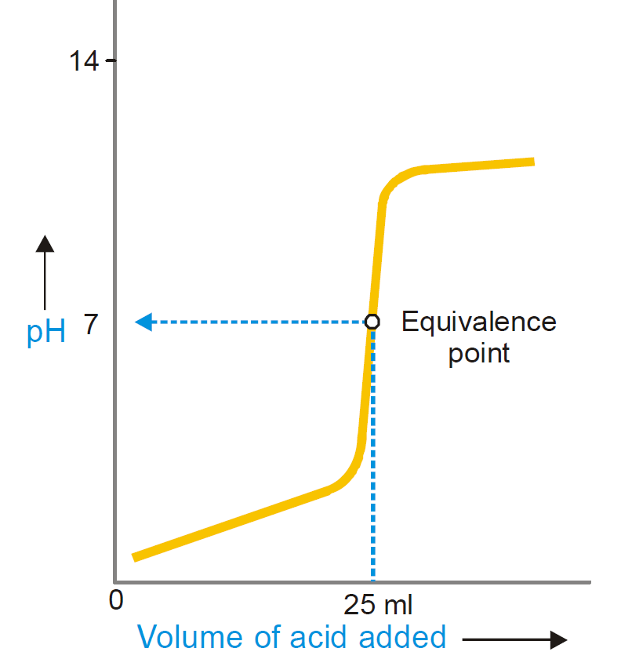
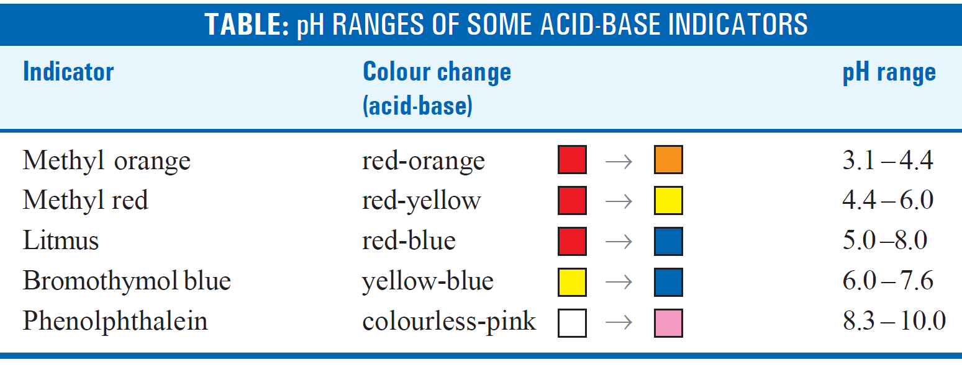
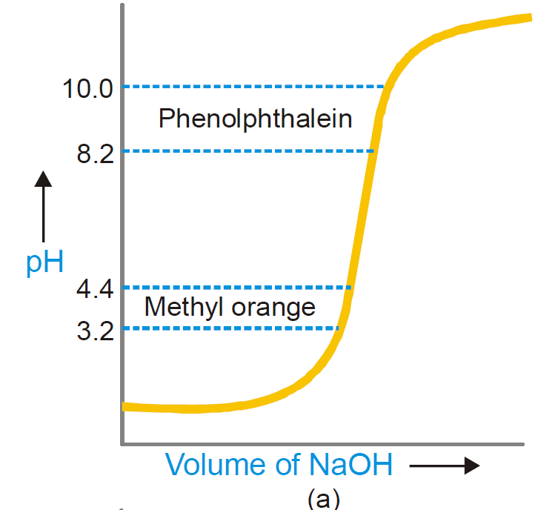
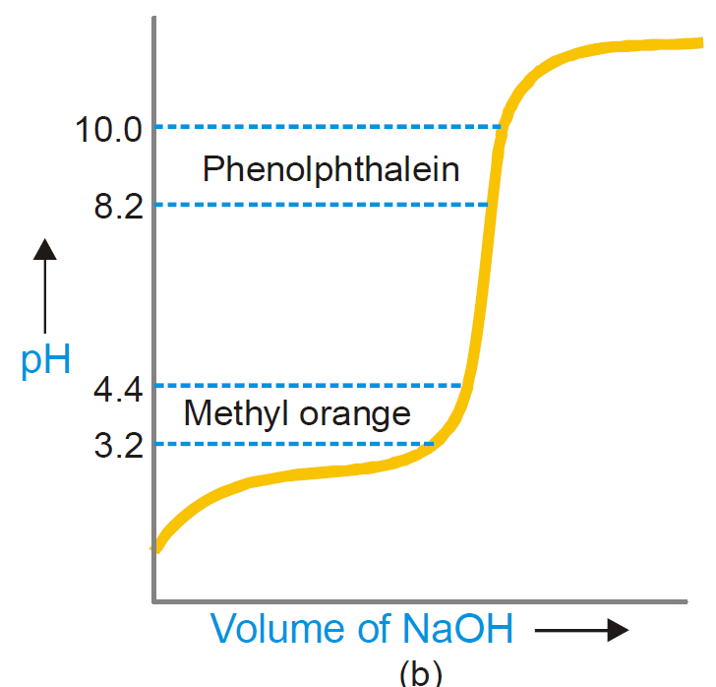
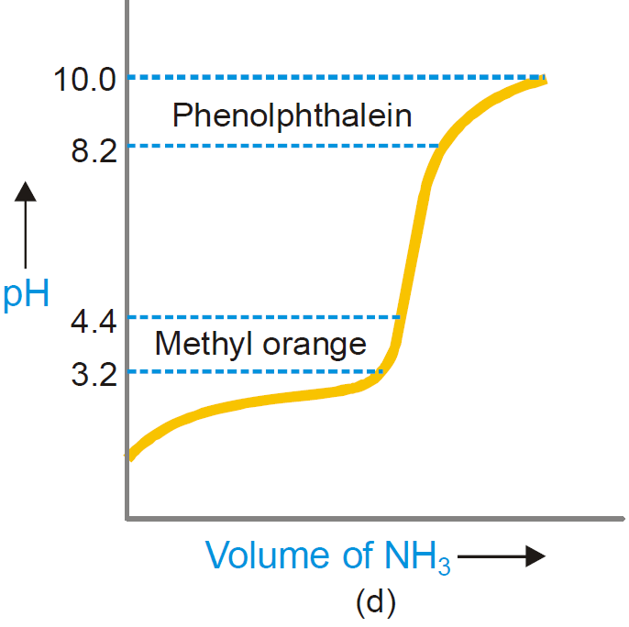
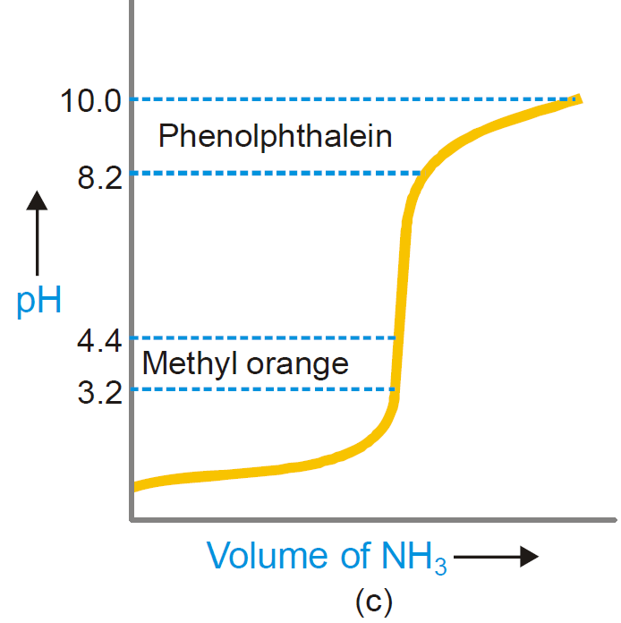
Acid-Base Indicators
An organic dye
signals the end-point
by a visual change in color
Methyl Orange
Figure: pH curve for titration of a strong
base with strong acid
Choice of a Suitable Indicator
*
*
*
*
Methyl red
*
Figure: pH curves for (a) a strong acid and strong base; (b) weak acid and strong base; (c) strong acid and weak base; (d) a weak acid and weak base
Reference: Essentials of Physical Chemistry, Bahl. A.; Bahl, B.S; Tuli, G.D.;
7

