Slide 1
Basics of chemical hazard and safety
Dr. Thamina Acter

Slide 2

Basics of Chemical Hazard and safety
Any chemical that can potentially cause harm is considered to be hazardous.
Chemicals can be hazardous if they:
Irritation on the eyes, skin, or respiratory
Are toxic or carcinogenic
Are corrosive
Can explode or cause fire
Create low-oxygen environments

Slide 3
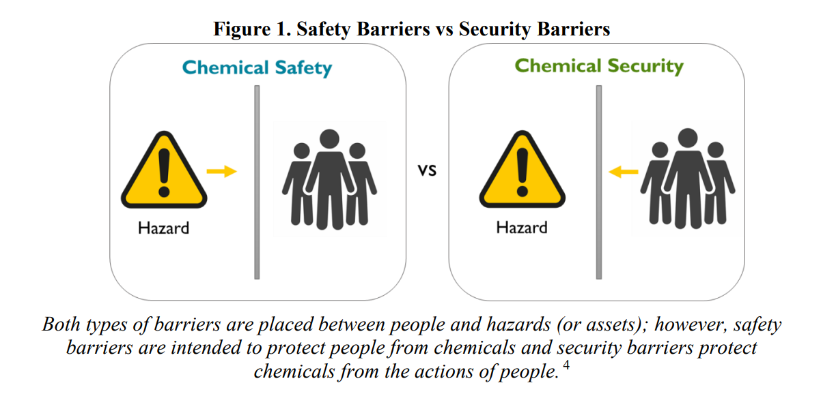
Introduction to chemical safety and security

Slide 4
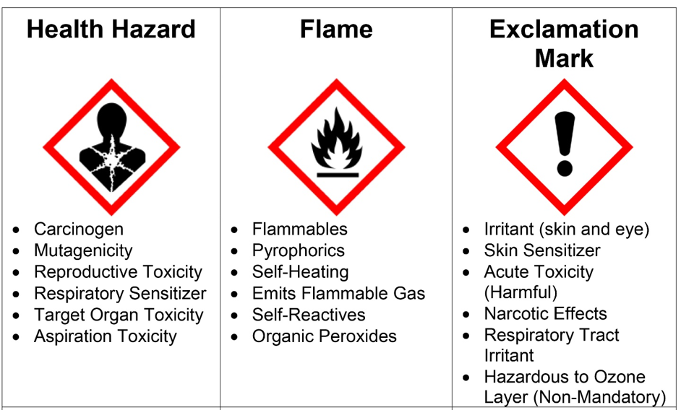
Hazard Communication

Slide 5
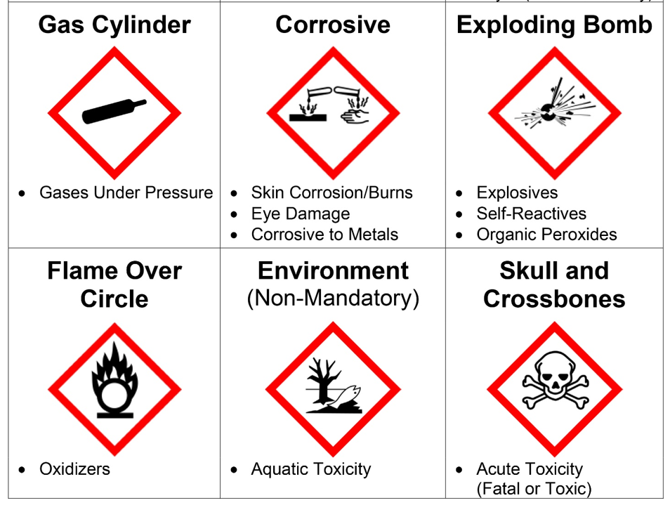

Slide 6
Health Risks of Chemical Exposure
Types of exposure:
The chemicals and pollutants we inhale can end up in our lungs and blood stream. Sometimes, we can smell or taste harmful chemicals, but it isn't always so easy.
These organs can be more sensitive to chemicals and may react more quickly than the rest of our bodies.
Many chemicals can be found in both our food and water sources. As we eat and drink, we might swallow chemicals that can harm us.
Air and inhalation
Skin and eye contact
Food, water, and ingestion

Slide 7
Potential health risks
the type of chemical
the amount you're exposed to
when and how long you are exposed
how you're exposed
your age and general state of health
Potential health effects
organ damage
weakening of the immune system
development of allergies or asthma
reproductive problems and birth defects
effects on the children
cancer

Slide 8





Reducing risks:
Read and follow all directions when using household chemical products.
During periods of high levels of outdoor air pollution, we should take measures to reduce the air entering our home from outside.
Keep all household chemical products out of sight and out of reach of children and animals.
Consult the Air Quality Health Index, and consider adjusting outdoor activities when air quality is poor

Slide 9


Chemical Safety Standards and Regulations:
General Chemical Safety Guidelines:
Maintain an organized and orderly facility.
Communicate hazards to everyone.
Follow basic safety procedures.
Prepare for accidents and emergencies.
Use engineering controls.
Use PPE as needed or required.
Follow requirements for high hazard chemicals.

Slide 10
The End

