Slide 1
Chemical Bonding
Dr. Thamina Acter

Slide 2
Chemical Bond
“A chemical bond is defined as a force that acts between two or more atoms to hold them together as a stable molecule”.
Types of chemical bonds:
Ionic or Electrovalent bond
Covalent bond
Coordinate covalent bond
Hydrogen bond
Metallic bond

Slide 3
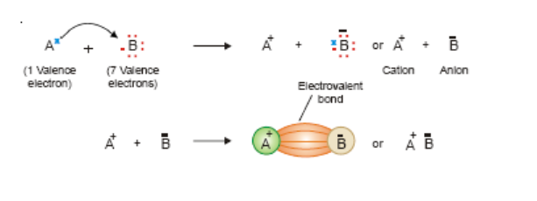
1.Ionic or Electrovalent bond
“The electrostatic attraction between the cation (+) and anion (-) produced by electron transfer constitutes an Ionic or Electrovalent bond”.

Slide 4
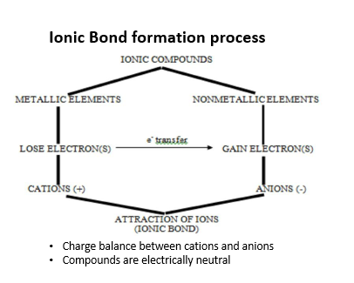

Slide 5
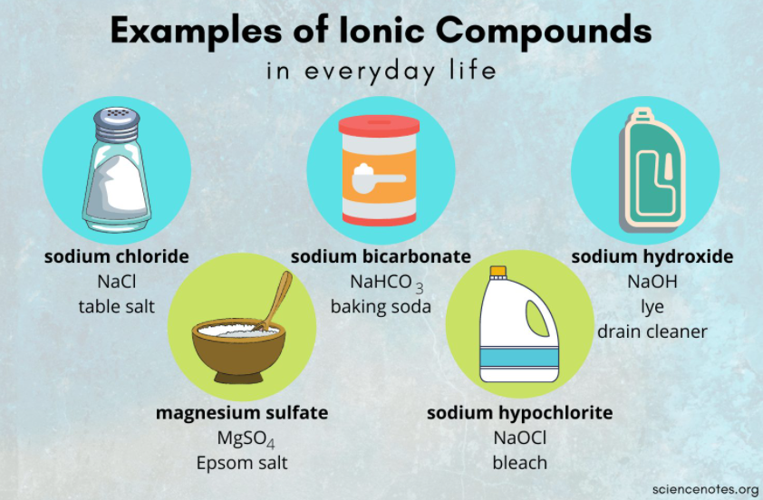

Slide 6
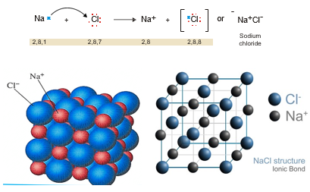
Some examples of Ionic compounds
1.Sodium Chloride, NaCl

Slide 7
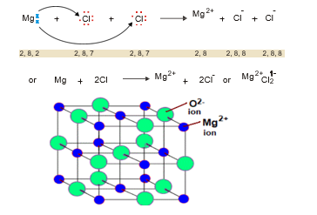
2. Magnesium Chloride, MgCl₂

Slide 8
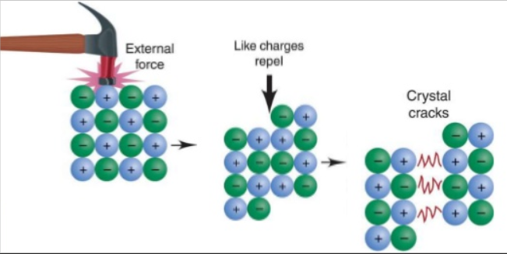
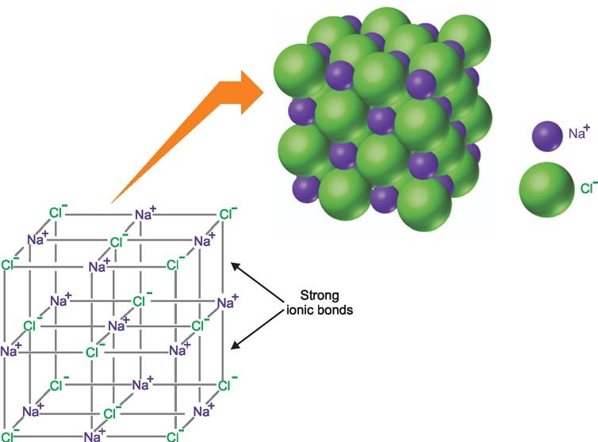
Ionic Compounds Exist as Crystals
Fig. Ionic crystal of Sodium Chloride

Slide 9
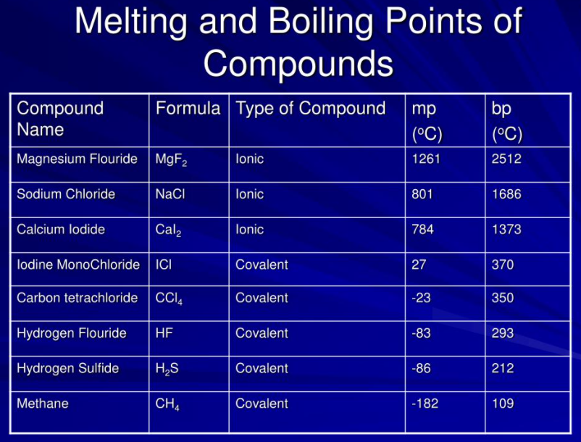
Characteristics of Ionic compounds:
Solids at Room Temperature.
High Melting Points.

Slide 10
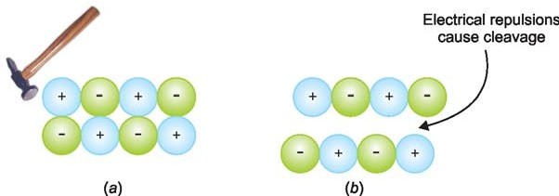
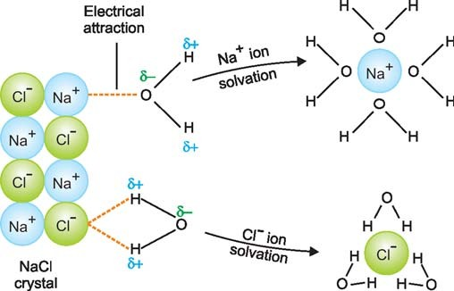
Hard and brittle.
Fig. (a) Two layers of (+) and (–) ions in a crystal. (b) When force is applied to one layer it slips over the other so that similar ions come above one another and electrical repulsions between them cause cleavage of the crystal.
(4) Soluble in water.
Fig. Solvation of NaCl in water

Slide 11
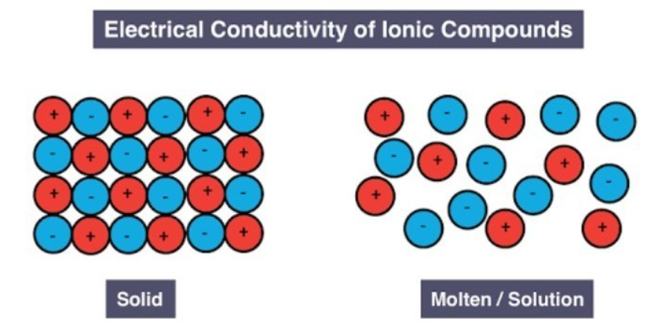
Conductors of electricity.
Do not exhibit isomerism.
Ionic reactions are fast.

Slide 12
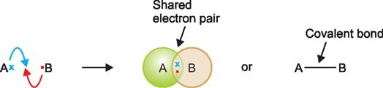
2.Covalent Bond
The shared pair is indicated by a dash (-) between the two bonded atoms. A shared pair of electrons constitutes a Covalent bond or Electron-pair bond.

Slide 13
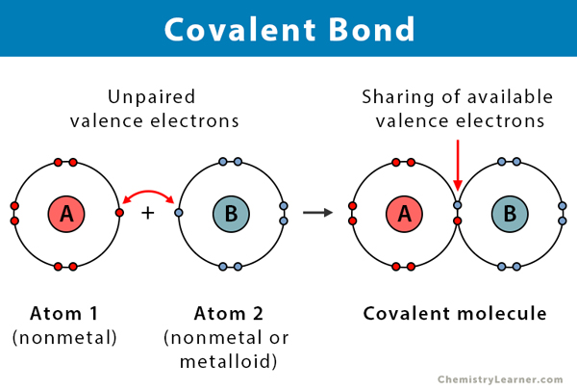


Slide 14
Types of Covalently bonded substances:
simple molecules
giant covalent structures

Slide 15
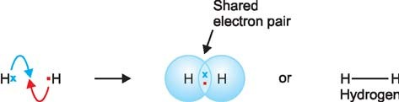
Some examples of Covalent compounds
Simple molecules
1. Hydrogen, H₂

Slide 16
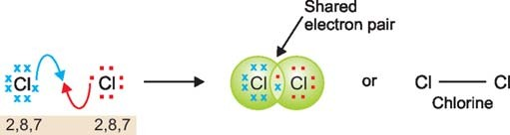
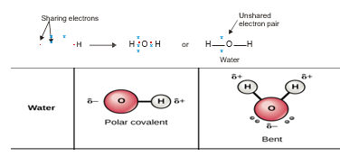
2. Chlorine, C1₂
3. Water, H₂O

Slide 17

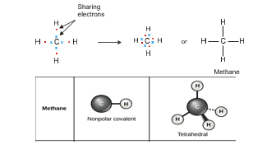
4. Ammonia, NH₃
5. Methane, CH₄

Slide 18


Examples of multiple covalent compounds
1. Carbon Dioxide, CO₂
2. Nitrogen, N₂

Slide 19
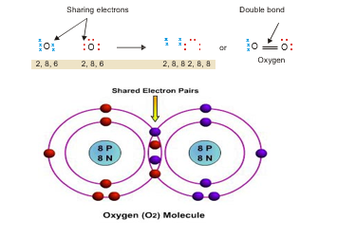
3. Oxygen, O₂

Slide 20
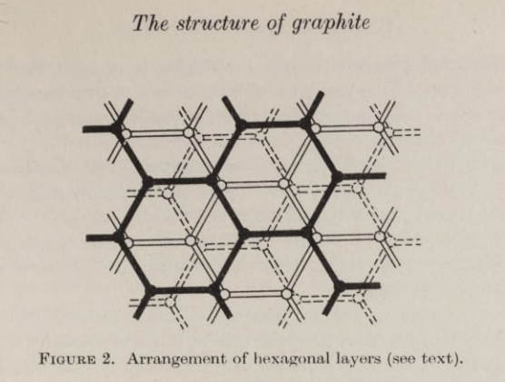
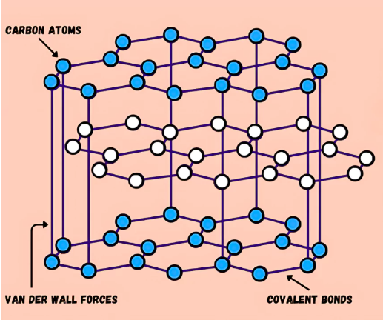
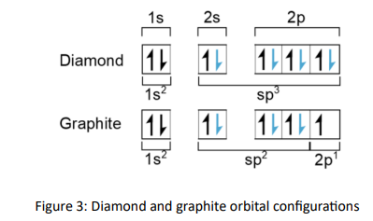
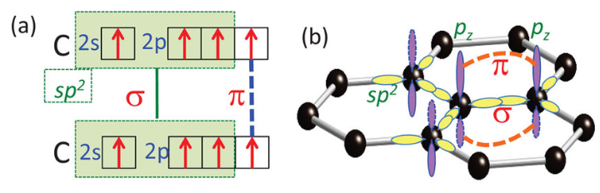
Giant covalent structures
(a) The electronic configuration and (b) molecular orbital model of graphene, where the r bonds are formed with half-filled sp2 hybrid orbitals per carbon in the honeycomb structure, and each p bond is shared by the three nearest neighbor C-C pairs in both space and time.

Slide 21
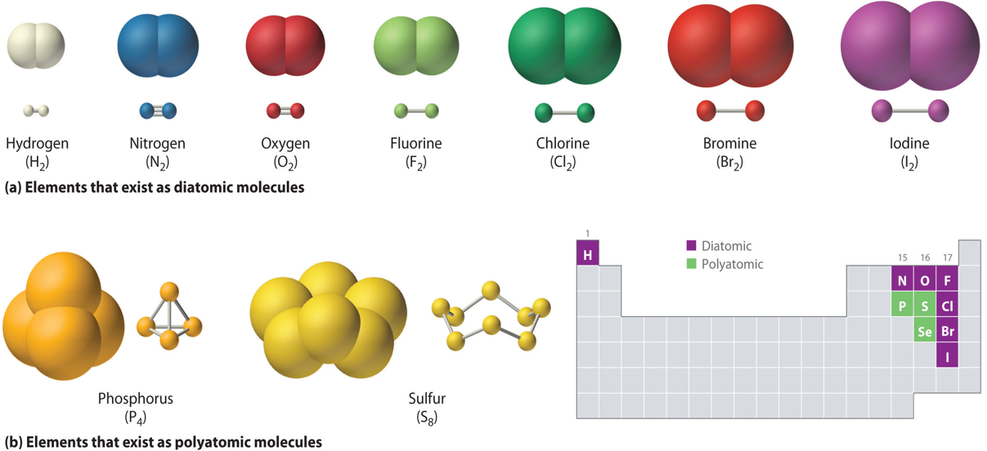
Characteristics of Covalent bonds:
Gases, liquids or solids at room temperature.
Low melting points and boiling points.
(3) Neither hard nor brittle.
(4) Soluble in organic solvents.
(5) Non-conductors of electricity.

Slide 22
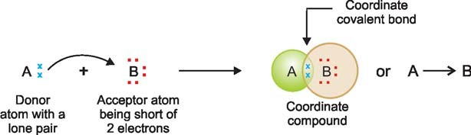
3.Coordinate Covalent Bond
The atom A which donates the lone pair is called the donor, while B which accepts it is called the acceptor. The bond thus established is indicated by an arrow pointing from A to B. Although the arrow head indicates the origin of the electrons, once the coordinate bond is formed it is in no way different from an ordinary covalent bond. The molecule or ion that contains the donor atom is called the ligand.

Slide 23


Some examples of Coordinate Covalent compounds or ions
1. Ammonium ion, NH₄⁺
2. Hydronium ion, H₃O⁺

Slide 24


3. Ozone, O₃
4. Carbon Monoxide, CO

Slide 25
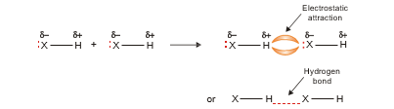
4.Hydrogen Bond
The electrostatic attraction between an H atom covalently bonded to a highly electronegative atom X and a lone pair of electrons on X in another molecule is called Hydrogen Bonding.

Slide 26
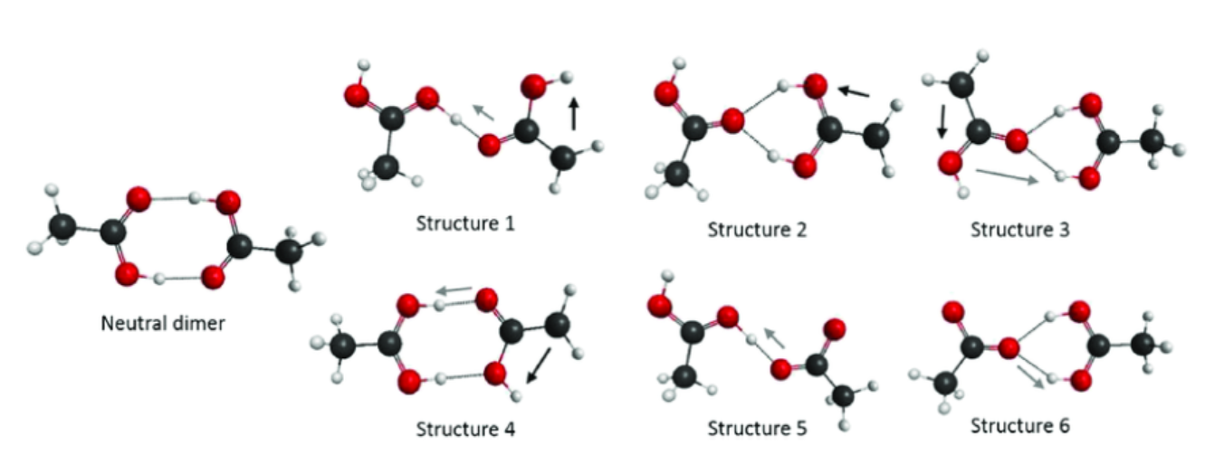
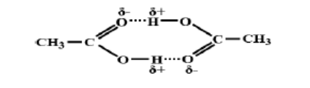
Type of H-bonding:
Inter-molecular H-bond:
Due to inter-molecular H-bond, dimmer molecules are formed such as two molecules of CH3COOH can form a dimmer by two H- bonds between the two –COOH groups.

Slide 27
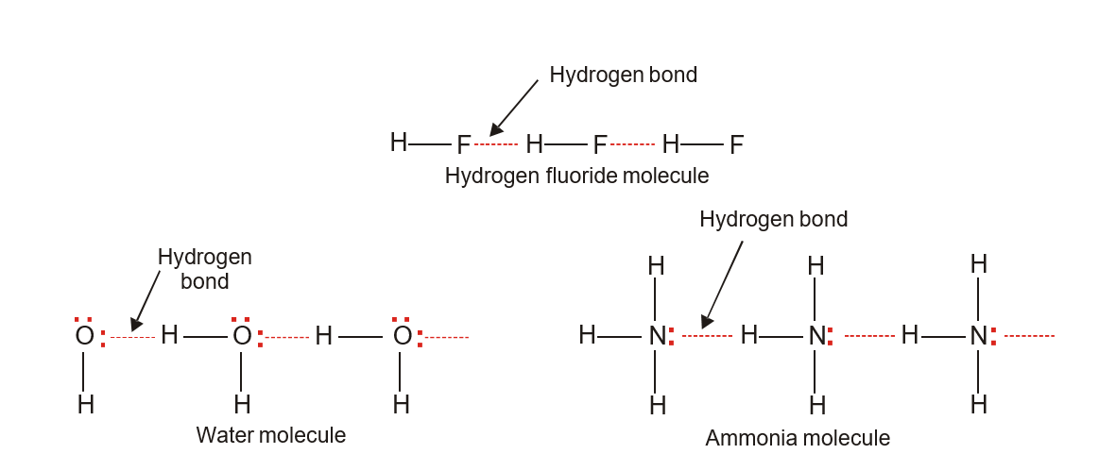
Fig. Intermolecular Hydrogen bonding in HF, H₂O and NH₃

Slide 28
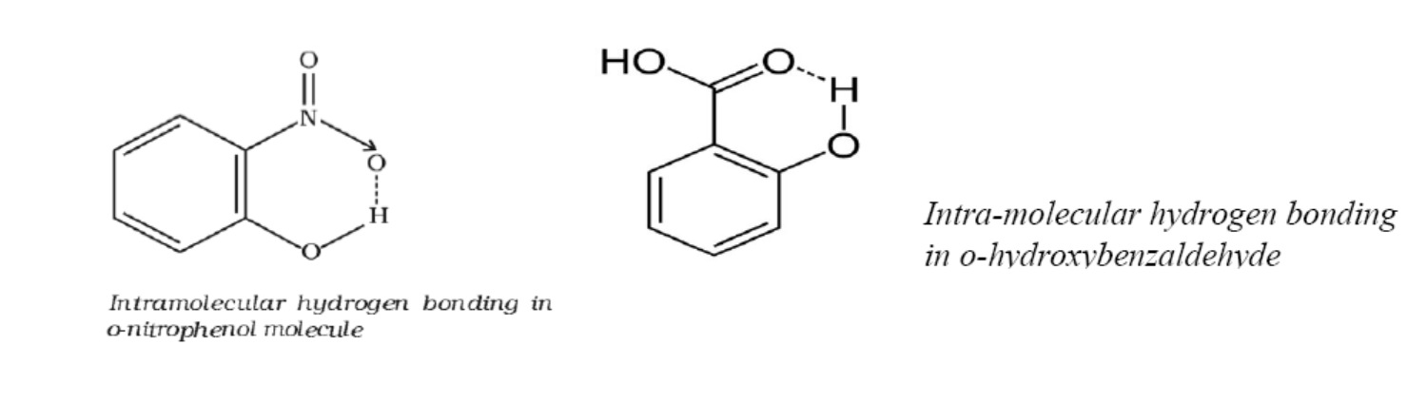
Intra-molecular H-bond:

Slide 29
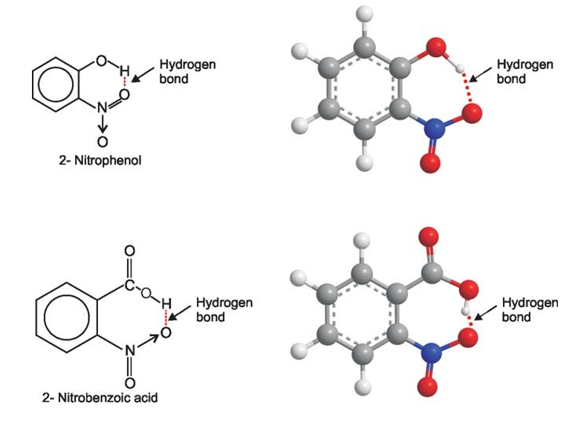
Fig. Intramolecular Hydrogen bonding

Slide 30
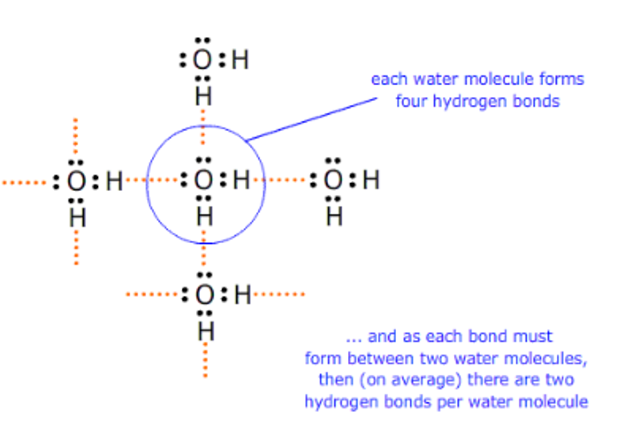

Slide 31
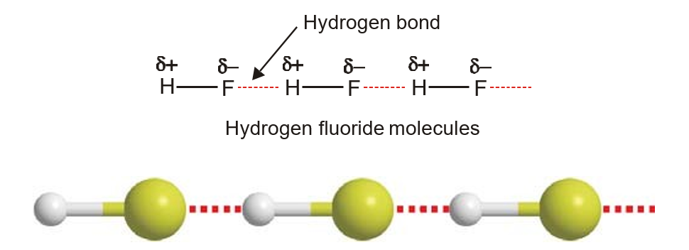
Examples of Hydrogen bond bond compounds:
Gradational strength of H-bond is H…..F > H…..O > H…..N.
1. Hydrogen Fluoride, HF

Slide 32
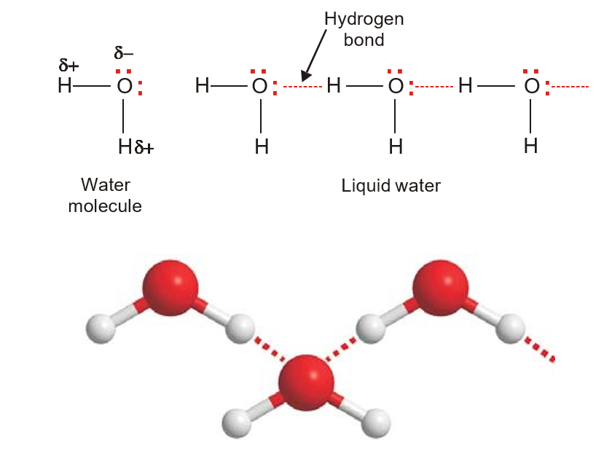
2. Water, H₂O

Slide 33
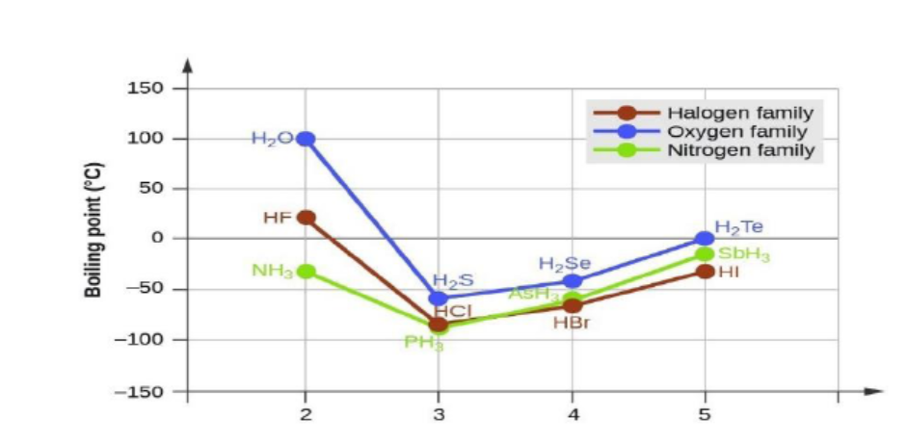
Characteristics of Hydrogen bond compounds
1. High melting points and high boiling points.

Slide 34
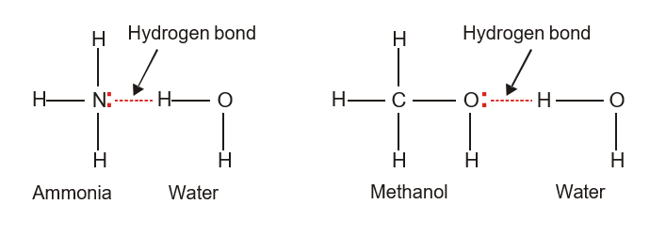
2. High solubility of some covalent compounds.

Slide 35
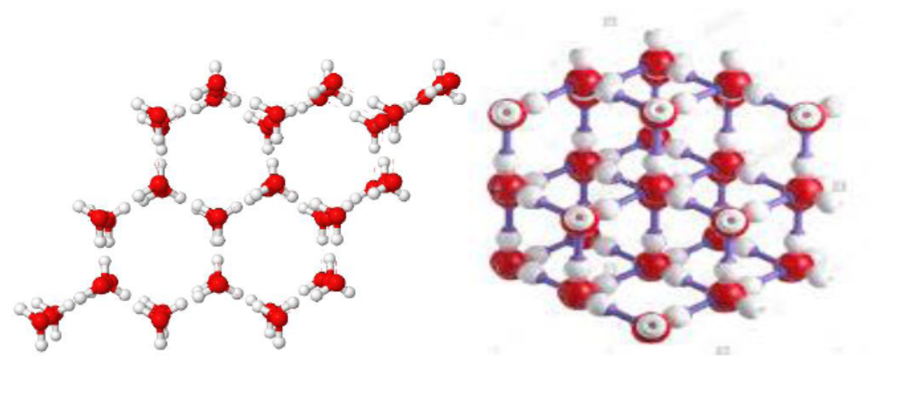
3. Shows three dimensional crystal lattice.

Slide 36
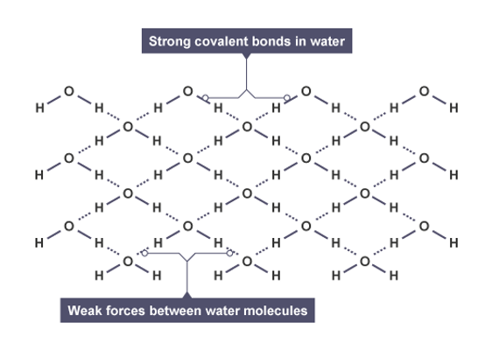
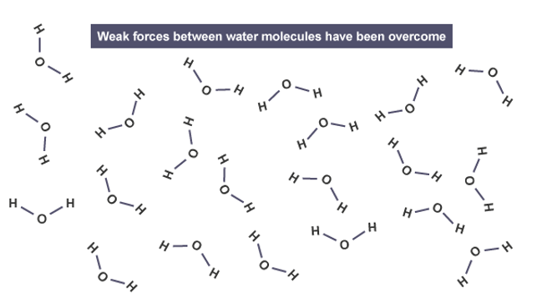
Abnormally high boiling and melting points of H₂O

Slide 37
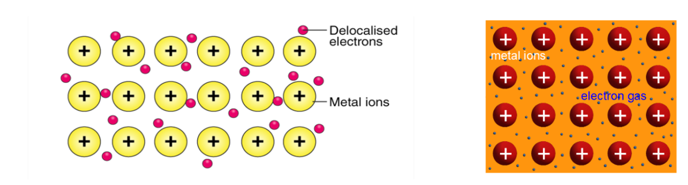
5. Metallic Bond

Slide 38
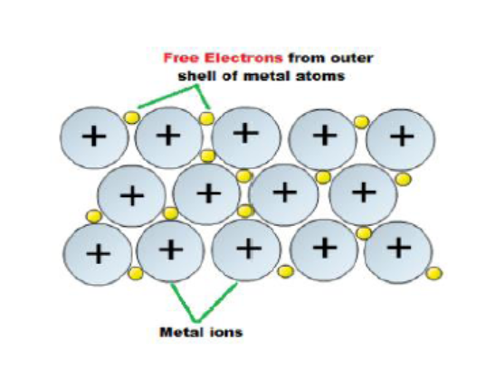
The strength of a metallic bond depends on three things:
1. The number of electrons that become delocalized from the metal
2. The charge of the metal.
3. The size of the metal.
Fig: Metallic Bond

Slide 39
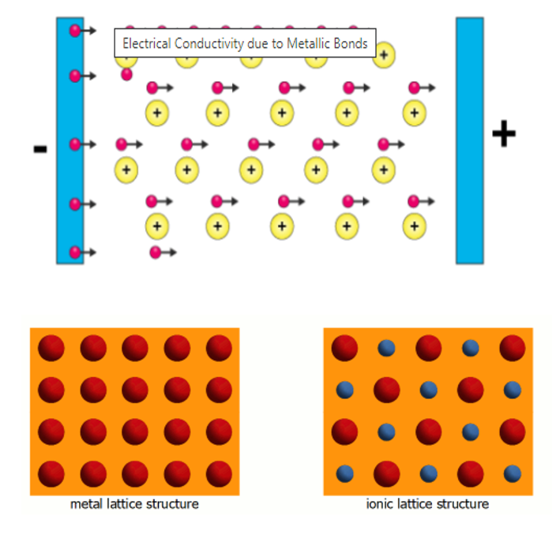
Due to their crystalline structure, metals are highly loadable, have high ductility so that they do not break instantly .

Slide 40
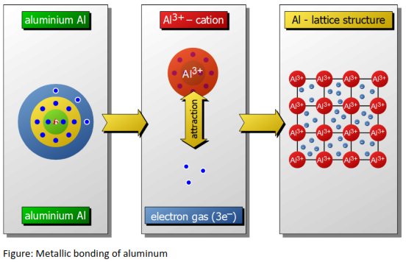

Slide 41
Characteristics of Metals
Metals are good conductors of electricity (Electrical conductivity).
Metals are good conductors of heat (Thermal conductivity)
Metals are opaque and have lustre or color.
Metals are malleable or plastic and ductile.
Metals form alloys.
Metals have elasticity.
Metals possess high tensile strength.
Metals are solids and have high density.
Metals have intermediate melting and boiling points as compared to those of covalent and ionic compounds.
Metals are usually hard solids.

Slide 42
The End

