Slide 1
Chemical equilibrium

Slide 2

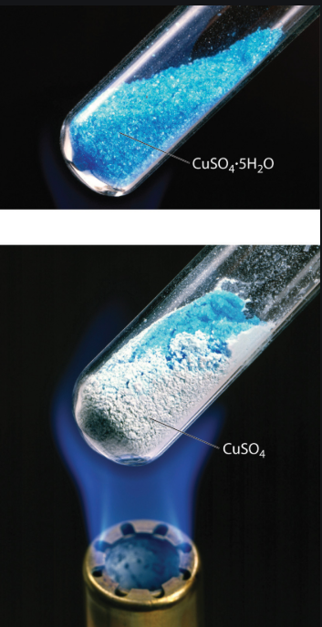


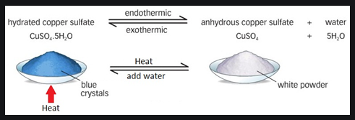
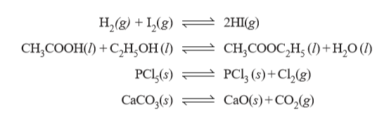
# Reversible reaction
A reaction which can go in the forward and backward direction simultaneously
Examples

Slide 3
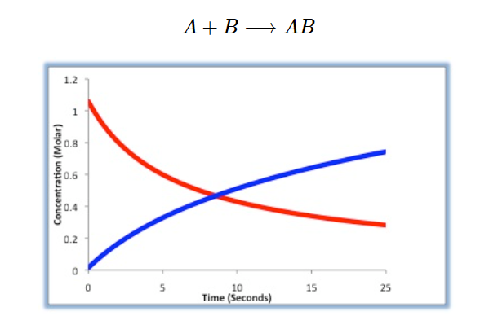

Reaction Rate
During the course of the reaction shown below, reactants A and B are consumed while the concentration of product AB increases. The reaction rate can be determined by measuring how fast the concentration of A or B decreases, or by how fast the concentration of AB increases.
The Reaction Rate for a given chemical reaction is the measure of the change in concentration of the reactants or the change in concentration of the products per unit time. The speed of a chemical reaction may be defined as the change in concentration of a substance divided by the time interval during which this change is observed:

Slide 4
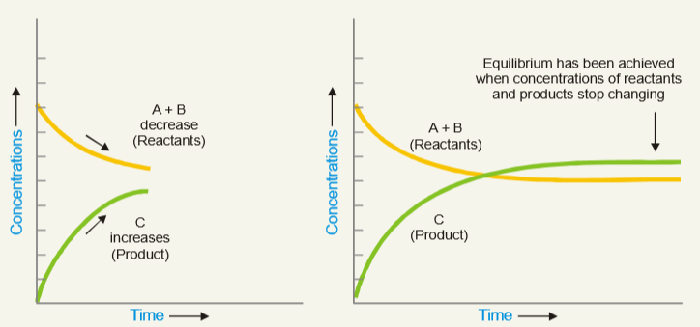
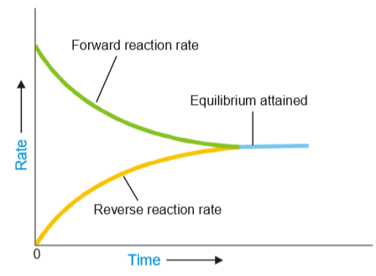
# Chemical equilibrium
If we start with A and B in a closed vessel, the forward reaction proceeds to form C and D
concentrations
of
Rate of two opposing reactions equals
Concentrations of
System attains a state of equilibrium
Rate of forward reaction decreases
Rate of reverse reaction increases
“The state of a reversible reaction when the two opposing reactions occur at the same rate and the concentrations of reactants and products do not change with time”
True equilibrium of a reaction can be attained from both sides

Slide 5
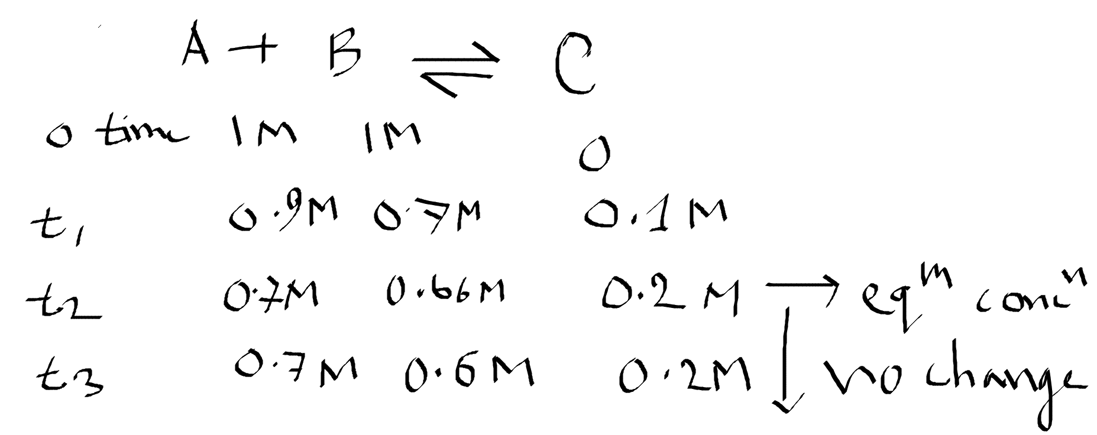

Slide 6
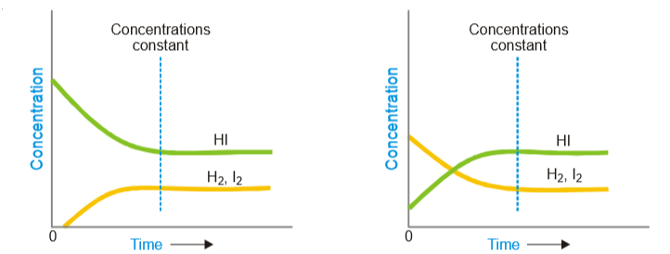
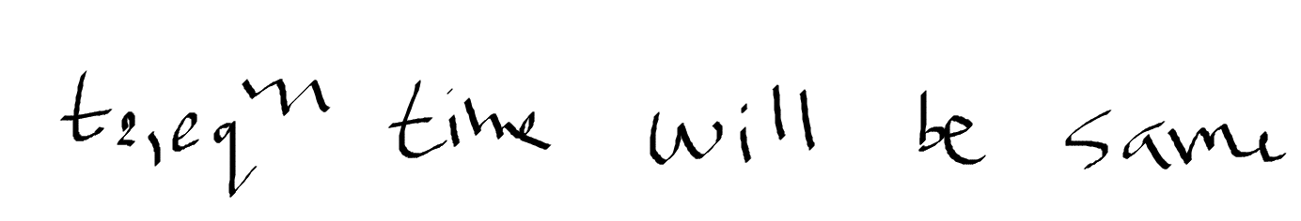
# Chemical characteristics of chemical equilibrium
(1) Constancy of concentrations:
When a chemical equilibrium is established in a closed vessel at constant temperature, concentrations of the various species in the reaction mixture become constant.
The reaction mixture at equilibrium is called Equilibrium mixture
The concentrations at equilibrium are called Equilibrium concentrations
(2) Equilibrium can be initiated from either side:
whether we start with 1 mole of I2 and 1 mole of H2, or with 2 moles of HI in a vessel of the same volume, the same mixture of H2, I2 and HI is obtained.
equilibrium is attained for start with 2HI
equilibrium is attained for start with H2 and I2
Equilibrium concentrations in both cases are the same

Slide 7
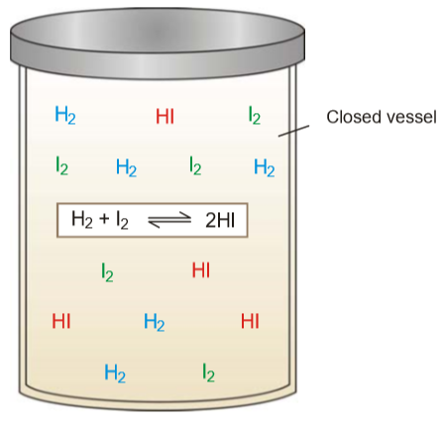
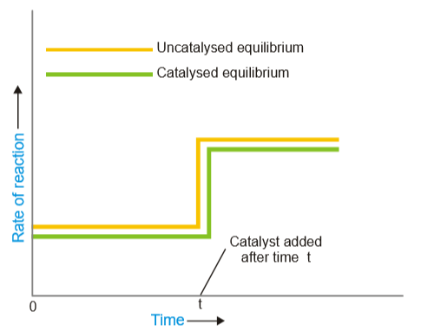
(3) Equilibrium cannot be Attained in an Open Vessel
The reaction vessel must be closed
no part of the reactants or products is allowed to escape out
Equilibrium can be attained when all the reactants and products are in the same phase
In an open vessel, the gaseous reactants and/or products may escape into the atmosphere leaving behind no possibility of attaining equilibrium
(4) A catalyst cannot change the equilibrium point
When a catalyst is added to a system in equilibrium,
it speeds up or enhance the rate of both the forward and the reverse reaction to an equal/same extent
Rate fast
A catalyst cannot change the equilibrium point (equilibrium mixture) except that it is achieved earlier; it can only change t.
Adding a catalyst makes absolutely no difference to the position of equilibrium, it cannot affect the position of equilibrium
Rate slow

Slide 8

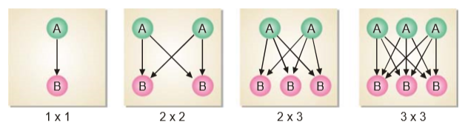
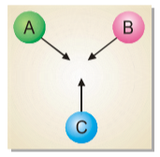
# Law of Mass action
“The rate of a chemical reaction is proportional to the active masses or molar concentrations of the reactants
1L
1L
1L
1L
In a reaction, A + B + C ⎯⎯→ the number of collisions between A, B and C depends on the concentration of each reactant
No. of
collisions
Fig: Possible collisions between molecules of the reactants A and B
Let us consider four boxes of one cubic centimetre volume; containing different number of reacting molecules A and B (Fig).
They undergo collisions to form the products C and D, the rate of reaction being governed by the number of possible collisions between them.
‘active mass’; [ ]
molar concentration i.e., number of moles per litre

Slide 9



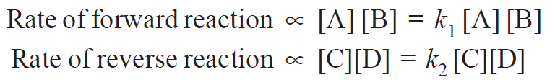
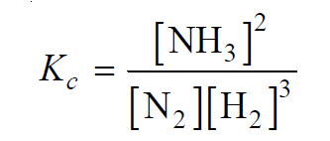

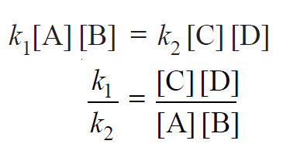

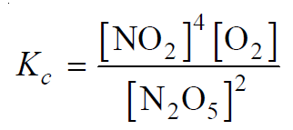
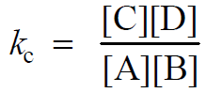
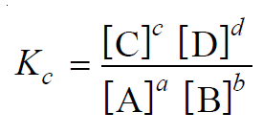
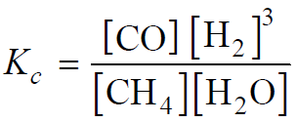
# Equilibrium constant or Equilibrium law:
Examples:
[A], [B], [C] and [D] represent the molar concentrations of A, B, C and D at the equilibrium point
Solution:
Where,
k₁ and k₂ are rate constants for the forward and reverse reactions
At equilibrium,
rate of forward reaction = rate of reverse reaction
Solution:
The ratio k₁/k₂ or K_{c} is called Equilibrium constant
Solution:
This equation is known as the Equilibrium constant equation

Slide 10

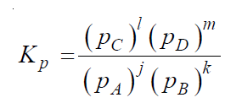
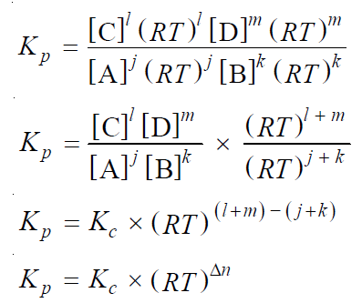




# Equilibrium constant in terms of partial pressure:
All reactants (A, B) and products (C, D) are gases.
The equilibrium constant expression in terms of partial pressures as:
Assuming that all these gases obey the ideal gas equation,
the partial pressure (p) of a gas is:
The partial pressures of individual gases are:

Slide 11
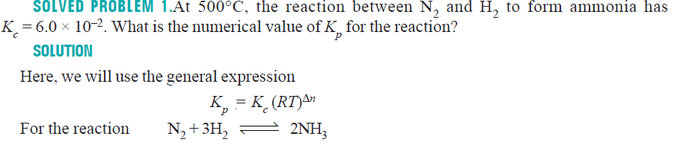
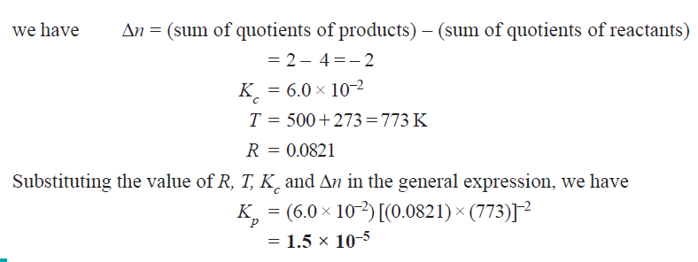

Slide 12

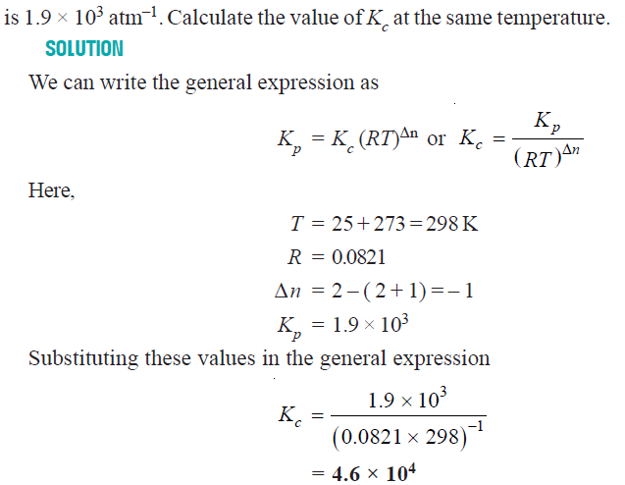

Slide 13

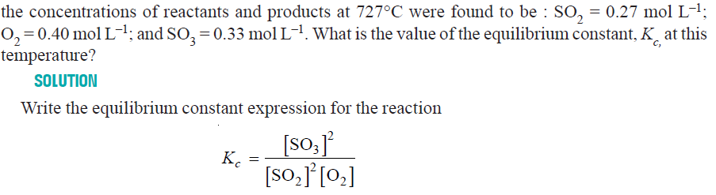
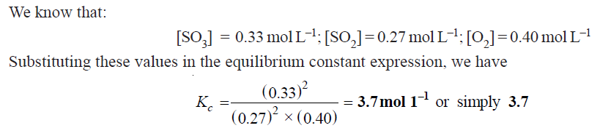

Slide 14
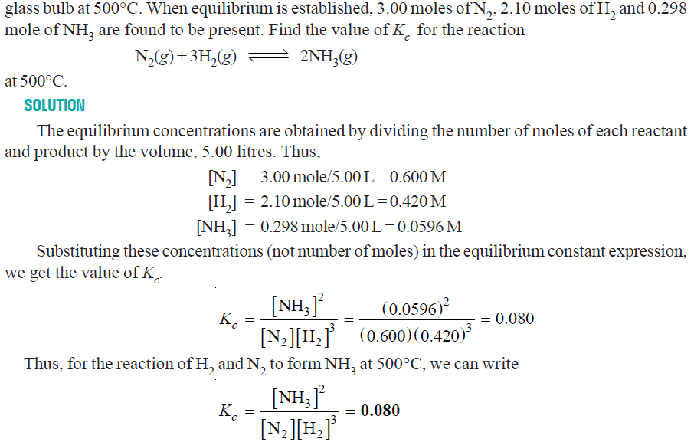

Slide 15

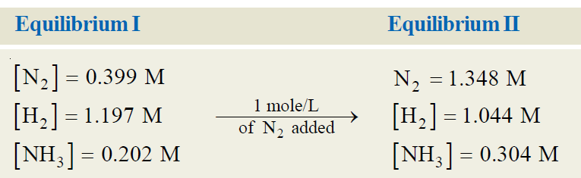
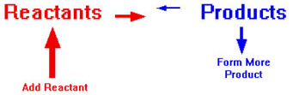
Le Chatelier’s principle
Changes in reaction variables cause a system to create a new point of equilibrium. This effect is explained by Le Chatelier’s principle.
“when a stress is applied on a system in equilibrium, the system tends to adjust itself so as to reduce the stress”
or
1) Effect of change in concentration:
“when concentration of any of the reactants or products is changed, the equilibrium shifts in a direction so as to reduce the change in concentration that was made”
To have a better yield of NH₃,
one of the reactants should be added in excess
When N₂ (or H₂) is added to the equilibrium I,
the equilibrium will shift to the right so as to reduce the conc. of N₂
Conc. of NH₃ at equilibrium II is more than at equilibrium I

Slide 16

1) Effect of change in concentration:
What happens if conditions are altered by increasing the concentration of A?
In this case, the equilibrium position will move to the right so that the concentration of A decreases again by reacting it with B to form more C and D.
What happens if conditions are altered by decreasing the concentration of A?
If the concentration of A is decreased, the position of equilibrium will move to the left so that the concentration of A increases again. More C and D will react to replace the A that has been removed. The position of equilibrium moves left
The position of equilibrium moves to the left if you decrease the concentration of A

Slide 17
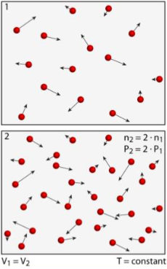
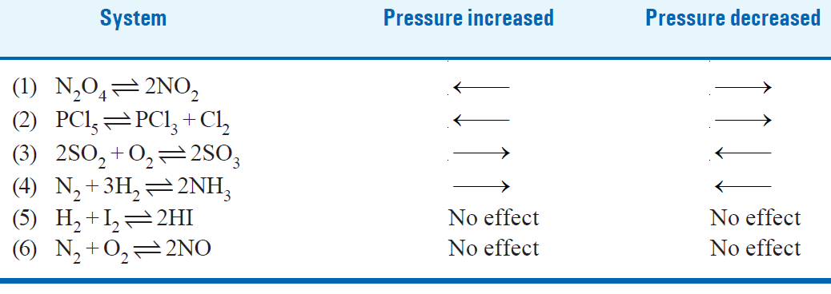
Le Chatelier’s principle
“when pressure is increased on a gaseous equilibrium reaction,
the equilibrium will shift in a direction which tends to decrease the pressure”
2) Effect of change in pressure:
If we want more NH3, we need to move equilibrium to right by increasing pressure;
Increased P will shift the reaction to right to decrease the pressure
N₂ + 3H₂ ← 2NH₃
N₂ + 3H₂ → 2NH₃
Pressure decrease
Increase N₂ and H₂
At equilibrium
N₂ + 3H₂ ↔ 2NH₃
_{Red Green}
Pressure increase
Increase NH₃
High product
P α n
[from PV = nRT]
High product
n α P
[if V, T = constant]
High product
P= Pressure of a gaseous reaction at equilibrium
n = Total number of molecules in reaction
High product
Collisions of gas particles with container wall = Pressure
More gas particles = more collisions = more greater pressure
Increasing pressure will shift the equilibrium to the reaction with lower no. of moles to decrease pressure
Decreasing pressure will shift the equilibrium to the reaction with higher no. of moles to increase pressure

Slide 18
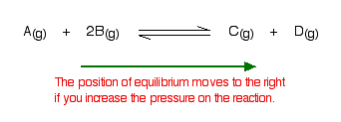

2) Effect of change in pressure:
if the pressure is increased, the position of equilibrium will move so that the pressure is reduced again. Pressure is caused by gas molecules hitting the sides of their container. The more molecules in the container, the higher the pressure will be. The system can reduce the pressure by reacting in such a way as to produce fewer molecules.
In this case, there are three moles on the left-hand side of the equation, but only two on the right. By forming more C and D, the system causes the pressure to reduce. Increasing the pressure on a gas reaction shifts the position of equilibrium towards the side with fewer moles of gas molecules.
What happens if there are the same number of molecules on both sides of the equilibrium reaction?
In this case, increasing the pressure has no effect on the position of the equilibrium. Because there are equal numbers of molecules on both sides, the equilibrium cannot move in any way that will reduce the pressure again.

Slide 19


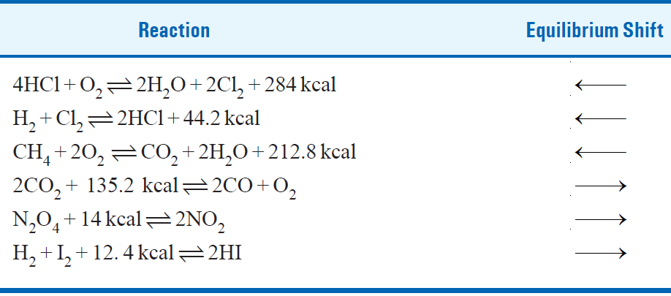
Le Chatelier’s principle
3) Effect of change in temperature:
“When temperature of a reaction is increased, the equilibrium shifts in a direction in which heat is absorbed.
Low Temp
If the forward reaction proceeds by the evolution of heat (exothermic),
(If you want more C)
At low T, the equilibrium will shift to right to increase temp
High Temp
If the reverse reaction occurs by the absorption of heat (endothermic)
At high T, the equilibrium will shift to right to decrease temp
At low
T?
High product
If temperature of a reaction is raised,
heat is added to the system.
Equilibrium shifts in a direction in which
heat is absorbed to lower T
High product
High product
At high
T?
High product

Slide 20
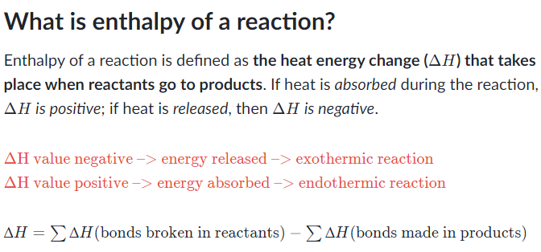

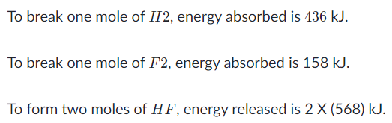

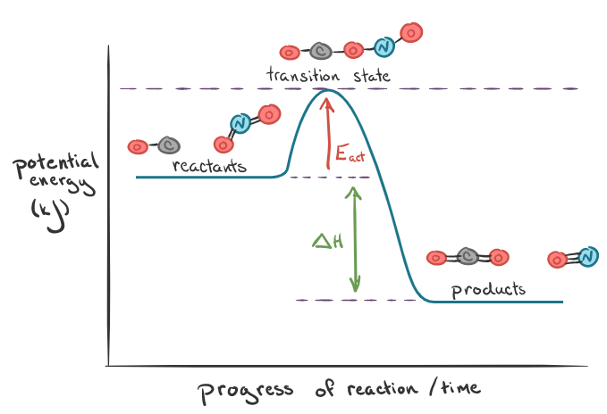
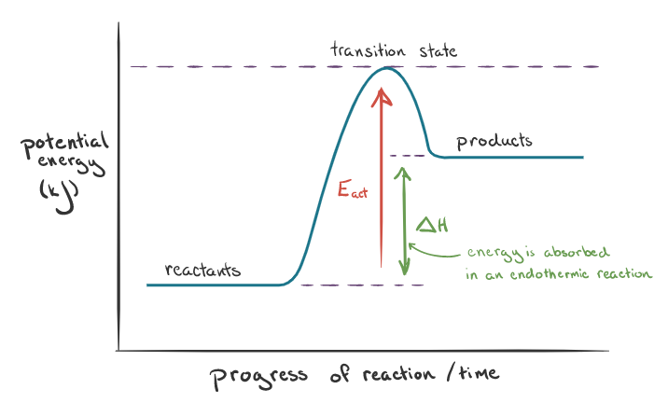
Exothermic Reaction
Endothermic Reaction
Spontaneous
Non-spontaneous
Ex: Combustion,
Condensation of water
vapor into rain
Ex: Cooking
Glucose in water

Slide 21
What Optimum conditions for maximum products in industrial processes ?
# Synthesis of Ammonia (Haber Process):
Basic information:
Optimum conditions:
Low temperature:
Low temperature will shift the equilibrium to the right.
Low temperature will give greater yield of ammonia.
In actual practice, a temperature of about 450°C is used
(2) High pressure:
As forward reaction proceeds with a decrease no. of moles.
High pressure will shift the equilibrium to the right
In actual practice, a pressure of about 200 atm is used
(3) Catalyst.
At low temperatures, rate of reaction is slow and equilibrium is attained in a long time.
To increase the rate of reaction and thus quicken the attainment of equilibrium,
a catalyst is used.
In actual practice, Finely divided Fe containing Mo is used
Mo acts as a promoter (increases the life & efficiency of catalyst)

Slide 22

Assignment:
1. Manufacture of Sulphuric acid (Contact Process)
On the basis of Le Chatelier’s principle, what are the conditions for the maximum yield in the manufacturing of sulphuric acid ?
2. Manufacture of Nitric oxide (Birkeland-Eyde process)
On the basis of Le Chatelier’s principle, what are the conditions for the maximum yield in the manufacturing of nitric oxide ?

