Slide 1
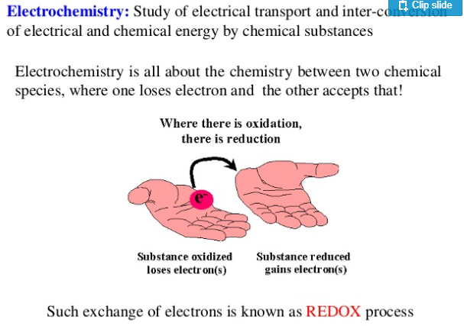
conversion

Slide 2
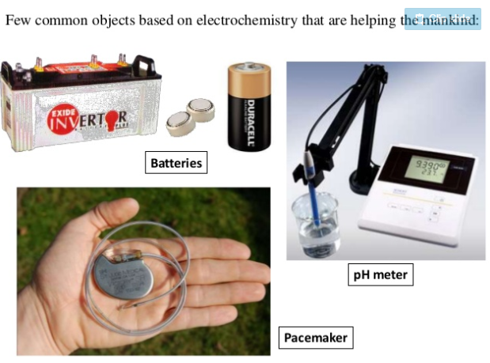
A pacemaker is a device that uses electrical pulses to prompt the
heart to beat at a normal rate.

Slide 3
Electrochemical cell
An electrochemical cell is a device capable of either generating electrical energy from chemical reactions or using electrical energy to cause chemical reactions.
1. Voltaic/galvanic cell
A voltaic/galvanic cell is an electrochemical cell that derives electrical energy from spontaneous redox reactions taking place within the cell. It has two electrolytes with two electrodes and salt bridge
Example:
Electrical battery, Fuel cell
2. Electrolytic cell
An electrolytic cell is an electrochemical cell that drives a non-spontaneous redox reaction (electrolysis) through the application of electrical energy.
It has an electrolyte and two electrodes
Example:
Decomposition of water into H2 and O2,
Extraction of metal,
bauxite into aluminium and other chemicals. Electroplating

Slide 4

Spontaneous redox reactions are voluntary reactions which occur with no external intervention. They start by themselves after exceeding the activation energy, and go on till completion of the reactants.
Examples include the rusting or corrosion of iron
Thermodynamically favorable
+ve cell potential
Occur without external power source
Votaic/galvanic cell
Non-spontaneous reactions require an energy input or a catalyst to lower the energy requirements to take place, i.e. they can only occur if energy is put into the reaction from an external source.
Ex: Large number of Organic reactions are not spontaneous.
Thermodynamically unfavorable
-ve cell potential
Need external electrical power or Battery to drive the redox reaction
Electrolytic cell

Slide 5
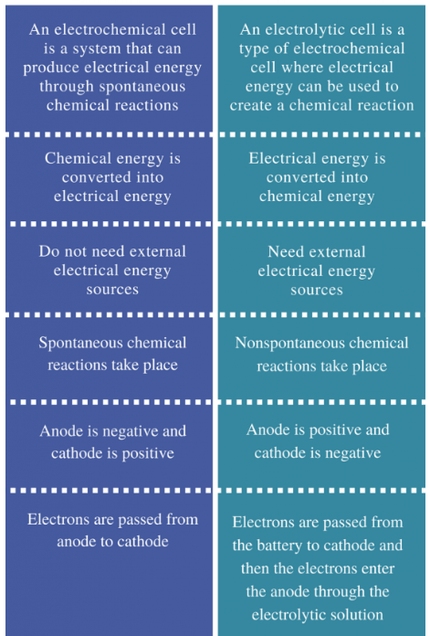
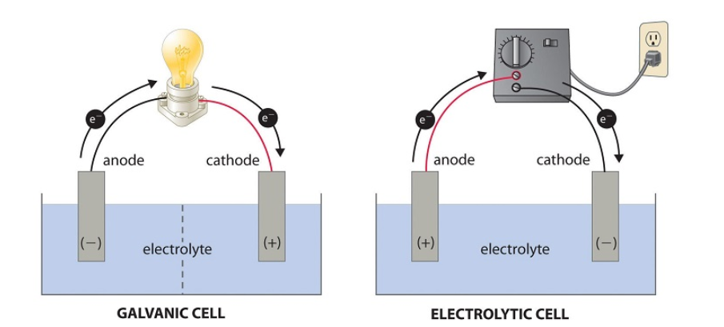
Difference between Galvanic cell and Electrolytic cell
Galvanic cells
Electrolytic Cells
e⁻ come from solution itself
e⁻ are FORCED (e⁻ come from battery) to be reduced at the cathode

Slide 8
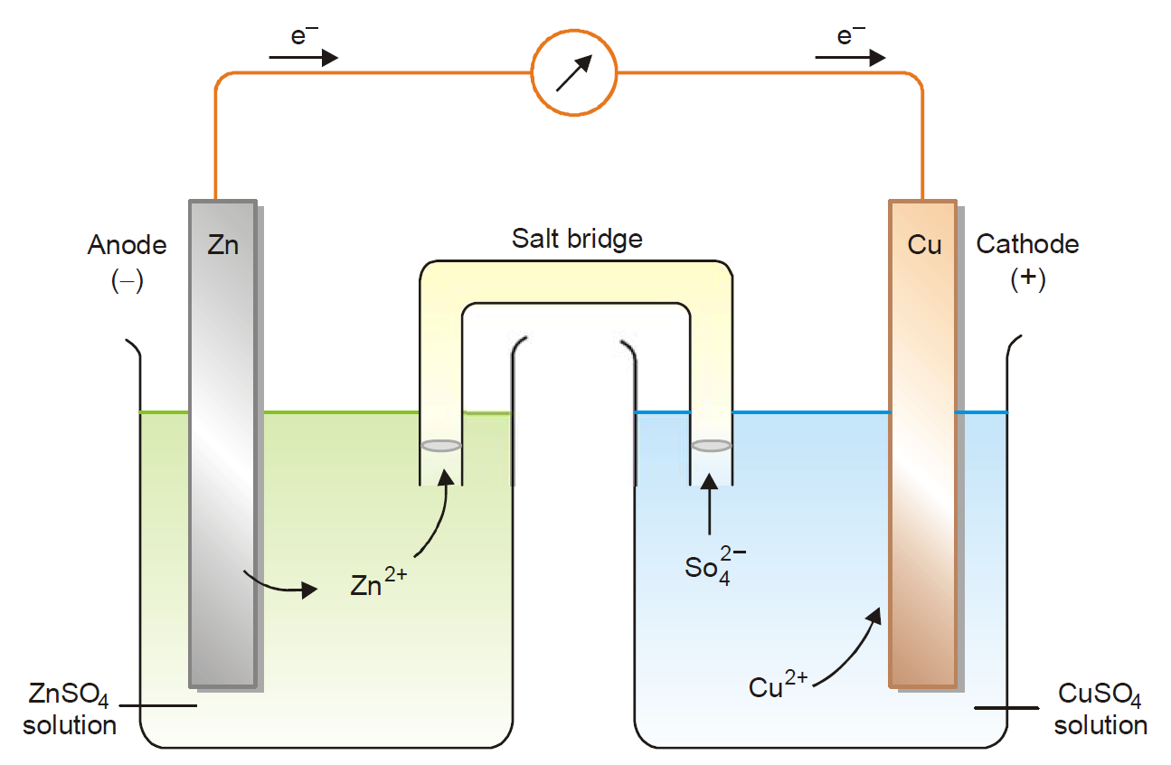
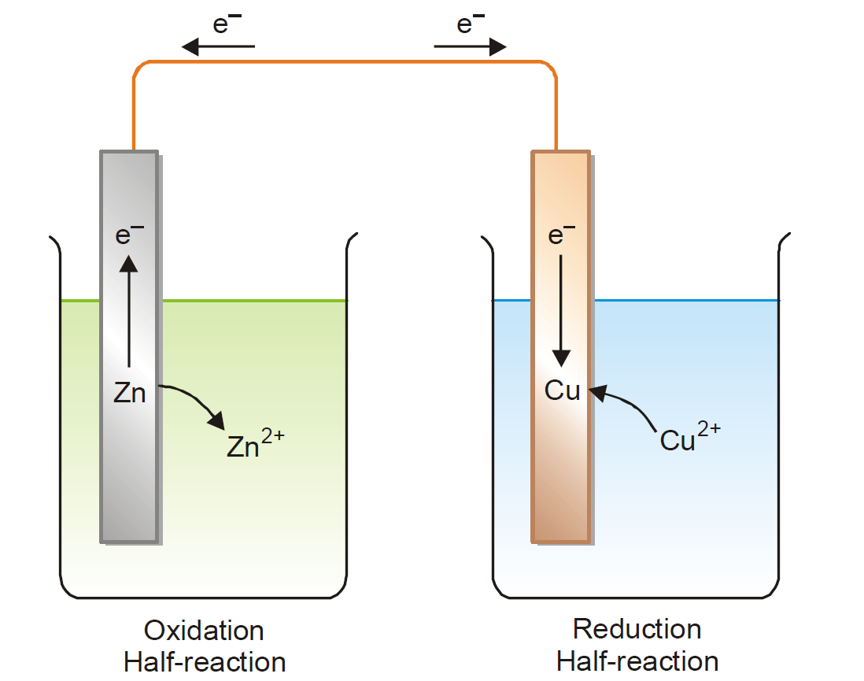
Galvanic cell
+
-
No Salt bridge
Current will flow for an instant, then stop because of the charge build up in the two compartments
Figure: Salt bridge in Voltaic (galvanic) cell
Salt bridge:
A salt bridge connects the oxidation and reduction half-cells of a galvanic cell
U-tube filled with an electrolyte-NaCl, KCl, or K₂SO₄
Function-provides a passage to ions from one compartment to the other compartment without extensive mixing of the two solutions. With this ion flow, the circuit is complete and electrons pass freely through the wire to keep the net charge zero in the two compartments

Slide 9
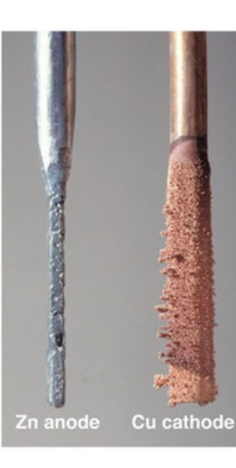
How a Redox reaction can produce an electrical current in galvanic cell ?
Spontaneous reaction of Zn metal with an aq. soln of CuSO₄:
Zn + CuSO₄ → ZnSO₄ + Cu
Oxidation half-reaction:
Zn → Zn²⁺ + 2e–
Reduction half-reaction:
Cu²⁺ + 2e– → Cu
When the cell is set up, e⁻ flow from Zn anode through the wire to the Cu cathode.
As a result, Zn dissolves in the anode solution to form Zn²⁺ ions. The Cu²⁺ ions in the cathode half-cell pick up electrons and are converted to Cu atoms on the cathode.
At the same time, SO₄^{2–} ions from the cathode half-cell migrate to the anode half-cell through the salt bridge. Likewise, Zn²⁺ ions from the anode half-cell move into the cathode half-cell.
This flow of ions completes the electrical circuit which ensure continuous supply of current.
The cell will operate till either the Zn metal or Cu ion is completely used up.
Figure: Voltaic (galvanic) cell
A Voltaic/galvanic cell is one in which electrical current is generated by a spontaneous redox reaction

Slide 10
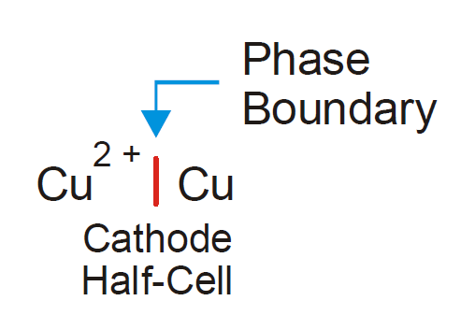
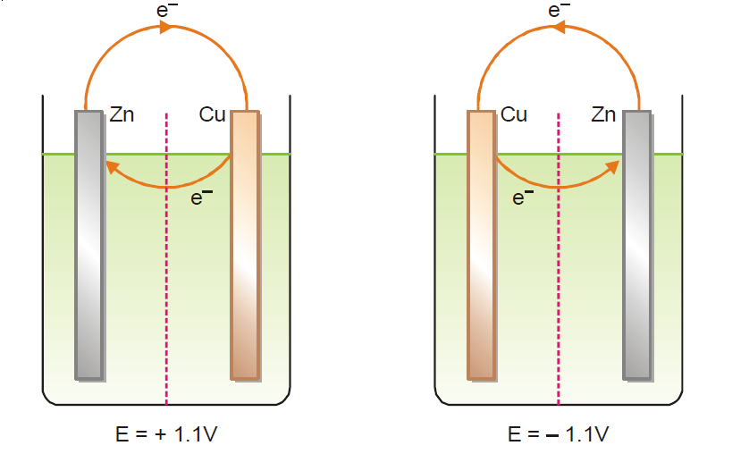
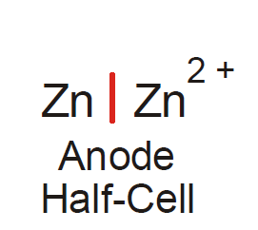
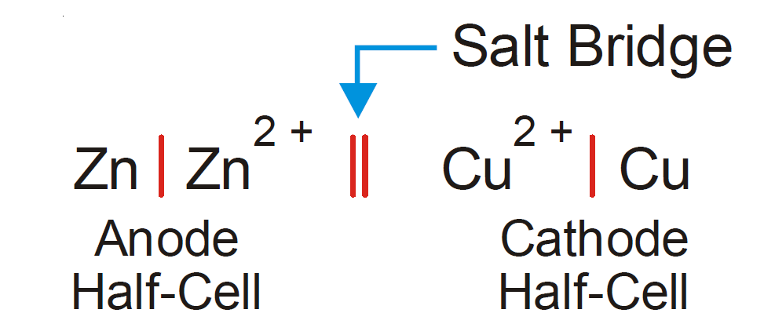
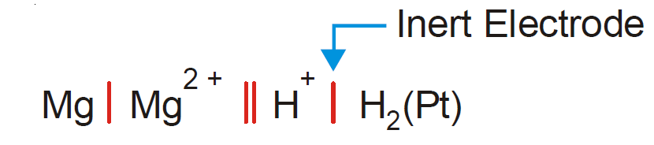
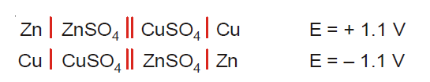
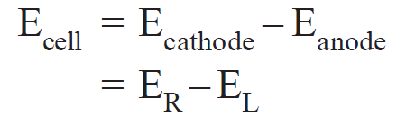
Cell potential/electromotive force/emf
In voltaic cell, the flow of current through the circuit is determined by the ‘push’, of electrons at the anode and ‘attraction’ of electrons at the cathode.
These two forces are the ‘driving force’ or ‘electrical pressure’ that sends electrons through the circuit called emf (V).
Half-cells:
between electrode & electrolyte
Complete cell diagram:
Fig: Mg-H cell
Fig: Zn-Cu cell
-ve: The cell is not feasible and
The redox reaction is non-spontaneous;
need external power source to drive the reaction
Calculating the emf of a cell:

Slide 11
Standard reduction potential
difference in the potential of cathode from SHE
Standard oxidation potential
difference in the potential of cathode from SHE
(measured at 298 K, 1 atm, and with 1 M solutions)
SOP is much like SRP; opposite in sign to each other for the same chemical species
Relation Between SRP and SOP: Eº (SRP) = − Eº (SOP)
For example,
Cu's Standard Reduction Potential
Cu²⁺+2e⁻ → Cu
Eº =+0.340 V
Cu's Standard Oxidation Potential
Cu(s) → Cu²⁺ +2e⁻(4)
Eº₀ = −0.340 V
How are Standard Reduction Potentials Applied ?
SRP are used to determine the standard cell potential.
SRP and SOP can be combined to determine the overall Cell Potentials of a galvanic cell
SRP
SOP
SRP
SRP

Slide 12
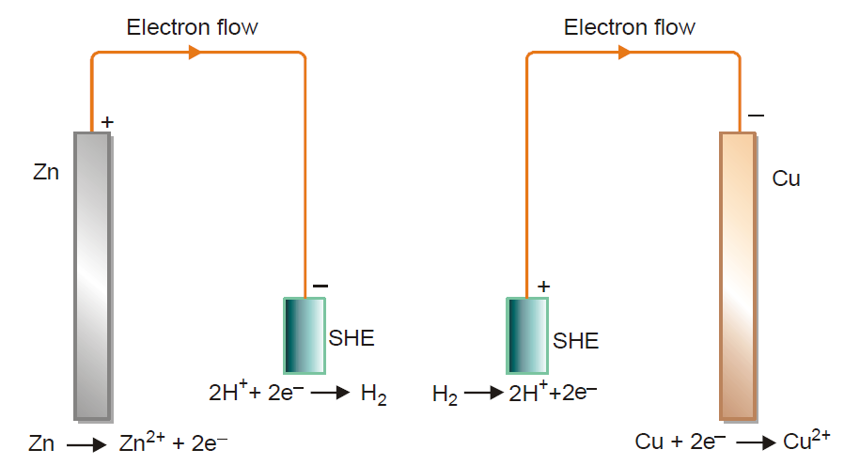
How are SRP/SOP Experimentally Determined ?
Universally, hydrogen has been recognized as having reduction and oxidation potentials of zero
SHE can act both as cathode and anode when joined with another half-cell
By using a galvanic cell in which one side is a SHE,
the other side is half cell of the unknown chemicals,
the potential difference from hydrogen can be
determined using a voltmeter.
SRP/SOP can both be determined in this fashion.
When the SRP is determined, the unknown species is
being reduced while hydrogen is being oxidized
When the SOP is determined, the unknown species is
being oxidized while hydrogen is being reduced.
The electrons flow to SHE and it acts as cathode
The electrons flow to Cu electrode and SHE act as
anode.

Slide 13

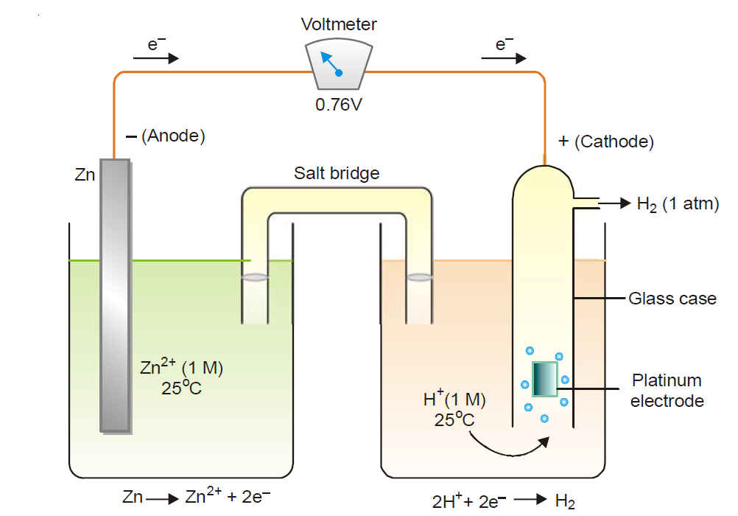


Determination of emf of a half-cell
Standard Hydrogen Electrode (SHE)
0.76 V = 0 -
= - 0.76 V
0.34 V = - 0
= 0.34 V

Slide 14

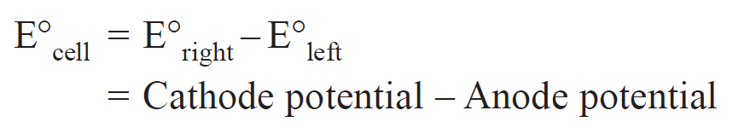
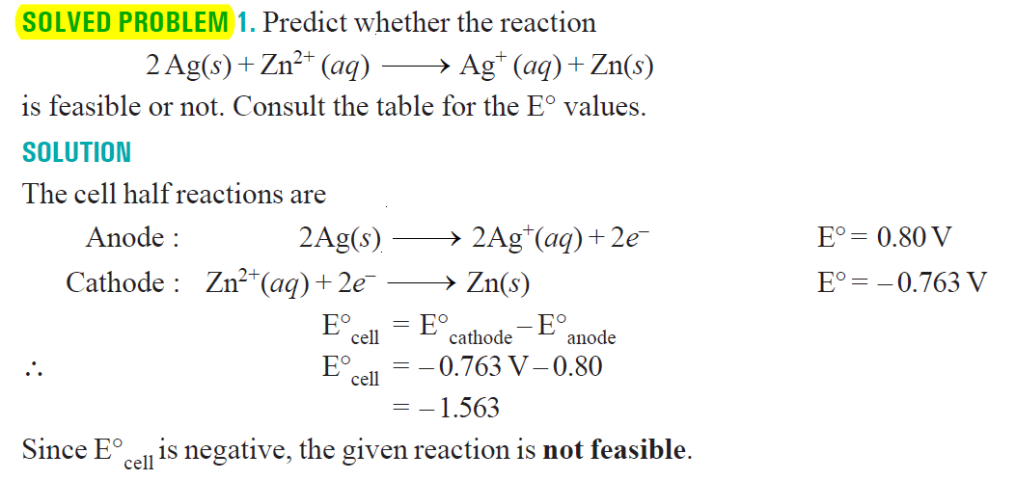
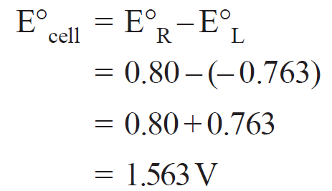
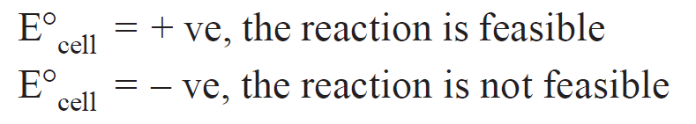
Predicting cell emf
Predicting Feasibility of Reaction

Slide 15
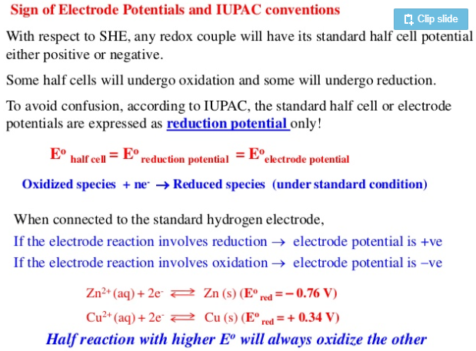

Slide 16
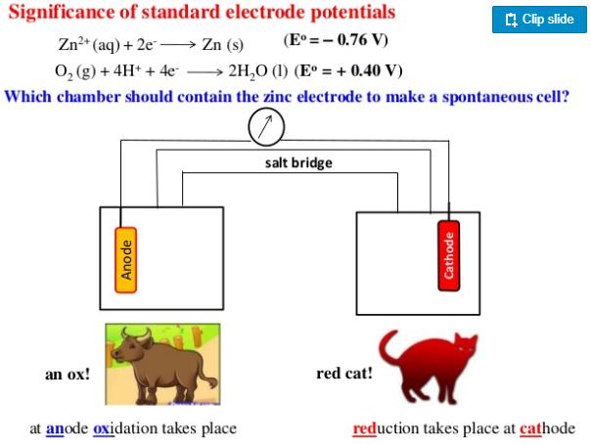

Slide 17
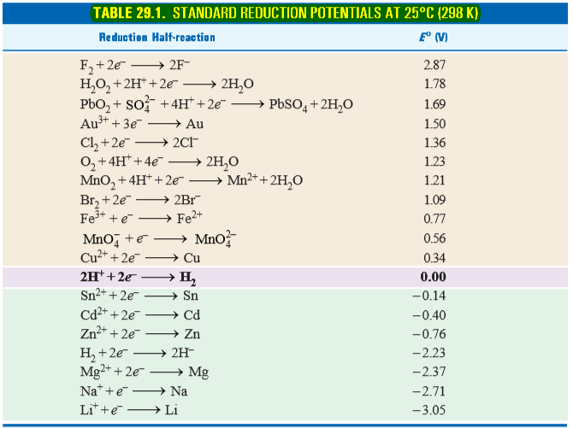
Electrochemical series:
(Good
oxidizing agent)
Strong
reduction
The more negative the E° value, the more
readily the metal loses electrons
when a species at top
is coupled with a
species at the bottom,
the one at the top will
become reduced while
the one at the bottom
will become oxidized
(Good
reducing agent)
Strong
Oxidation

Slide 18
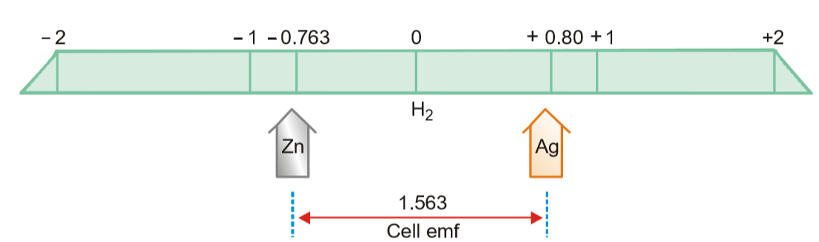
(Good
reducing agent)
(Good
oxidizing agent)
Strong
Oxidation
Strong
reduction
Figure: Diagrammatic representation of Cell emf.

Slide 19
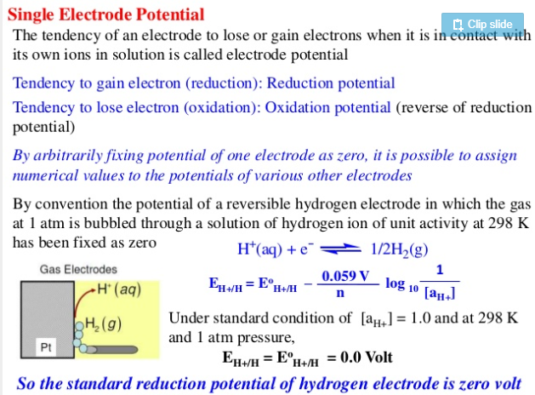
The absolute electrode potential for the
standard hydrogen
electrode (SHE) is
estimated to be
4.44 ± 0.02 V at 25 °C
However, for the ease of comparison with
other electrode
potentials, the SHE is
given a reference
potential of 0 V at all
temperatures

Slide 20
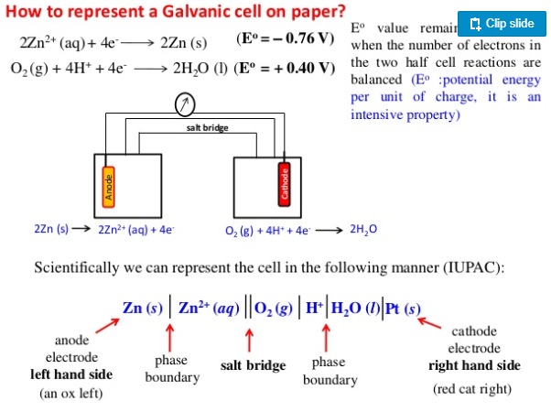
unchanged

Slide 21
Practice:
A chemist has constructed a galvanic cell consisting of two beakers. One beaker contains a strip of tin
immersed in aqueous sulfuric acid, and the other contains a platinum electrode immersed in aqueous
nitric acid. The two solutions are connected by a salt bridge, and the electrodes are connected by a wire. Current begins to flow, and bubbles of a gas appear at the platinum electrode. The spontaneous redox
reaction that occurs is described by the following balanced chemical equation:
3Sn(s)+2NO₃⁻_{(aq)}+8H⁺_{(aq)}→3Sn²⁺_{(aq)}+2NO_{(g)}+4H₂O_{(l)}
For this galvanic cell,
a) Write the half-reaction that occurs at each electrode.
b) Indicate which electrode is the cathode and which is the anode.
c) Indicate which electrode is the positive electrode and which is the negative electrode.

Slide 22
Practice:
Consider a simple galvanic cell consisting of two beakers connected by a salt bridge. One beaker contains a solution of MnO₄⁻ in dilute sulfuric acid and has a Pt electrode. The other beaker contains a solution
of Sn²⁺ in dilute sulfuric acid, also with a Pt electrode. When the two electrodes are connected by a wire, current flows and a spontaneous reaction occurs that is described by the following balanced chemical
equation:
2MnO_{4(aq)}+5Sn²⁺_{(aq)}+16H⁺_{(aq)}→2Mn²⁺_{(aq)}+5Sn⁴⁺_{(aq)}+8H₂O_{(l)}
For this galvanic cell,
a) Write the half-reaction that occurs at each electrode.
b) Indicate which electrode is the cathode and which is the anode.
c) Indicate which electrode is positive and which is negative.

Slide 24
Electrolysis
Chapter 24
Essential of Physical Chemistry
Ball and Tuli

