Slide 1
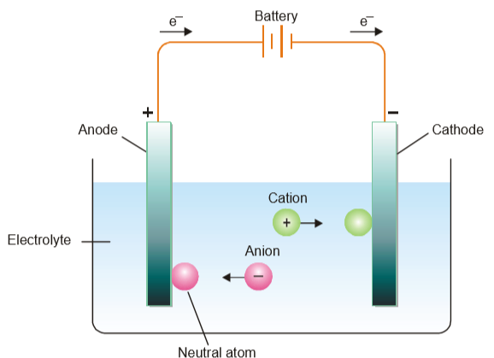
Figure: The mechanism of electrolysis

Slide 2
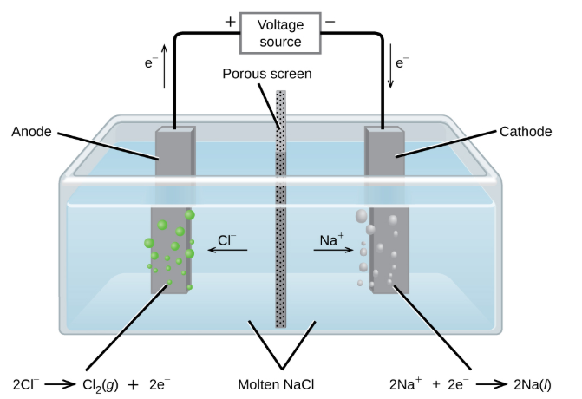
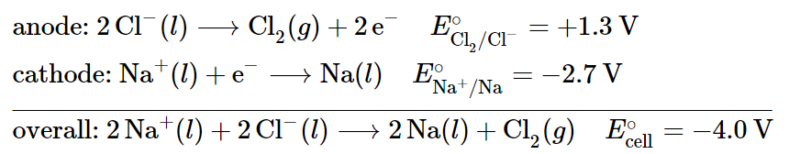
Figure : Passing an electric current through molten NaCl decomposes the material into Na metal and Cl gas. Care must be taken to keep the products separated to prevent the spontaneous formation of NaCl

Slide 3
Faraday’s Laws of Electrolysis
First Law:
“The amount of product during electrolysis is directly proportional to the quantity of electricity which passes through the electrolyte solution”
m ∝ Q
m ∝ I × t
[Q = I × t]
m = Z × I × t
[Z = Electrochemical equivalent of electrolyte]
m = Z
[If I = 1 A, t = 1 sec]
Electrochemical equivalent is the amount of a substance deposited by 1 ampere current passing for 1 second

Slide 4
Faraday’s Laws of Electrolysis
Second Law:
“When the same quantity of electricity passes through solutions of different electrolytes, the amounts of the product are directly proportional to their chemical equivalents.”
m₁
E₁
=
m₂
E₂
1 Faraday = 1 Mole electrons
= 1.602 × 10⁻¹⁹ C × 6.023 × 10²³
= 96,500 coulombs
[Avogadro’s number = 6.023 × 10²³
No of atoms in 1 mol of substance]
[1e = 1.602 × 10⁻¹⁹ C]

Slide 5
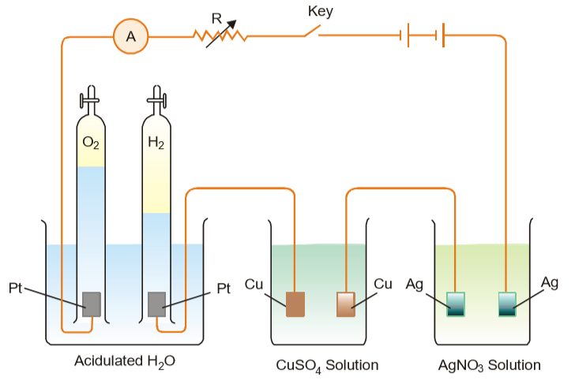
Figure: Illustrating Faraday's Second Law of Electrolysis

Slide 6
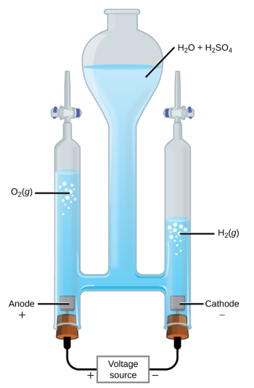
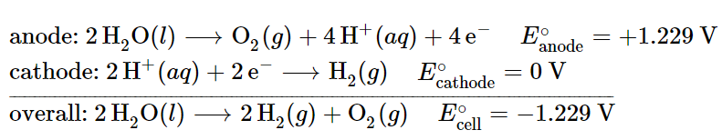
Figure : H2O decomposes into O2 and H2 gas during electrolysis.
H2SO4 -> increase the concentration of H+ ions and the total number of ions in solution, but does not take part in the reaction.
The volume of hydrogen gas collected is twice the volume of oxygen gas collected, due to the stoichiometry of the reaction.

Slide 7
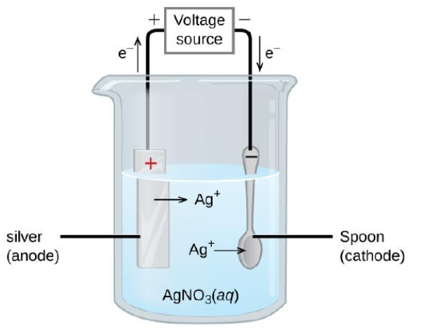


Electroplating
Figure : The spoon is the cathode.
The anode is a silver electrode.
The net result is that silver metal is removed from the anode and deposited on the cathode.

