Slide 1
Electroplating
Electrolysis is used to electroplate objects (coat them with a thin layer or metal)
Useful for coating a cheaper metal with a more expensive one, such as copper or silver
How it works
The negative electrode should be the object to be electroplated.
The positive electrode should be the metal that you want to coat the object with.
The electrolyte should be a solution of the coating metal, such as its metal nitrate or sulfate.

Slide 2
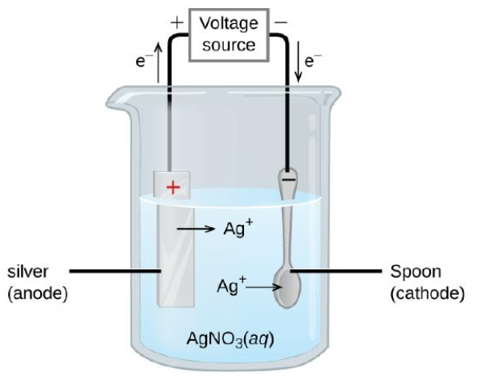


Electroplating with Ag
Figure : The spoon is the cathode.
The anode is a silver electrode.
The net result is that silver metal is removed from the anode and deposited on the cathode.
The object to be plated, such as a metal spoon, is connected to the negative terminal of the power supply.
A piece of silver is connected to the positive terminal.
The electrolyte is silver nitrate solution.

Slide 3
Electroplating with Cu
The object to be plated, such as a metal pan, is connected to the negative terminal of the power supply A piece of copper is connected to the positive terminal
The electrolyte is copper sulfate solution.
Cu²⁺
Cu
(anode)
Cu²⁺
Cu(NO₃)₂

