Slide 1



Nanotechnology and Chemistry: The Unseen Scale with Magnificent Impact
Dr. Thamina Acter
Associate Professor
Dept of MPS
EWU
2024.04.15

Slide 2
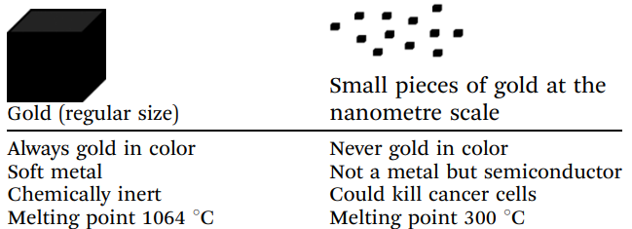
What is Nano and Why is it important?
Table 1.1 Physical and chemical properties of gold at the macroscale and nanoscale

Slide 3
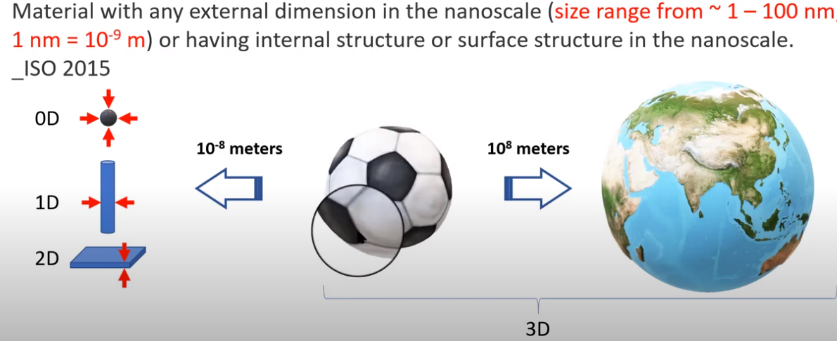
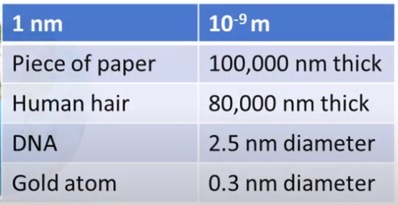
Nanomaterials?

Slide 4
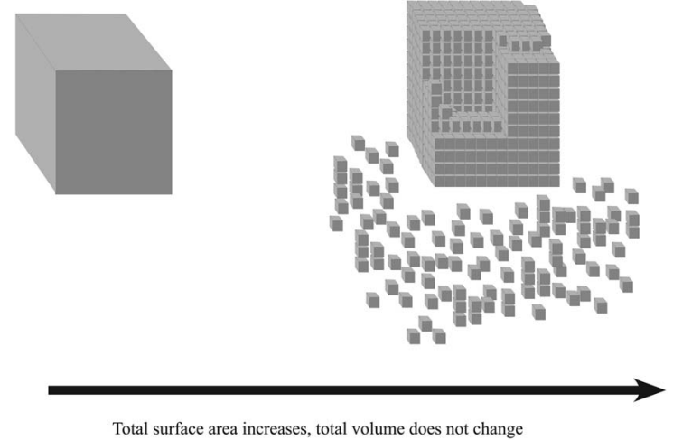
Why do properties of materials change at the nanoscale?
Figure 1.1 Total surface area increases while cutting cube to smaller cubes

Slide 5
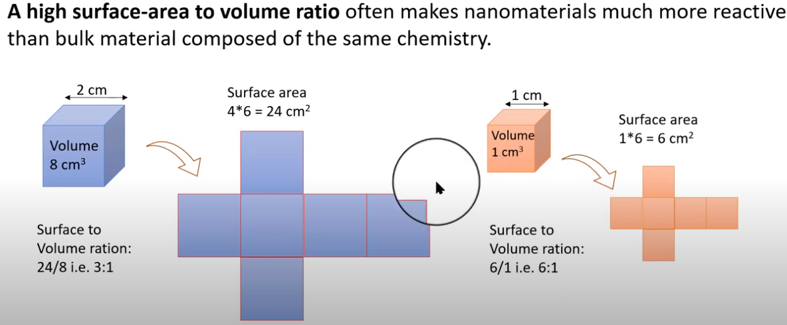
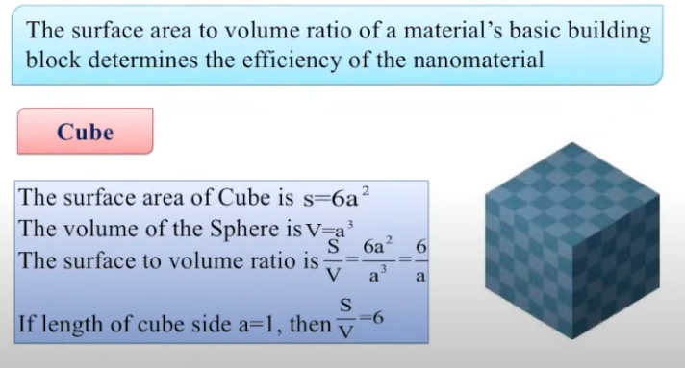
Surface area to volume ratio

Slide 6
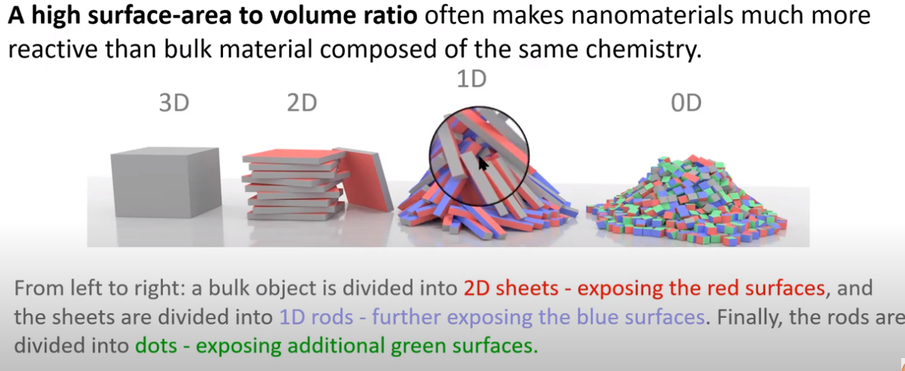
Surface area to volume ratio

Slide 7
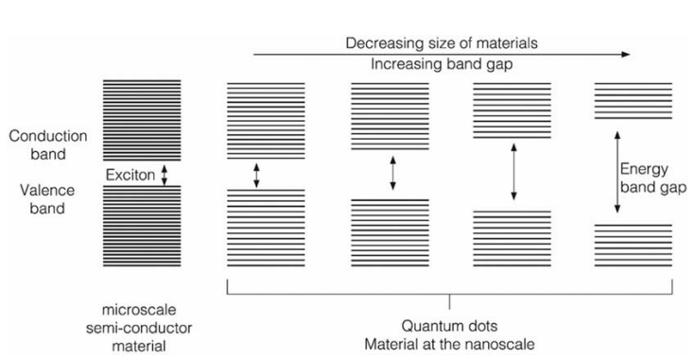
Figure 1.2 Schematic illustration of quantum confinement effect.

Slide 8
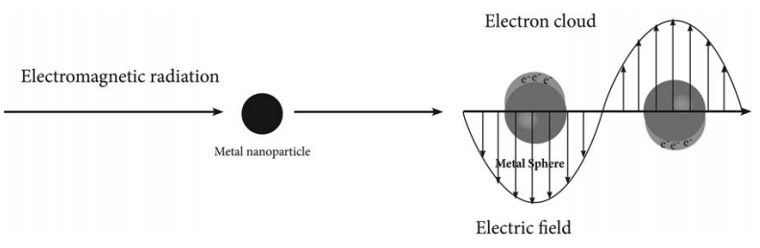
Figure 1.4 Schematic illustration of localized surface plasmon resonance (LSPR) of metal Nanoparticles.

Slide 9
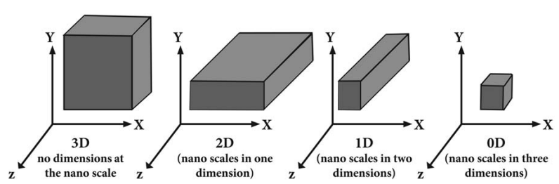
Types of nanostructured materials
Figure 1.3 Types of nanostructured materials based on number of nanoscale dimensions.

Slide 10
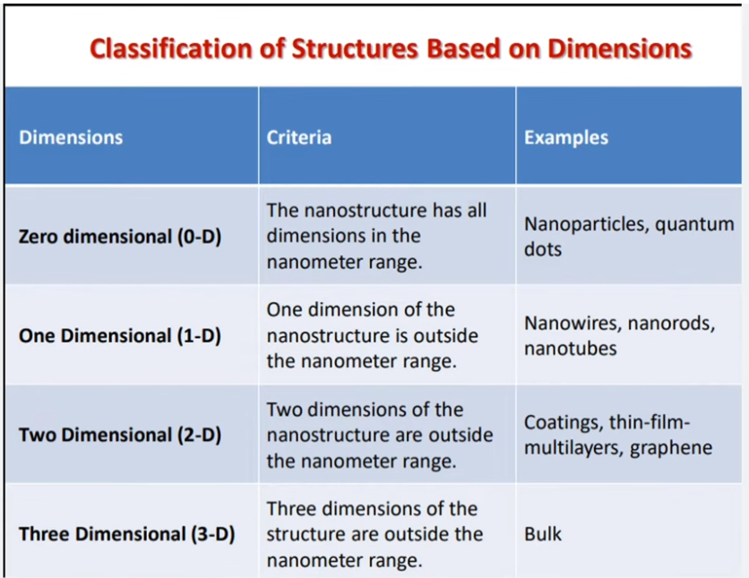
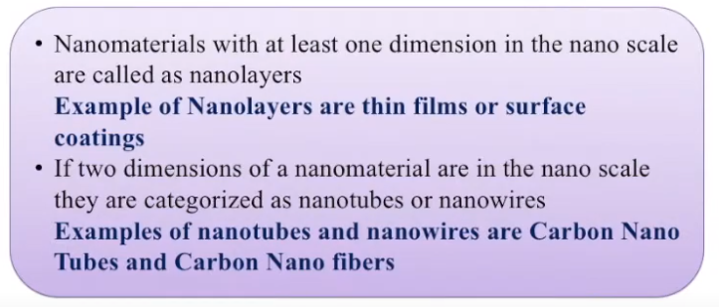
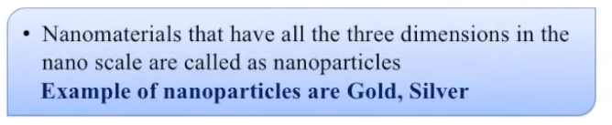

Slide 11
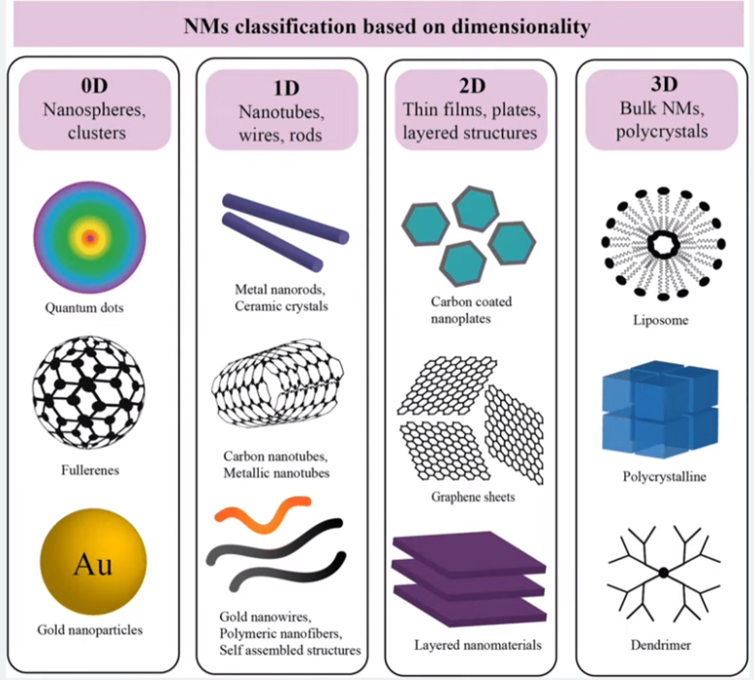
y
One dimension
is outside of nm range
Two dimensions
are outside of nm range
no dimension is in nm range
z
All dimensions are in nm range
x
x
y
z
x
z
x

Slide 12
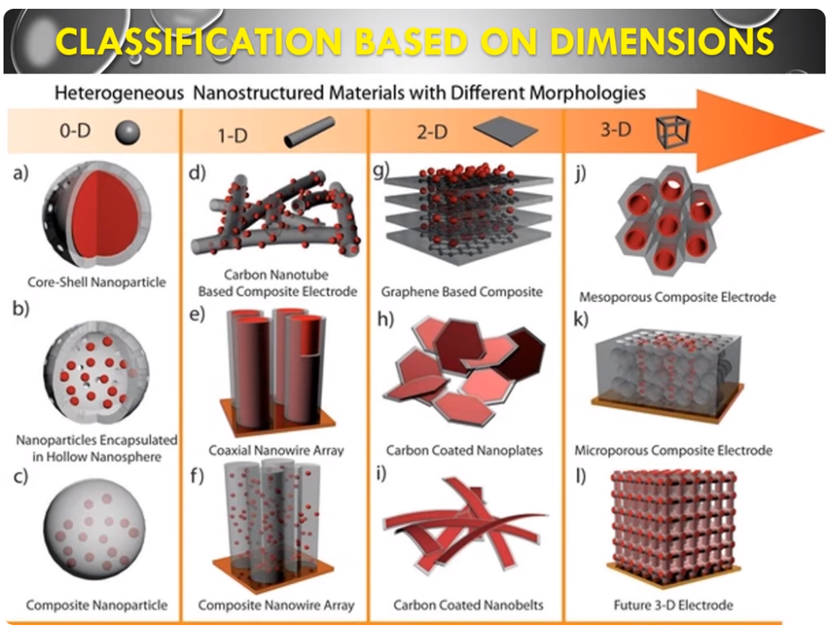

Slide 13
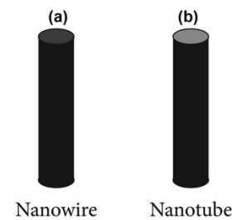
Figure 1.5 Schematic description of: 1.5a, nanowire and 1.5b, nanotube.

Slide 14
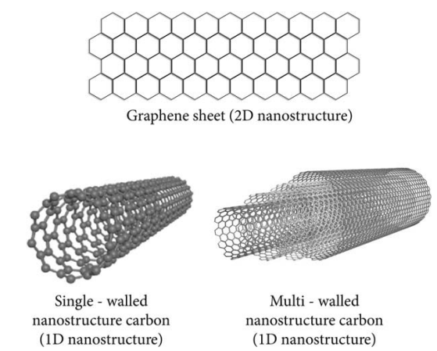
Figure 1.6 An illustration of graphene sheet structure, single-walled carbon nanotube, and multiple-walled carbon nanotube.

Slide 15
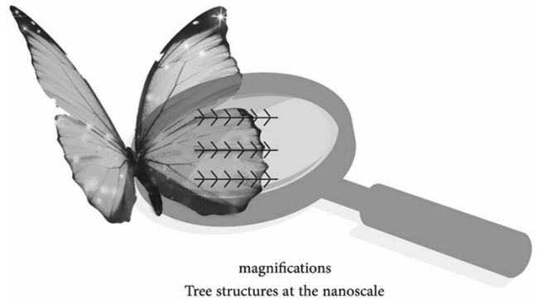
Figure 1.7 Nanostructures of Morpho butterfly wings.

Slide 16
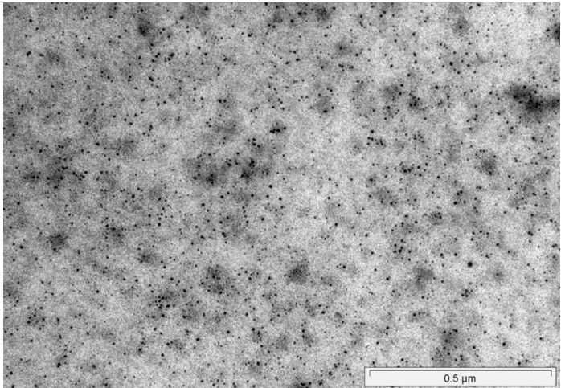
Seeing at the nanoscale
Figure 1.11 An image of magnetite (Fe3O4) nanoparticles obtained by transmission electron microscope (TEM).

Slide 17
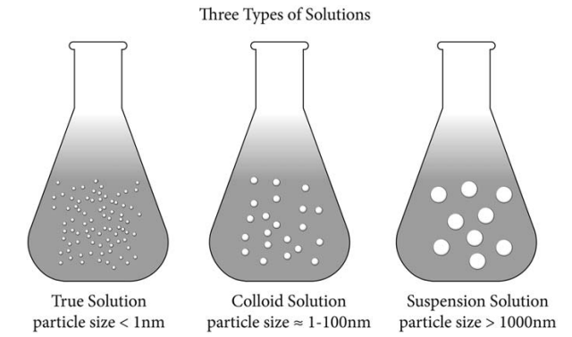
Nanoparticle behavior of colloid solution
Figure 1.13 Schematic illustration of three kinds of solutions according to solute particle size.

Slide 18
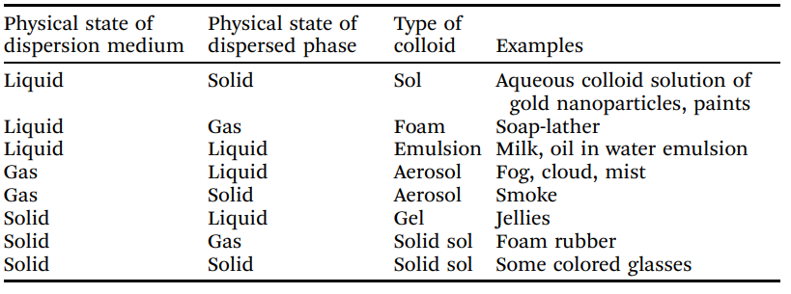
Table 1.2 Types of colloid solutions depending on the physical state of both the dispersion medium and the dispersed phase

Slide 19
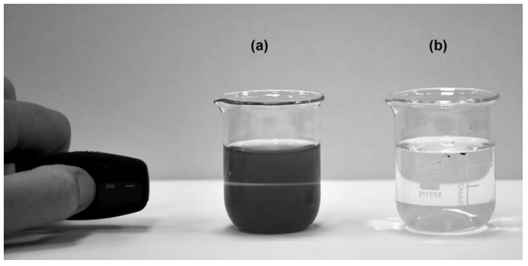
Figure 1.15 Description of the Tyndall effect: passing of laser beam through, a, colloid solution of silver nanoparticles, b, true solution of silver ions.

Slide 20
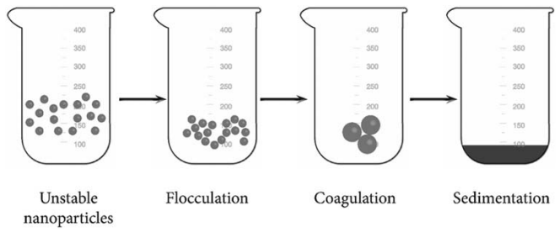
Figure 1.16 Schematic illustration of aggregation process of unstable nanoparticles.

Slide 21
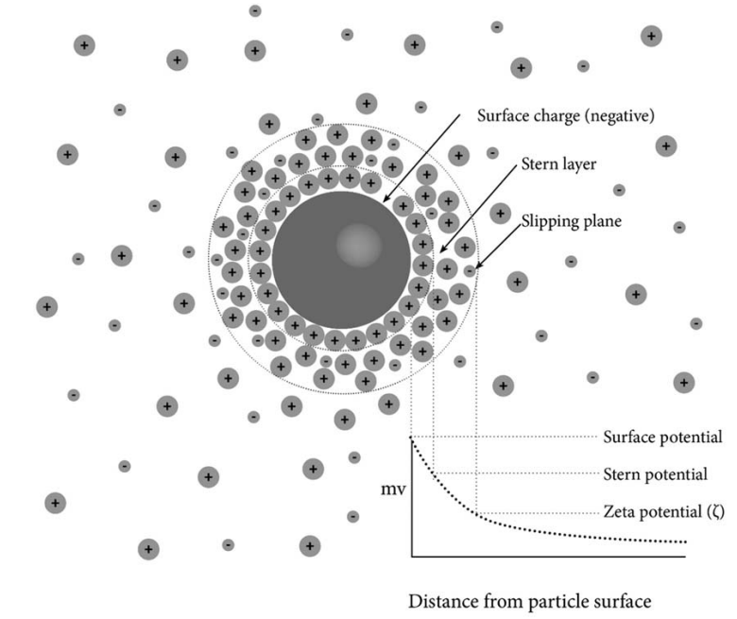
Figure 1.17 Schematic illustration of an electrical double layer of negatively charged nanoparticle. and a curve represents electrical potential as a function of distance from the nanoparticle surface.

Slide 22

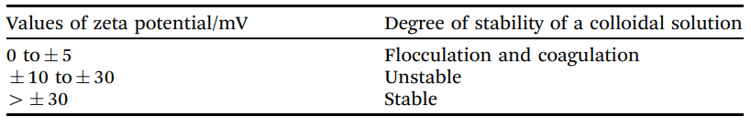
Figure 1.16 Schematic illustration of aggregation process of unstable nanoparticles.
Table 1.3 Possible values range of zeta potential and its relationship on the stability and instability of colloidal solutions.

Slide 23
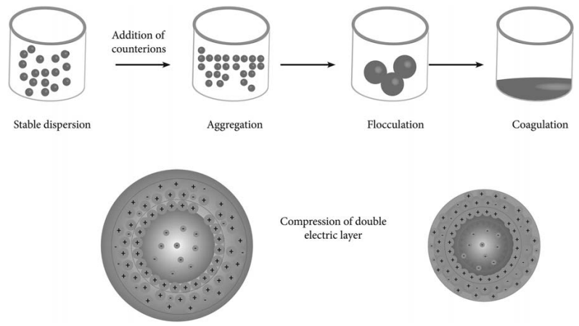
Figure 1.18 Schematic illustration of aggregation process of electrical charged nanoparticles induced by adding counterions.

Slide 24
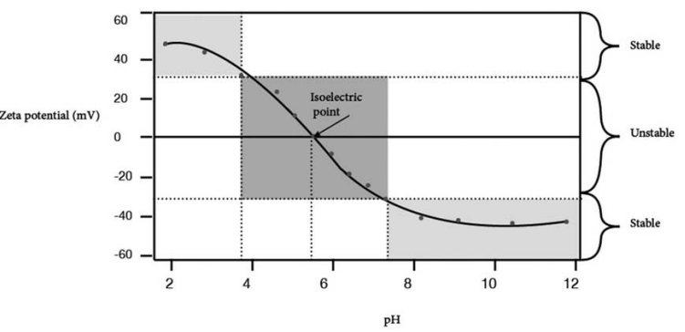
Figure 1.19 A curve represents zeta potential values versus pH.

Slide 25
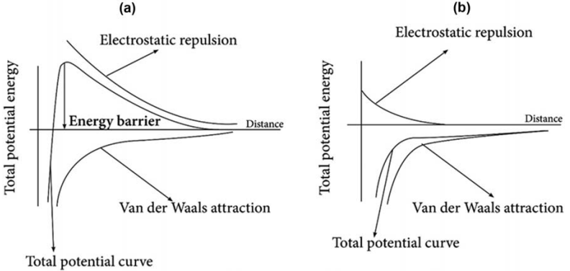
Figure 1.20 A curve that describes the total potential energy between two particles as a function of the distance between them in the case of a, a stable colloid solution, b, unstable colloid solution under aggregation process.

Slide 26
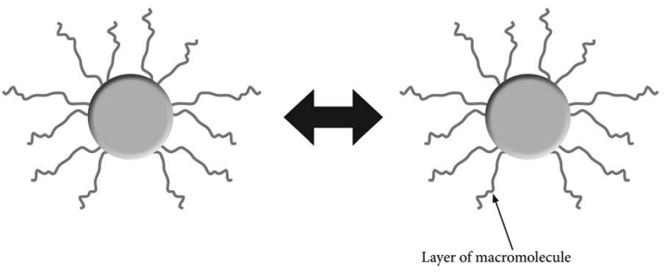
Figure 1.21 Schematic illustration of steric stabilized nanoparticles in colloid solution.

Slide 27
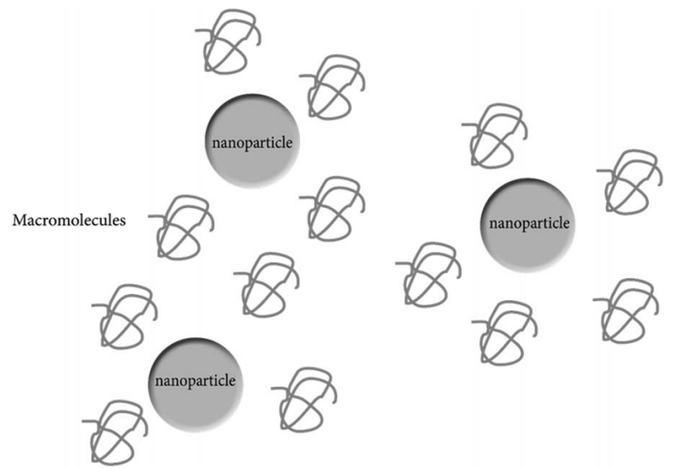
Figure 1.22 Schematic illustration of depletion stabilization of nanoparticles in colloid solution.

Slide 28
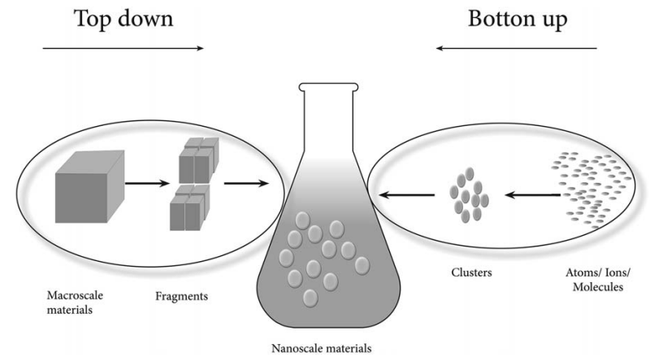
Figure 1.23 Description of bottom-up and top-down approaches for the preparation of nanomaterials.

Slide 29
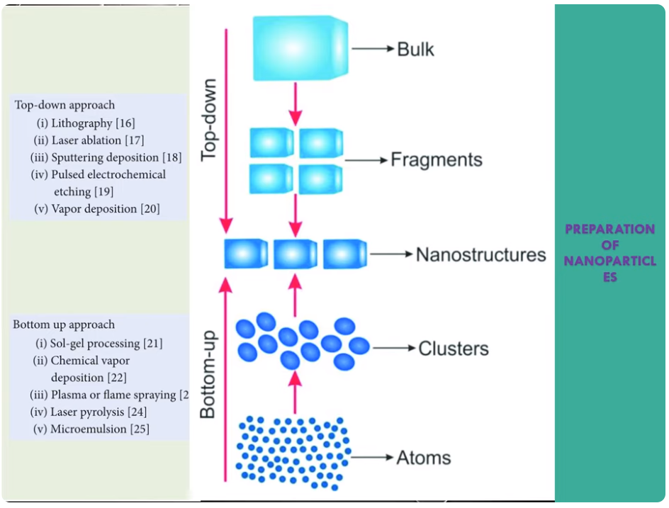

Slide 30
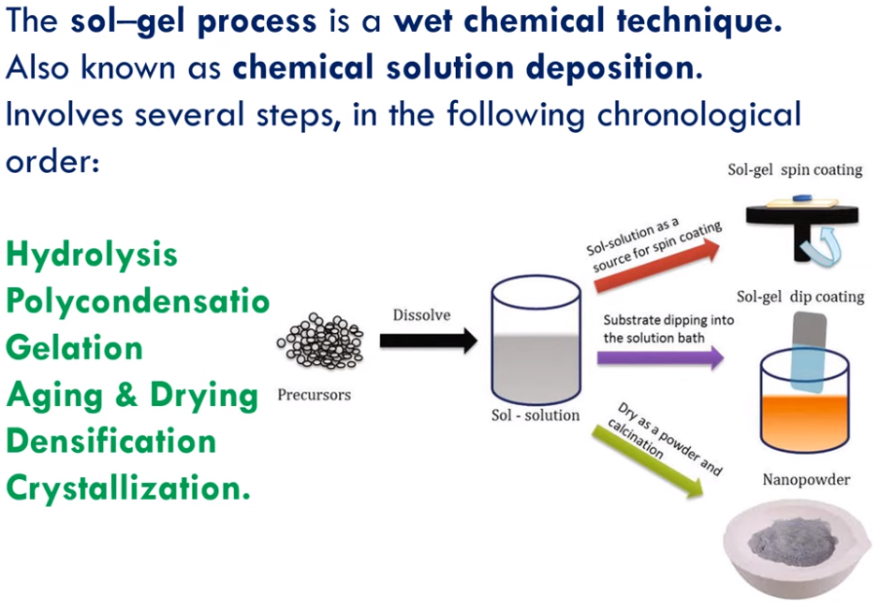

Slide 31
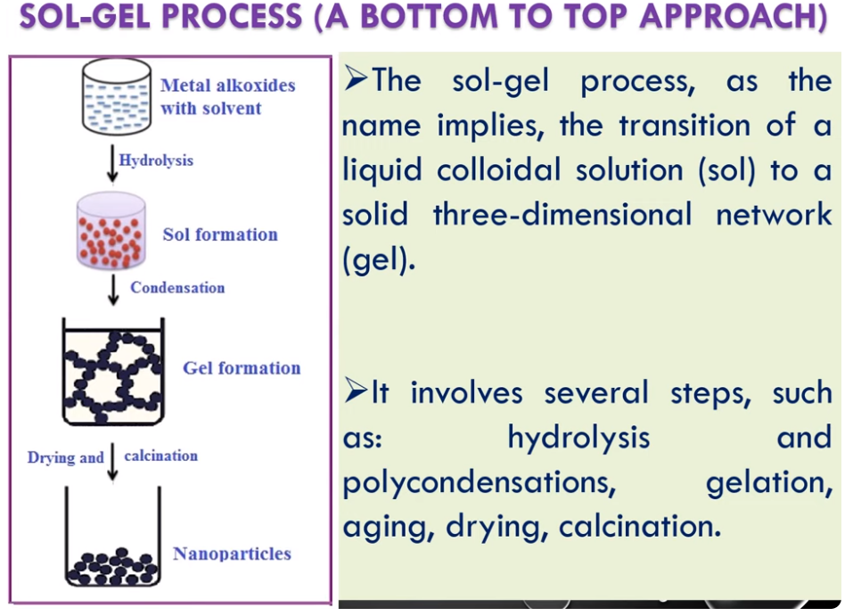

Slide 32
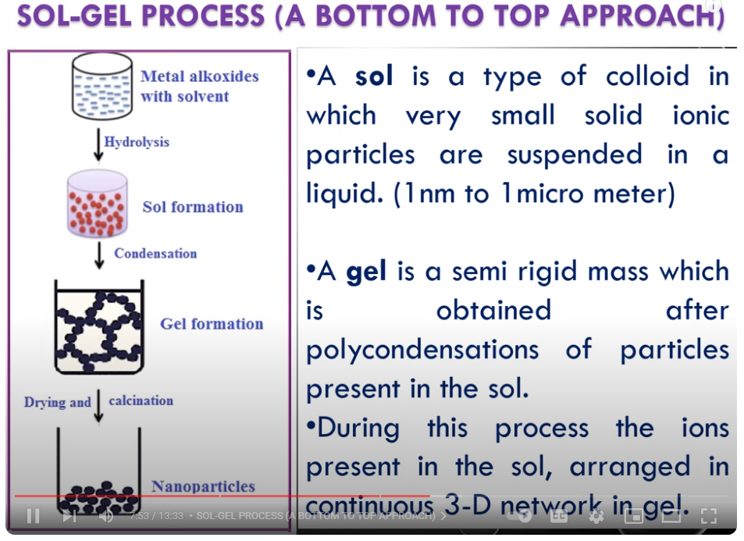

Slide 33
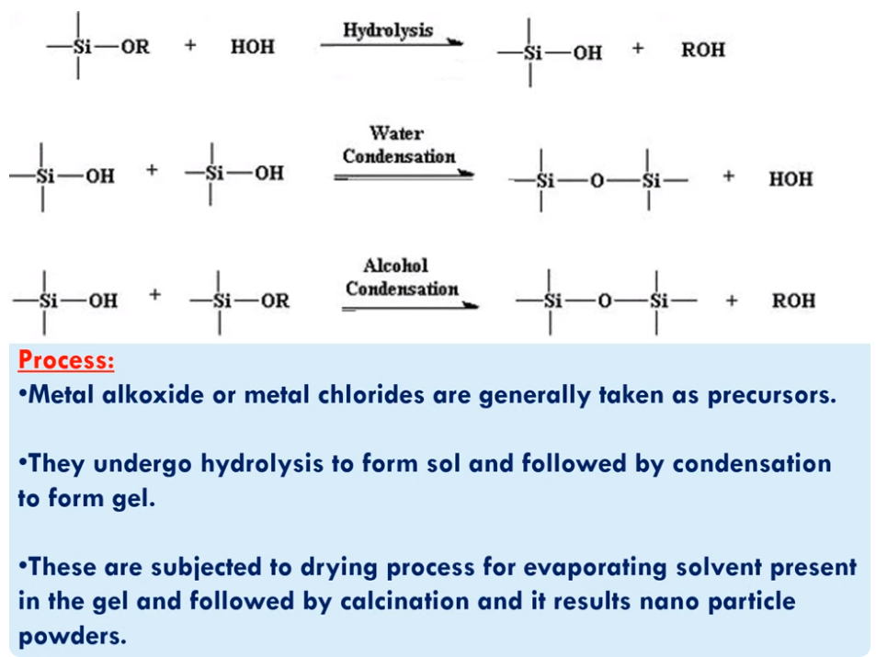

Slide 34
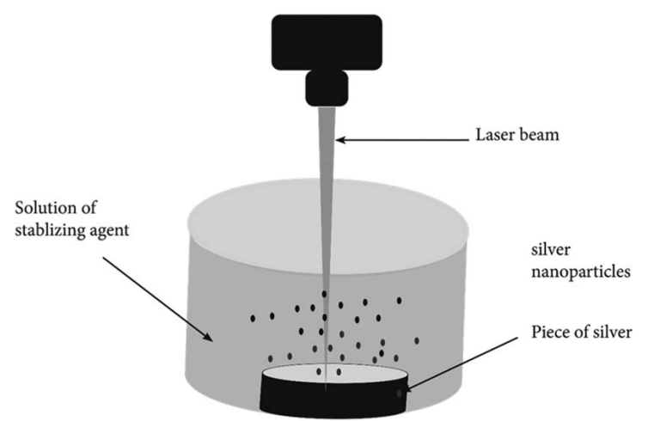
Figure 1.24 Schematic illustration of top-down laser ablation synthesis of metal nanoparticles

Slide 35
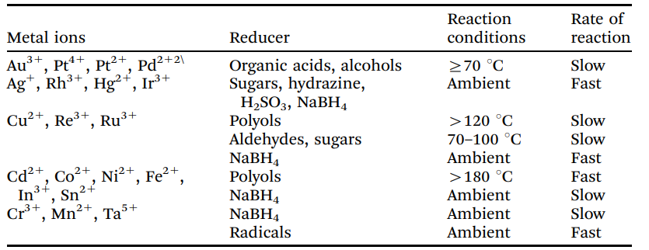
Table 1.4 Reducing agents, and reaction conditions for the reduction of various metal ions.

Slide 36
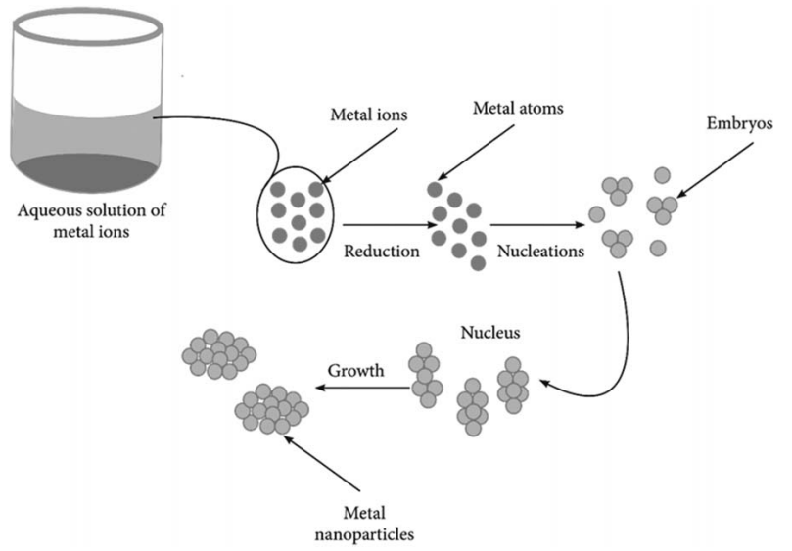
Figure 1.25 Illustration of the mechanism of producing metal nanoparticles by reduction method.

Slide 37
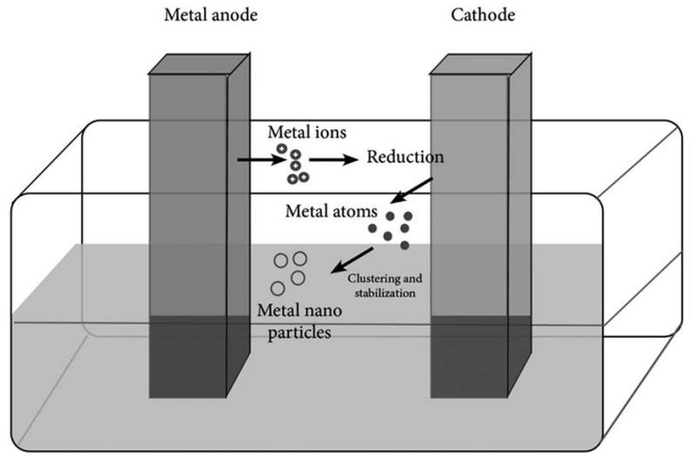
Figure 1.26 An illustration of electrochemical method for the preparation of metal nanoparticles.

Slide 38
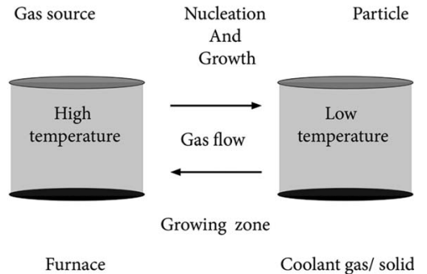
Figure 1.27 Schematic illustration of gas phase preparation of nanoparticles.

Slide 39
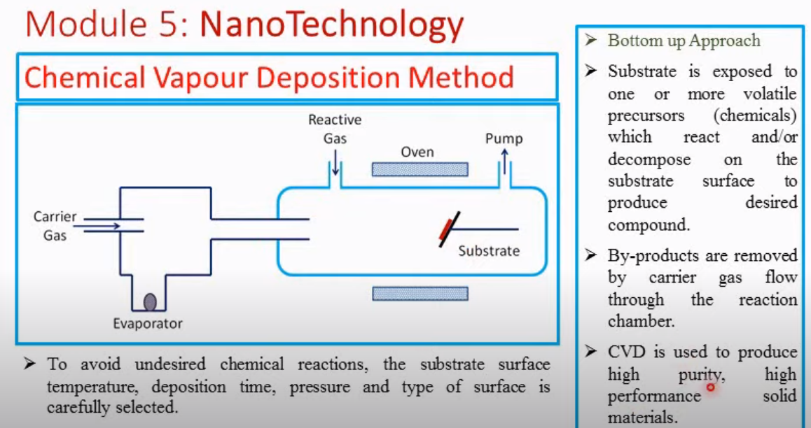
Reaction chamber
Notes:
Reactive gas is introduced in the reaction chamber and react with the substrate and decompose on the substrate (undergo chemical reaction there) to form a film of nano material. In this chemical reaction by products may be formed, which are dissolved and evacuated from the reaction chamber by a maintained carrier gas flow.

Slide 40
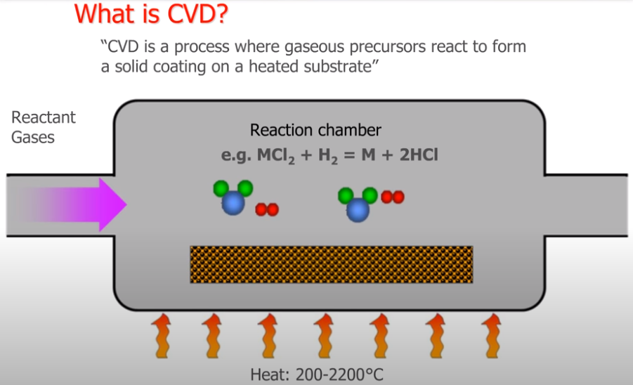
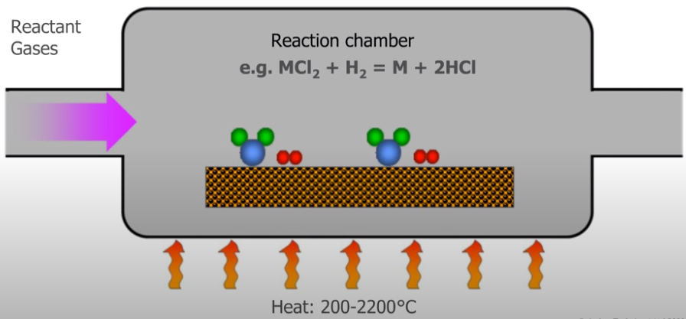
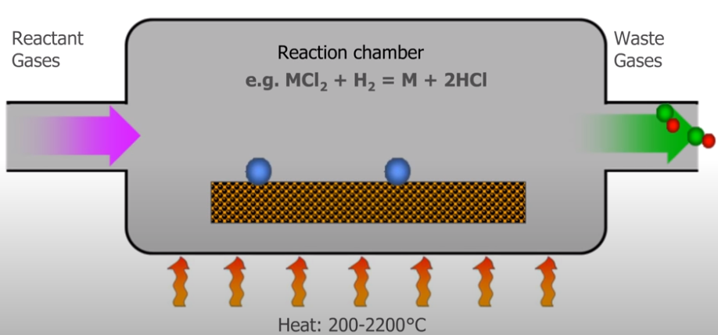
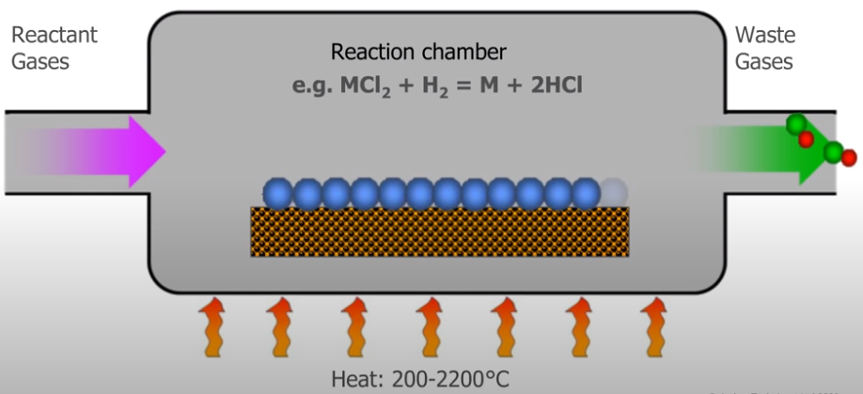

Slide 41
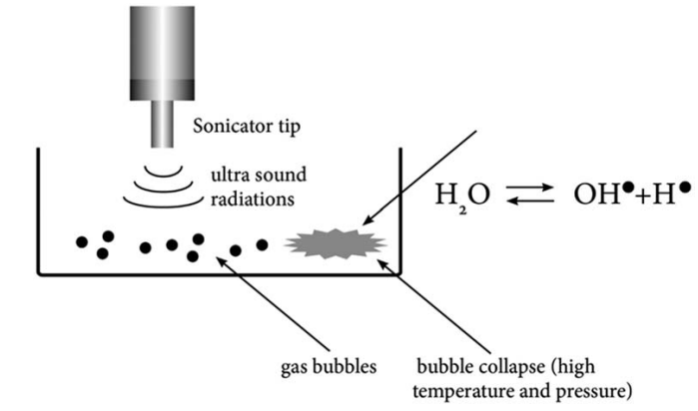
Figure 1.28 Schematic illustration of sonochemical reaction system (reactions under ultrasound irradiation).

Slide 42
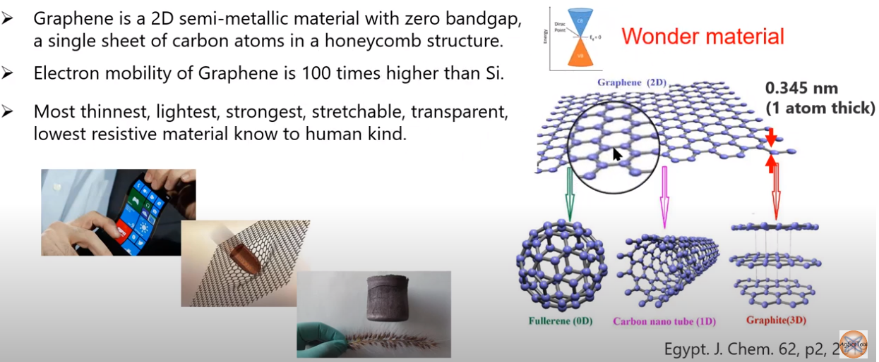
Graphene

Slide 43
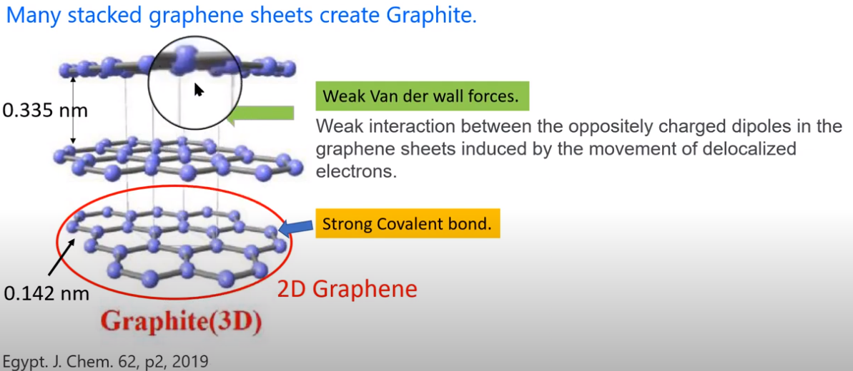
Graphene

Slide 44

Thank You.

