Slide 1


Nuclear Chemistry: Key Concepts
This presentation explores the fundamental concepts of nuclear chemistry, including radioactive elements, their properties, and the different types of nuclear reactions.

Slide 2


Radioactive Elements: Overview
1
Unstable Nuclei
2
Examples
Radioactive elements have unstable nuclei that emit radiation.
Uranium-238, Radium-226, and Thorium-232 are common examples.
3
Radioactive Decay
These elements undergo radioactive decay to form stable products.

Slide 3
Properties of Radioactive Elements
Radiation Emission
Half-Life
Hazard
Radioactive elements emit radiation in the form of alpha, beta, or gamma rays.
They have a measurable half-life, during which half of the material decays.
Radiation exposure can damage living tissues, making these elements hazardous.

Slide 4

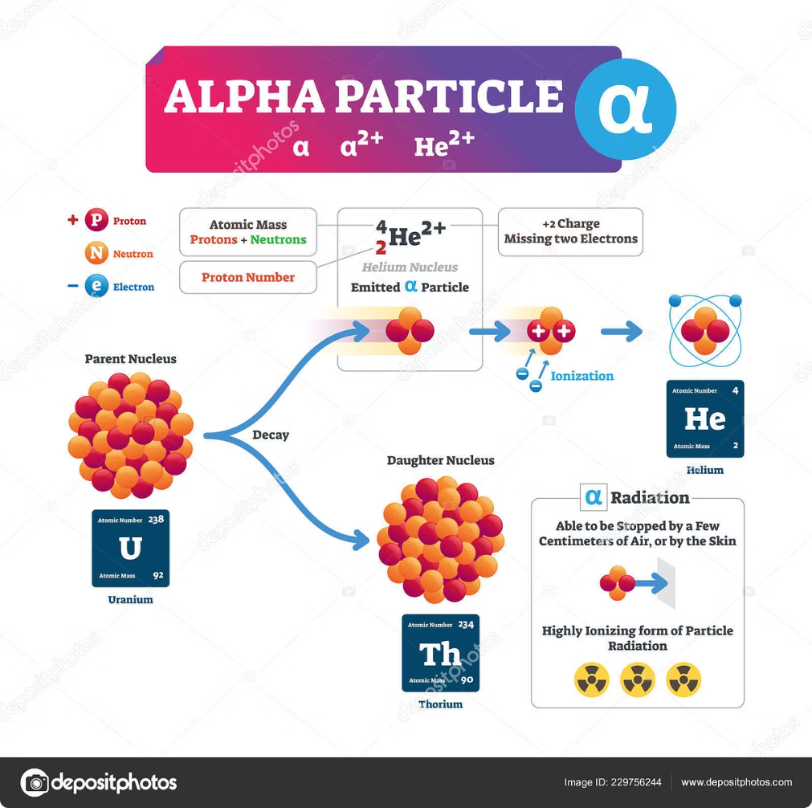
Properties of Alpha Rays
Helium Nuclei
Low Penetration
Alpha rays (α) are helium nuclei consisting of 2 protons and 2 neutrons.
They have low penetration power and can be stopped by a simple sheet of paper.
Equation Example
Uranium-238 decays into Thorium-234 and an alpha particle (He-4).

Slide 5


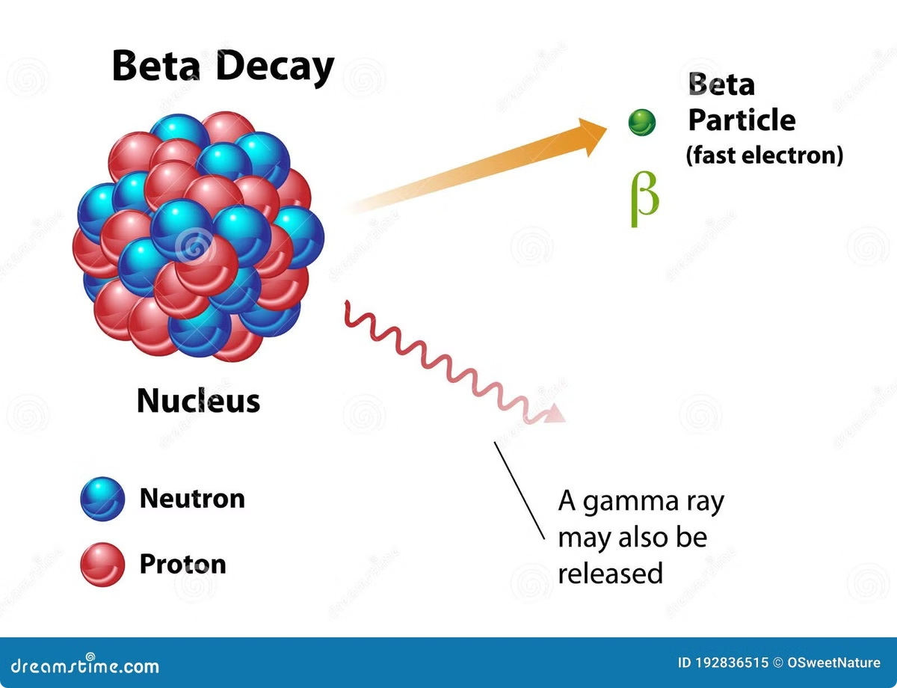


Properties of Beta Rays
High-Energy Electrons
Beta rays (β) are high-energy electrons or positrons emitted by the nucleus.
Moderate Penetration
They can penetrate skin but are stopped by aluminum.
Equation Example
Carbon-14 decays into Nitrogen-14 and a beta particle.

Slide 6


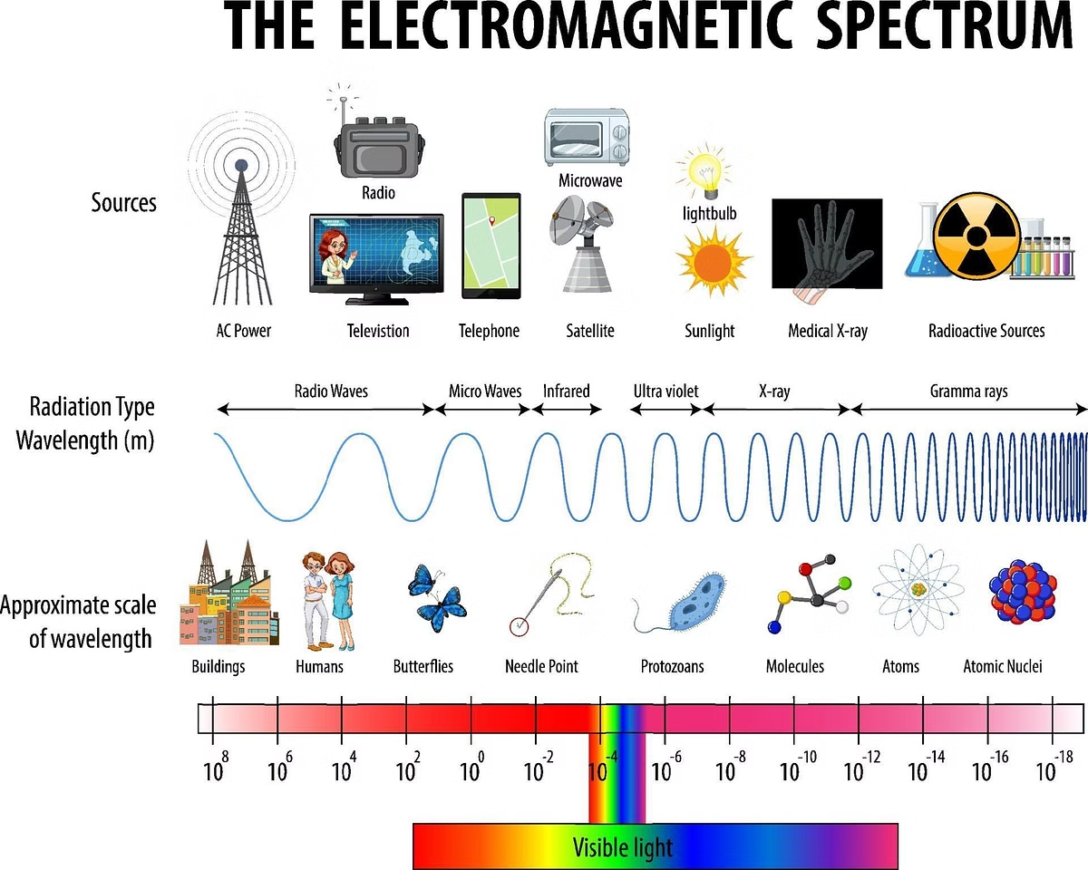


Properties of Gamma Rays
High-Energy Electromagnetic Waves
Gamma rays (γ) are high-energy electromagnetic waves.
High Penetration
They can pass through the body but are stopped by lead.
Accompanying Decay
Gamma rays usually accompany alpha or beta decay.

Slide 7

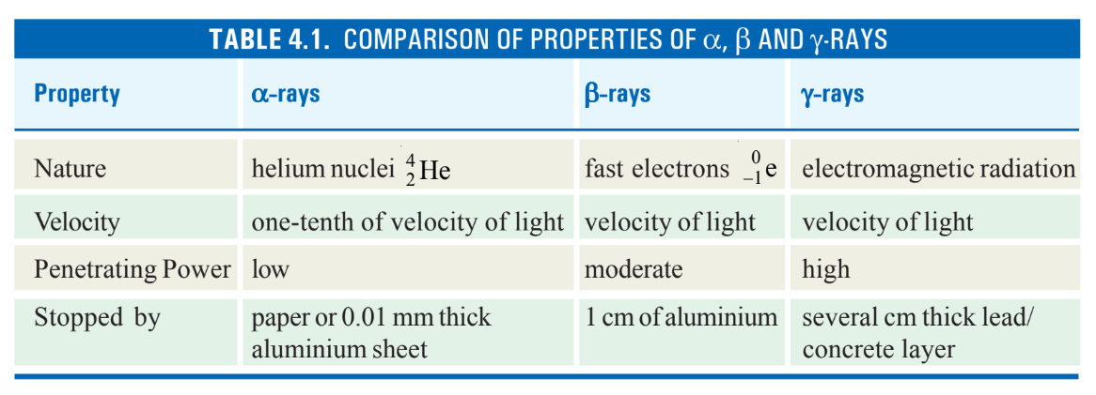
Comparison of the Three Rays

Slide 8
Types of Radioactive Decay
Alpha Decay
Loss of an alpha particle (He nucleus)
Beta Decay
Emission of a beta particle (electron or positron)

Slide 9
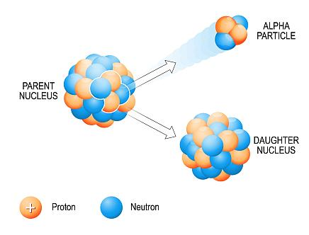
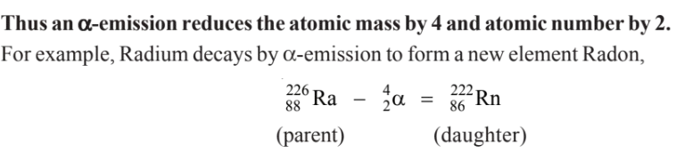
Alpha Decay
Definition
Emission of an alpha (α) particle from the nucleus.
Alpha particle: 2 protons and 2 neutrons (He nucleus).
Nuclear Changes
Atomic mass decreases by 4.
Atomic number decreases by 2.
Calculation Example:

Slide 10
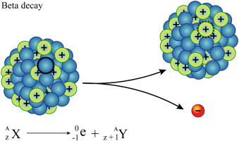
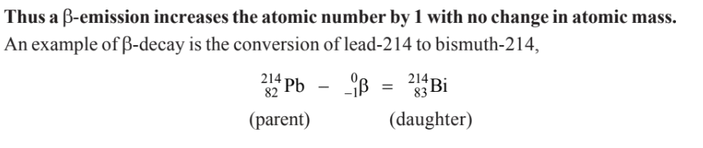
Beta Decay
Definition
Emission of a beta (β) particle occurs when a neutron converts into a proton.
Nuclear Changes
Atomic number increases by 1.
No change in atomic mass.
Calculation Example:

Slide 11
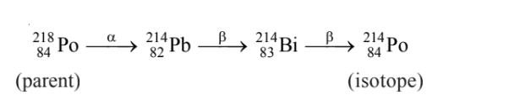
Isotope Formation (Combined α and β Emissions)
Polonium-218 undergoes one α-emission and two β-emissions:
Alpha emission reduces mass and atomic number.
Beta emissions increase atomic number.

Slide 12
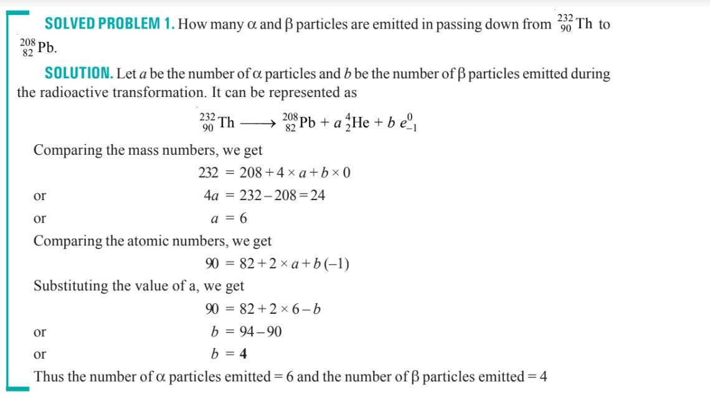

Slide 13

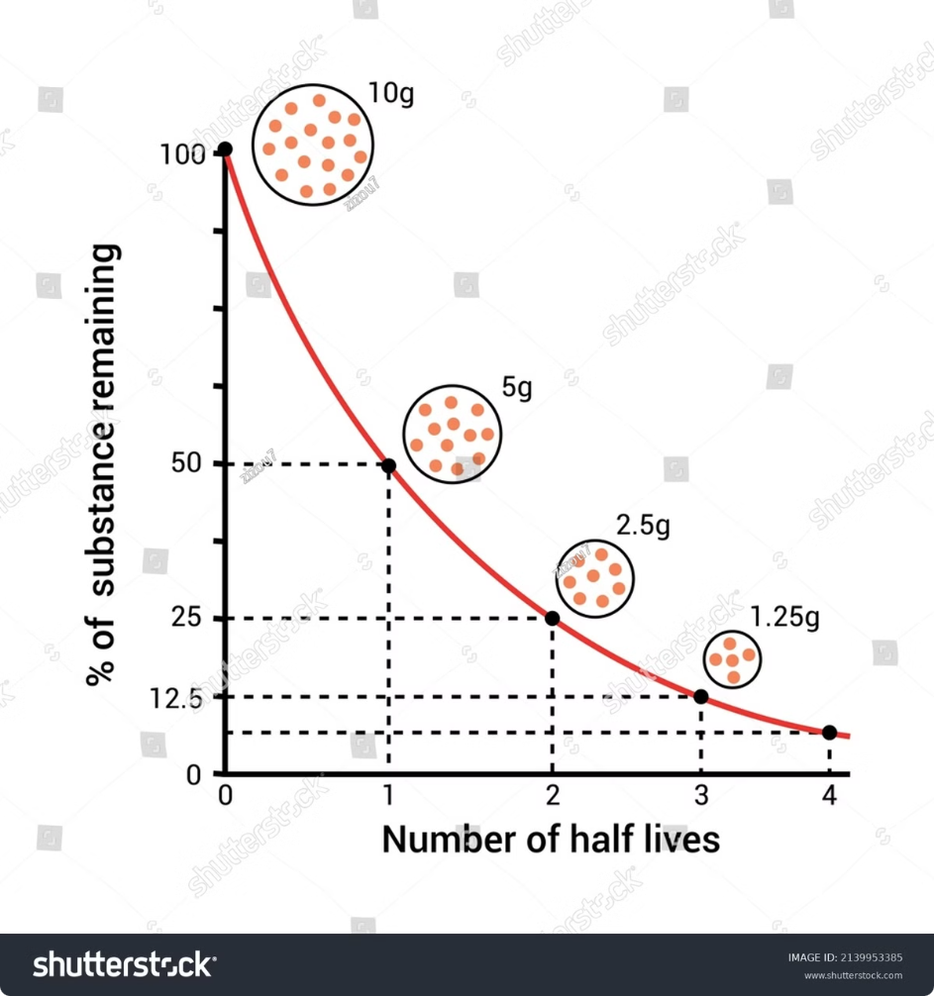
Half-Life Period Calculation
1
Half-Life Definition
2
Formula
The half-life (T1/2) is the time required for half the radioactive nuclei to decay.
T1/2 = ln(2) / λ, where λ is the decay constant.
3
Example
An isotope with a decay constant of 0.693/year has a half-life of 1 year.

Slide 14
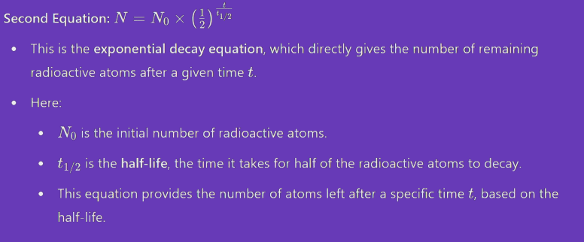
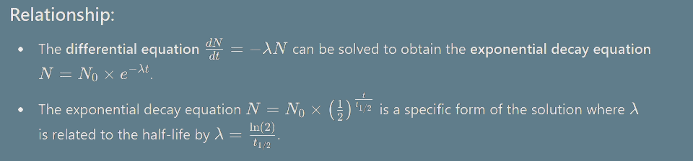
Half-Life Period Equation Relation

Slide 15
Some Example Problems
Problem-01: Calculate the disintegration constant of cobalt 60 if its half-life to produce nickel – 60 is 5.2 years.
Problem-02: The half-life period of radon is 3.825 days. Calculate the activity of radon. (atomic weight of radon = 222)
Problem-01: A sample of radioactive 133 I gave with a Geiger counter 3150 counts per
minute at a certain time and 3055 counts per unit exactly after one hour later. Calculate the half life
period of 133I.
Reference: Book-02(Pages-116-117)

Slide 16


Radioactive Dating Methods
1
Carbon-14 Dating
Used to determine the age of ancient artifacts and fossils.
2
Uranium-Lead Dating
Used to date rocks and the age of the Earth.
3
Potassium-Argon Dating
Used for volcanic rock dating.

Slide 17
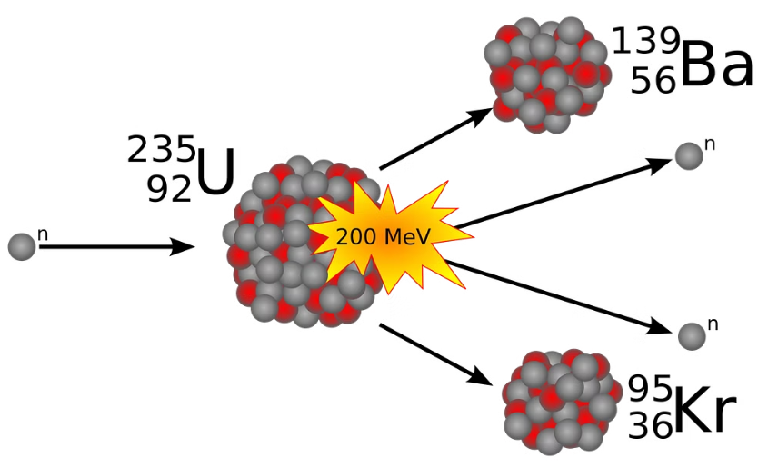
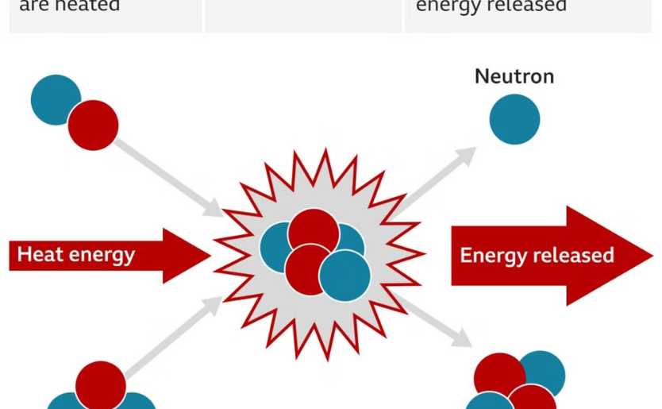
Types of Nuclear Reactions
Fission
Fusion
Splitting of a heavy nucleus into two lighter nuclei, releasing energy.
Combination of two light nuclei to form a heavier nucleus, releasing energy.

Slide 18
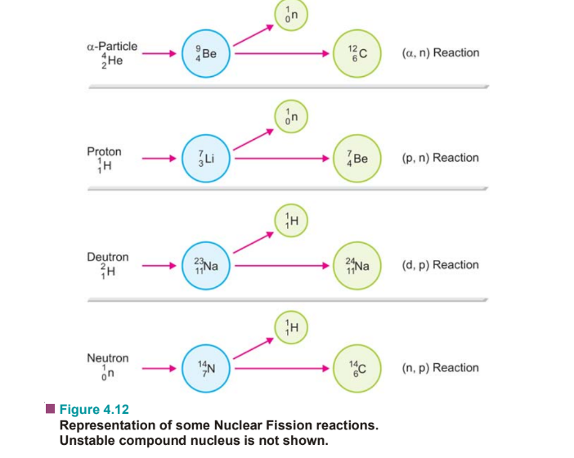
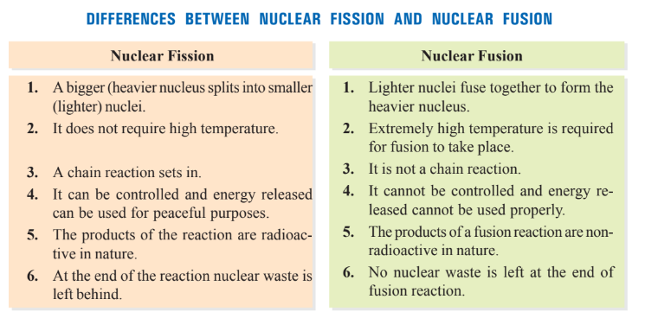
Mechanism of Nuclear Fission Reactions and Differences between two

Slide 19
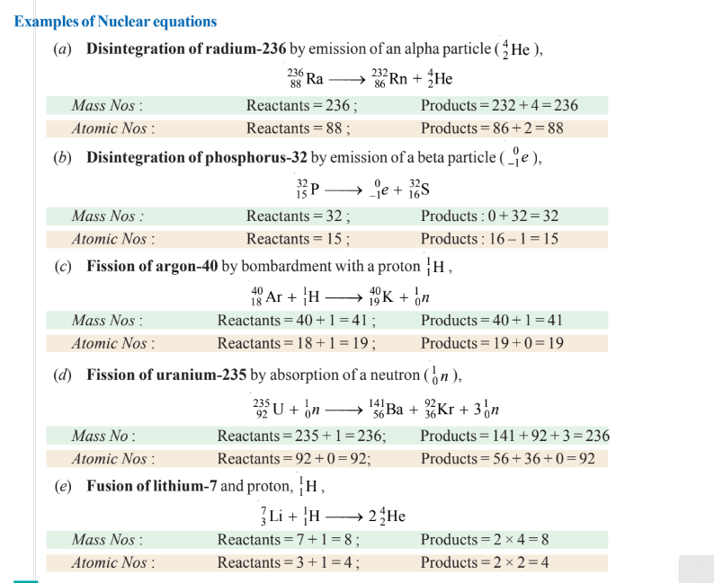
Example of Nuclear Equations

Slide 20


