Slide 1
Oxidation and Reduction

Slide 2
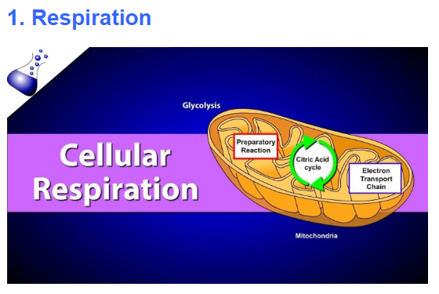
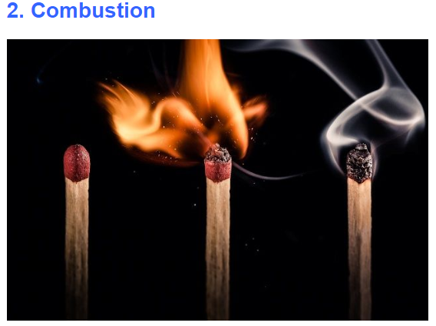

Food that we consume is converted into energy by redox reactions only
During the process of respiration, the carbon-dioxide is reduced whereas the water is oxidized to form oxygen
Combustion of octane (H-C), a component of gasoline,
occurs in the engine of most cars
The oxygen present in the atmosphere bonds with carbon and hydrogen present in the compound being burned.
The oxygen-reduced, the compound-oxidized

Slide 3
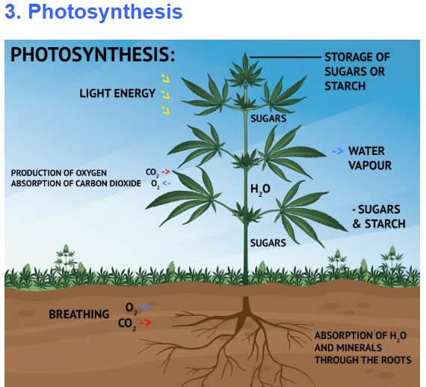
The process of photosynthesis takes place in the leaves of the plants.
Carbon dioxide and water combine in the presence of sunlight to release oxygen and glucose.
The glucose which is formed in the whole process of photosynthesis is used to fuel the metabolic reactions of the plants.
In photosynthesis, water is oxidised and carbon dioxide is reduced.

Slide 4

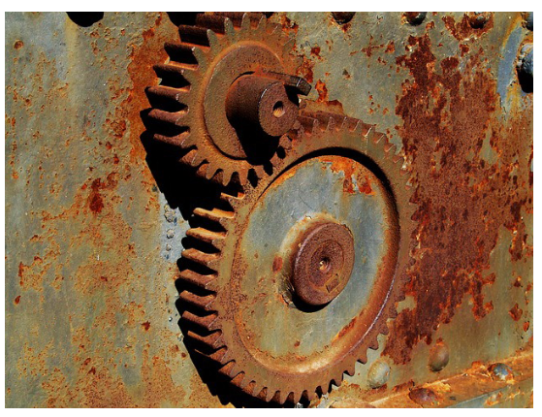



On contact with a metal, say, an iron door, some of the oxygen atoms present in water oxidize iron and, thereby, lead to the generation of free hydrogen ions. The hydrogen ions generated combine with oxygen to yield water, and the whole cycle begins once again.
Hydrogen peroxide, the most commonly used antiseptic.
It oxidizes necrotic matter and bacteria and helps in removal as well as the loosening of the slough, ear wax, etc by the liberation of oxygen in the presence of water.
Oxygen has been both oxidized and reduced in the reaction

Slide 5

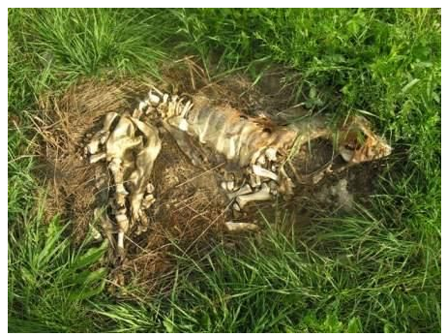

The living matter in nature, primarily, is made up of carbon, hydrogen, and oxygen.
Upon the death of any living organism, the organic compounds present in the organism start reacting with oxygen.
This prolonged process commonly referred to as “decay” or “decomposition”
Fireworks
The compounds chosen for fireworks emit radiation in the visible spectrum. The wavelength of light emitted differs from chemical to chemical. Our eyes detect the various wavelengths and perceive them as color.
Examples of incandescence
Red lava flowing down a volcano
Red burners on an electric stove

Slide 6
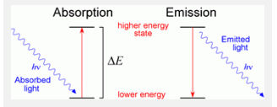
Fireworks use an exothermic, redox reaction (the transfer of electrons). Firework fuel is known as “black powder” since its main ingredient is charcoal. Black powder is a mixture of charcoal, sulfur, metal powder, oxidizers, binders, and coloring agents.
The metal in the black powder donates electrons to an oxidizing agent [chlorate (-ClO3)], which releases oxygen gas. When chlorates burn, they release enough heat to reach temperatures between 1700-2000°C and high temperatures create more intense colors.
2KClO3 + metal ——> 2KCl + 3O2 (g)
The oxygen gas produced reacts with a reducing agent (electron donor), either carbon or sulfur and then the reaction rapidly releases heat and expanding carbon dioxide and sulfur dioxide gas resulting in an explosion.
O2 (g) + S ——> SO2 (g)
O2 (g) + C ——> CO2 (g)
Examples of Coloring Agents
Sodium — Yellow
Copper — Blue
Strontium — Red
Calcium — Orange
Barium — Green
The beautiful colors we see are the result of atomic and molecular emission and incandescence. The coloring agents absorb the energy generated by the above reaction. Electrons in the coloring agents are promoted to higher energy or excited states. However, these high energy states are unstable, so the absorbed energy is released in the form of light. This is atomic and molecular emission. Incandescence occurs when an extremely hot compound releases radiation.

Slide 7
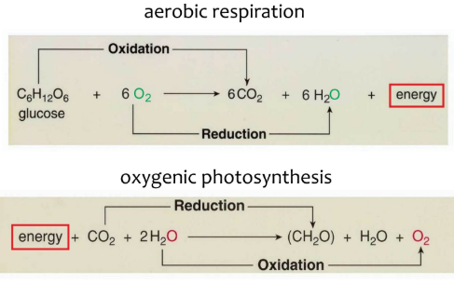
Redox reaction
An oxidation-reduction (redox) reaction is a type of chemical reaction that involves a transfer of electrons between two species
Redox reactions are common and vital to some of the basic functions of life, including photosynthesis, respiration, combustion, and corrosion or rusting.

Slide 8
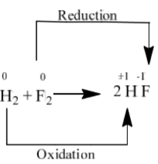
Oxidation
Oxidation occurs when a reactant loses electrons during the reaction.
Oxidation is the loss of electrons or an increase in oxidation state by a molecule, atom, or ion.
Reduction
Reduction occurs when a reactant gains electrons during the reaction.
Reduction is the gain of electrons or a decrease in oxidation state by a molecule, atom, or ion.
It occurs when metals are reacted with acid.
Oxidation (loss of electrons):
H₂ (Reducing agent) ─ 2e─ → 2H⁺
Reduction (gain of electrons):
F₂ (Oxidizing agent) + 2e─ → 2F─

Slide 9
Oxidation Number
The oxidation number of an element indicates the number of electrons lost, gained, or shared as a result of chemical bonding.
Rules for Assigning Oxidation States
The oxidation state of an individual atom is 0.
The total oxidation state of all atoms in a neutral species is 0 and in an ion is equal to the ion charge.
3. Group 1 metals have an oxidation state of +1 and Group 2 an oxidation state of +2.
4. The oxidation state of fluorine is -1 in compounds.
5. Hydrogen generally has an oxidation state of +1 in compounds.
6. Oxygen generally has an oxidation state of -2 in compounds

Slide 10
Determine the Oxidation States of each element in the following reactions: 1) Fe(s) +O₂(g) → Fe₂O₃(g)
2) Ag(s) +H₂S → Ag₂S(g) +H₂(g)
Solutions
1) Fe and O2 are free elements; therefore, they each have an oxidation state of 0 according to Rule 1. The product has a total oxidation state equal to 0, and following Rule 2, O has an oxidation state of -2, which means Fe has an oxidation state of +3.
2) Ag has an oxidation state of 0, H has an oxidation state of +1 according to Rule 5, S has an oxidation state of -2 and hence Ag in Ag2S has an oxidation state of +1.

Slide 11
Determine the Oxidation State of the bold element in each of the following:
1) Na₃PO₃ 2) H₂PO₄⁻
Solutions:
The O.N. of Na and O are +1 and -2.
Because sodium phosphite is neutral,
the sum of the O.N. must be zero.
Letting x be the O.N of phosphorus,
0= 3(+1) + x + 3(-2).
x = oxidation number of P = +3.
Solutions
H and O have O.N. of +1 and -2.
The ion has a charge of -1,
so the sum of the O.N. must be -1.
Letting y be the O.N. of phosphorus, -1= y + 2(+1) +4(-2),
y = oxidation number of P = +5.

Slide 12
Determine the oxidation number (O.N.) of the bold element in the following compounds:
1) KMnO₄
2) K₂Cr₂O₇
3) [Cr(CN)₆]³⁻
Solution:
Let us consider, the Oxidation Number of Mn in the KMnO₄ = x. Then, (+1) + x + (-2) × 4 = 0.
Or, x +1− 8 = 0.
Or, x = +7
B. Let us consider, the Oxidation Number of Cr in K₂Cr₂O₇ = x
Then, 2 (+1) + 2x + 7(− 2) = 0.
Or, + 2 + 2x – 14 = 0.
Or, 2x – 12 = 0.
Or, x = +6 C.
C. Let us consider, the Oxidation Number of Cr in [Cr (CN)₆]³⁻ = x
Then, x + 6 (− 1) = − 3.
Or, x = +3

Slide 13
Determine which element is oxidized and which element is reduced in the following reactions (be sure to include the oxidation state of each):
Zn + 2H⁺ → Zn²⁺ + H₂
2Al + 3Cu²⁺ → 2Al³⁺ + 3Cu
CO₃²⁻ + 2H⁺ → CO₂ + H₂O
Solutions
1) Zn is oxidized (Oxidation number: 0 → +2);
H⁺ is reduced (Oxidation number: +1 → 0)
2) Al is oxidized (Oxidation number: 0 → +3);
Cu²⁺ is reduced (+2 → 0)
3) This is not a redox reaction because each element has the same oxidation
number in both reactants and products: O = -2, H = +1, C = +4.

Slide 14
Balancing Redox Equations
Two methods can be used:
Oxidation number method
Half-reaction method
Example 1: Use the oxidation number method to balance the following equation:
Cu_{(s)} + HNO_{3(aq)} → Cu (NO₃)_{2(aq)} + NO_{(g)} + H₂O_{(l)}
Copper (Cu) reacts with nitric acid (HNO3) to produce copper (II) nitrate [Cu(NO3)2], nitric oxide [NO] and water

Slide 15
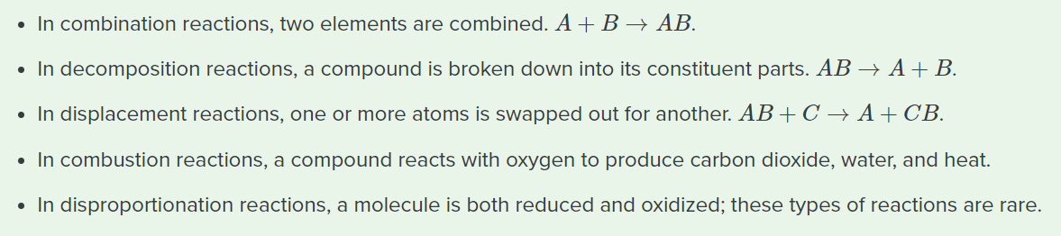




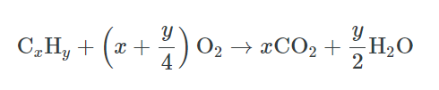

Types of Redox Reactions
Combination
Decomposition
Displacement
Combustion
Disproportionation

Slide 16
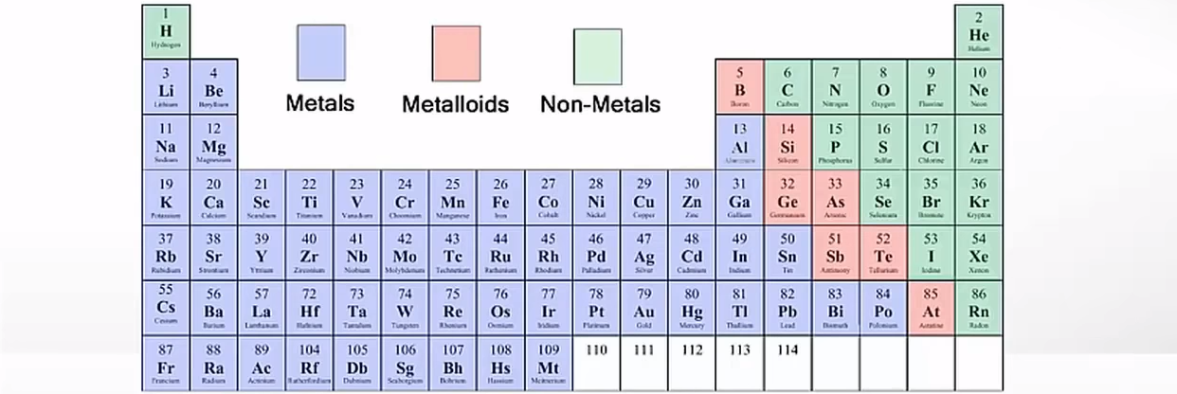
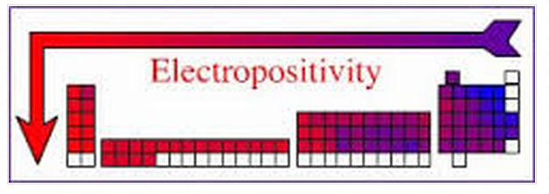
Metals, Metalloids and Non-metals
The electropositivity of an element is dependent on several factors such as the metallic character of the element, the distance between the nucleus and the valence shell, the effective nuclear charge acting on the valence electrons, and the ionization energy of the element.

Slide 17
How can we know which atom is electropositive or electronegative?
Electronegativity is a chemical property that describes the tendency of an atom or a functional group to attract electrons (or electron density) towards itself. An atom's electronegativity is affected by both its atomic number and the distance that its valence electrons reside from the charged nucleus. As the effective nuclear charge acting on the valence shell electrons increases across a period, the tendency to lose electrons will decrease. Hence, non-metals tend to form bonds by gaining electrons and are electronegative in nature.
Electropositivity is a measure of an element's ability to donate electrons, and therefore it gives rise to positive ions; the greater the metallic character of an element, the greater the electropositivity. Down the group, the effective nuclear charge experienced by valence electrons is decreasing because the outermost electrons are farther away from the nucleus. Therefore, these can be lost easily. Hence electropositive character increases down a group.
If an atom has 1-3 valence electrons in its outermost shell, then it is easier for the atom to lose it and attain the stable octet configuration of the closest noble gas. For ex: Mg with atomic number = 12 has E.C = 2,8,2 so it has 2 valence electrons and hence can easily lose them to gain the noble gas configuration of Neon (2,8). So, it is electropositive in nature.
If an atom has 5-7 valence electrons in its outermost shell, then it becomes difficult for the atom to lose this number of electrons and it rather gains electrons to attain the stable octet configuration. For ex: Cl with atomic number = 17 has E.C = 2,8,7 so it is easier for Chlorine to gain one electron instead of losing 7 valence electrons. So, it gains one electron to attain the noble gas configuration of Ar (2,8,8).

Slide 18
0
+1
-1
+1
-1
0
Br: oxidation
Cl: reduction
+3
-2
+1
-1
+3
-1
+1
-2
Non-redox
O: oxidation
+1
-1
+1
-2
0
O: reduction

