Slide 1
Skill-up station::
Career Advancement
In the 21st century
Facilitator:
Nazmus Sakib,
Lecturer, Department of English,
TAF Coach, Trainer,
Daffodil International University
Sakib.eng@diu.edu.bd

Slide 2
Skill-goals for today-
SWOT Analysis
SMART Goals
Understanding relevant 21st century skills
Creating a CV with precise intent

Slide 3
Career vs. Job?

Slide 4
Skill 1: SWOT analysis

Slide 5
Weaknesses stop an organization from performing at its optimum level. They are areas where the business needs to improve to remain competitive: a weak brand, higher-than-average turnover, high levels of debt, an inadequate supply chain, or lack of capital.
Strength
Weakness
Opportunities
Threats
Strengths describe what an organization excels at and what separates it from the competition: a strong brand, loyal customer base, a strong balance sheet, unique technology, and so on.
Opportunities refer to favorable external factors that could give an organization a competitive advantage. For example, if a country cuts tariffs, a car manufacturer can export its cars into a new market, increasing sales and market share.
Threats refer to factors that have the potential to harm an organization.
1
2
3
4

Slide 6
Skill 2: SMART goals

Slide 7
I want to increase my typing speed.
1. 1 I would like to increase my typing speed from 50 words per minute to 65 words per minute, and I can measure my progress by taking timed tests that show the increase in my typing speed.”
1.2 ^
Specific
Measurable
Achievable
Relevant
1.3 ^
Time-bound
1.4 I will increase my typing speed of 50 words per minute to 65 words per minute within three months. I will set aside 15 minutes each day to practice at speed and take timed tests weekly to measure my progress.

Slide 8
Skill 3: Understanding relevant 21st century skills

Slide 9
Learning skills
Critical thinking: Finding solutions to problems
Creativity: Thinking outside the box
Collaboration: Working with others
Communication: Talking to others

Slide 10
2. Literacy Skills
Information literacy: Understanding facts, figures, statistics, and data
Media literacy: Understanding the methods and outlets in which information is published
Technology literacy: Understanding the machines that make the Information Age possible

Slide 11
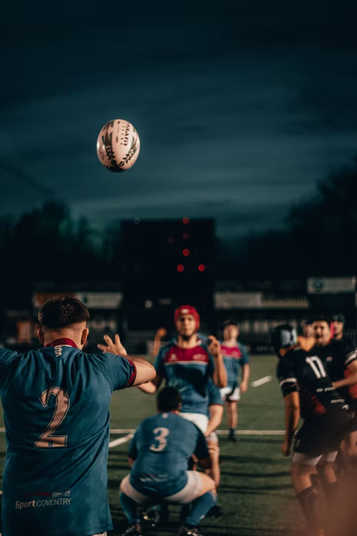
3. Life Skills
Flexibility: Deviating from plans as needed
Leadership: Motivating a team to accomplish a goal
Initiative: Starting projects, strategies, and plans on one’s own
Productivity: Maintaining efficiency in an age of distractions
Social skills: Meeting and networking with others for mutual benefit

Slide 12
Skill 4: Creating a CV with precise intent

Slide 13
Case study
Link

Slide 14
Questions?

Slide 15
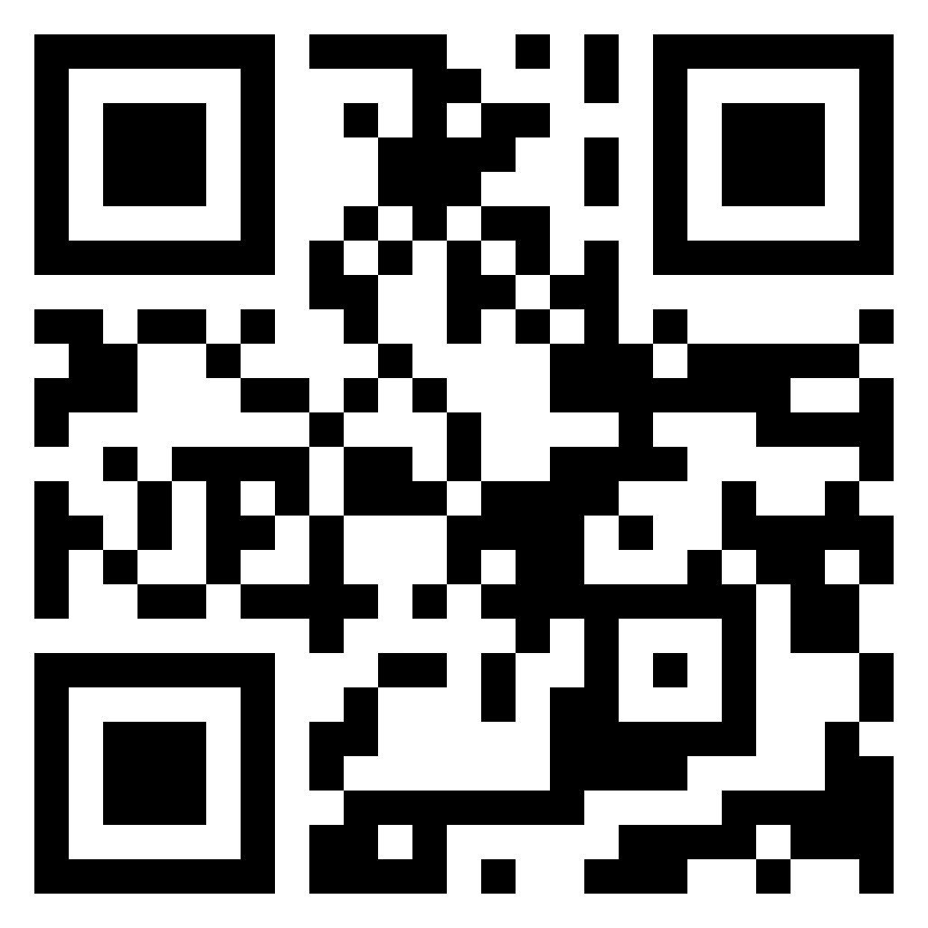
Feedback
Link: https://padlet.com/sakibtaf/sessions
Thank you for listening!

