Slide 1

Waste Cooking Oil Collection & Management
Ensuring High-Quality Biodiesel Production
Dr. Thamina Acter

Slide 2
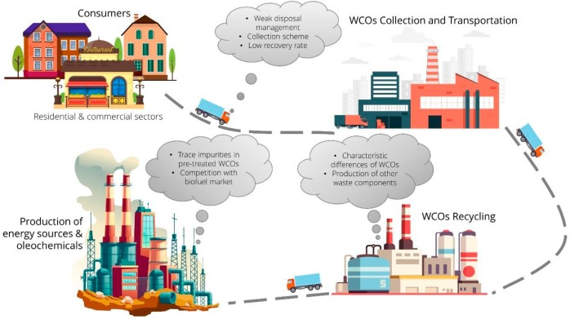
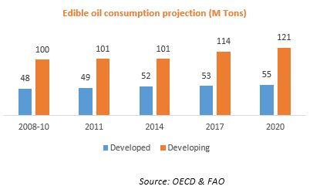
Introduction
Rising consumption of vegetable oils.
Improper disposal of waste cooking oils (WCOs) leads to environmental pollution.
WCO as a potential feedstock for biodiesel production.
Need for a structured WCO collection system.

Slide 3
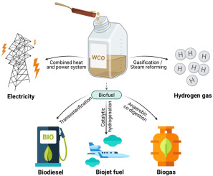


Why Focus on Waste Cooking Oil?
Environmental Impact: Dumping WCO clogs drainage systems and pollutes water.
Economic Potential: WCO can be converted into biodiesel, reducing dependence on fossil fuels.
Health Concerns: Reuse of degraded WCO for cooking is harmful.

Slide 4
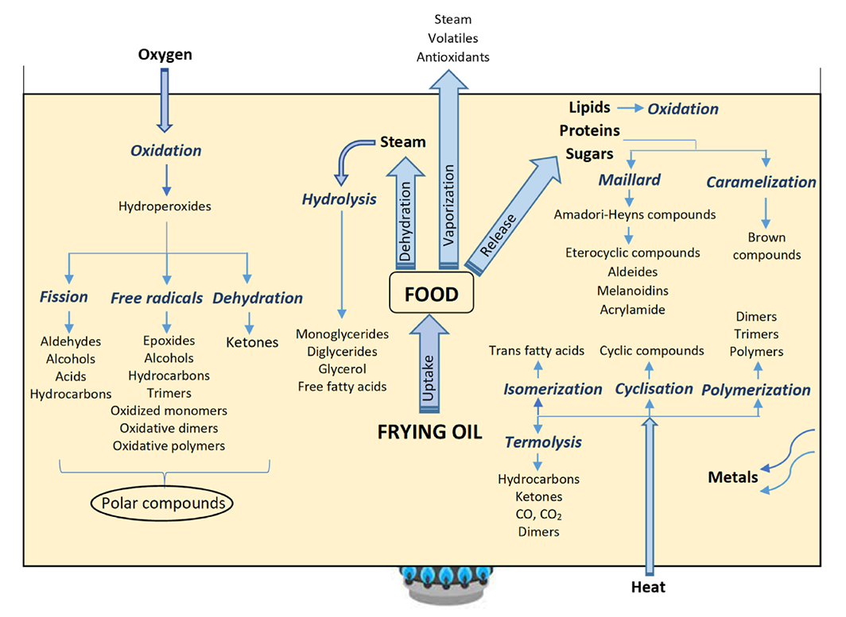
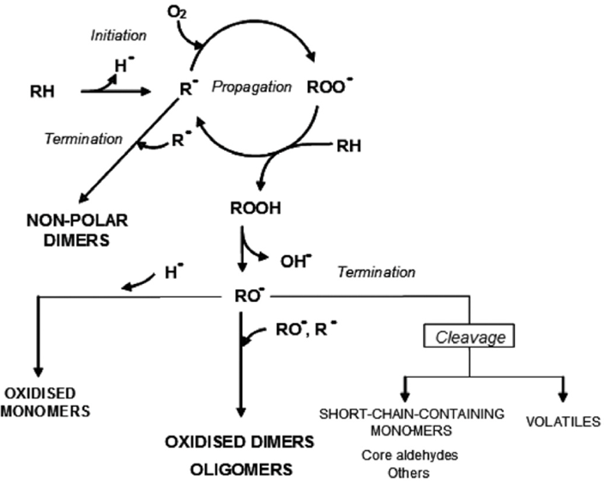
Physico-Chemical Changes in Frying Oil
Degradation Reactions: Hydrolysis, oxidation, and polymerization.
Factors Affecting Degradation: High temperature, repeated use, exposure to air.
Impact on WCO Quality: Increased viscosity, acidity, and peroxide value.

Slide 5
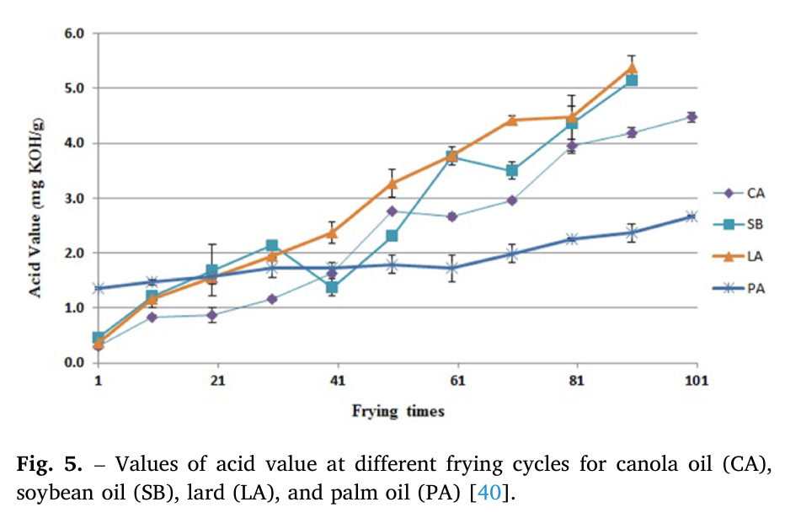
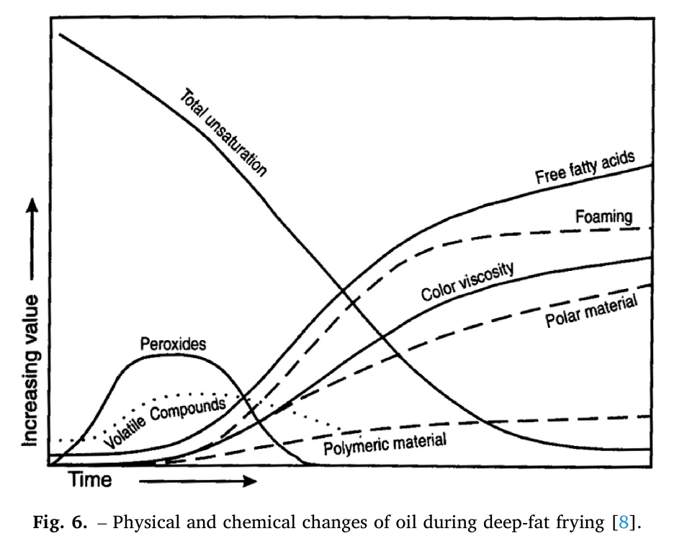
Effect of Storage on WCO Quality
Proper Storage Requirements: Stainless steel or food-grade plastic containers.
Deterioration Factors: Light, temperature, oxygen exposure.
Best Practices: Cool, dark storage; minimal exposure to air.

Slide 6
Pre-Treatments Before WCO Conversion
Pre-treatment Method | Advantages | Disadvantages
Neutralization | High selectivity to acid removal. | High loss of vegetable oil.
Esterification | High efficiency. | High production costs. Low catalyst recovery.
Distillation | Low water consumption. Simultaneous removal of volatile impurities. | High energy consumption. Polymers and gums are not removed.
Supercritical Fluid Extraction | Applicable to any oil quality. No generation of by-products. | High costs of production and equipment.
Filtration: Removal of food particles.
Deacidification: Reducing free fatty acids (FFAs).
Dewatering: Removing moisture to prevent microbial growth.
Decolorization: Improving oil clarity for better biodiesel yield.

Slide 7
Criteria for High-Quality WCO for Biodiesel
Property | Neat SU | Waste SU | Neat PA | Waste PA
Acid Value (mg KOH/g) | - | 2.29 | 0.3 | 0.66-4.03
Kinematic Viscosity at 40°C (mm²/s) | 28.744 | 31.381 | 27.962-39.994 | 38.407-44.956
Dynamic Viscosity at 40°C (MPa*s) | - | - | 35.92 | 40.52
Iodine (cg/g) | - | 111.1 | - | 54.2-81.7
Peroxide (meq/kg) | - | - | <10 | 10
Acid Value: < 4 mg KOH/g.
Water Content: < 0.2% w/w.
Iodine Value & Peroxide Value: Indicators of oxidation level.
Viscosity: Should be < 38.46 mm²/s for efficient biodiesel conversion.

Slide 8

Proposed WCO Collection Strategy
Hybrid Model:
  Commercial Sector: Mandatory collection from restaurants & hotels.
  Household Sector: Incentivized collection through designated drop-off points.
Government & Private Collaboration: Policy implementation, subsidies, and investment.
Public Awareness Campaigns: Educating people on safe disposal & benefits of biodiesel.

Slide 9

Potential Benefits of Implementation
Environmental Protection: Reducing pollution and drainage clogging.
Energy Independence: Biodiesel as an alternative to fossil fuels.
Job Creation: Opportunities in collection, processing, and biodiesel production.
Sustainable Economy: Circular economy model ensuring waste utilization.

Slide 10
Thank You

