Slide 1
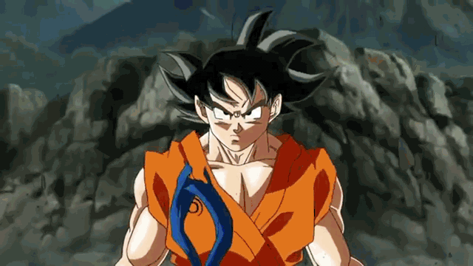
Transformation of sentences

Slide 2
Why?
Transformation of a Sentence means changing its form without altering its sense. Knowledge of Sentence Transformation helps us to expand our usage skills by testing various ways of presenting a sentence in multiple ways but without changing its actual meaning.

Slide 3
How many types of sentences are there?
1

Slide 4
According to structure:
Simple, complex, compound
According to purpose:
declarative, interrogative, imperative, optative, exclamatory

Slide 5
Types of Clause
**Dependent clause
**Independent clause
Damian won't be able to play in the game because he injured his foot.

Slide 6
According to structure:
Simple, complex, compound

Slide 7
*Guess the title*
1.Mr. Potato Head eats monkeys.
2. I refuse.
-one independent clause

Slide 8
*Guess the title*
He recommends them highly because they taste like chicken when they are hot.
Although chicken always appeals to me, I still feel skeptical about monkey.
Mrs. Potato Head, because she loves us so much, has offered to make her special monkey souffle for us.
She can cook it however she wants.
Although I am curious, I am still skeptical.
-one dependent, one connector and one independent clause

Slide 9
*Guess the title*
Situation A
Mr. Potato Head eats them for breakfast every day, but I don’t see the attraction.
Eating them makes him happy; however, he can’t persuade me.
FANBOYS: for, and, nor, but, or, yet, so
-two dependent clauses

Slide 10
Tasks
-Opening the book, Mizan tried to find his lesson. (Complex)
-He works very hard so that he can have a large break later. (Simple)
iii. Jahid entered the kitchen but he didn’t know how to cook anything. (Complex)
iv. An intuitive student can always find a way out. (Complex)
v. Fahad knows every one of his classmates.. (Complex)

Slide 11
Thoughts and questions?

Slide 12
According to purpose:
declarative, interrogative, imperative,
optative,
exclamatory

Slide 13
https://admin.sli.do/event/9cqc0ama/polls

Slide 14
Tasks::
Everyone loves him. (Negative)
He is smarter than an her. (Negative)
Two and two has always made four. (Interrogative)
God is omnipresent. (Interrogative)

